Slide 1

Safeguarding Children & Young People Code of Conduct
Compliance –MO 1359 Implementing the Child Safe Standards- Managing the Risks of Child Abuse in Schools and School Boarding Premises
Notes:
This brief approximately 4.5 presentation aims to provide schools with an explanation to the requirement for signing a new Safeguarding Children & Young People Code of Conduct

Slide 2
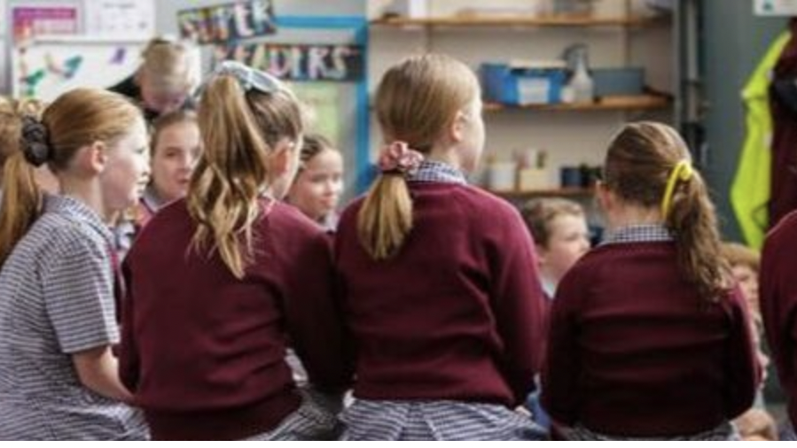
MO 1359
schools’ focus on safety for Aboriginal and Torres Strait Islander students​
the involvement of families and students in child safety efforts​
better management of the risk of child abuse in online environments​
governance, systems and processes to keep students safe​, including changes to the recruitment of volunteers
Notes:
As you would be aware the new Ministerial Order 1359 Implementing the Child Safe Standards- Managing the Risk of Child Abuse in Schools and School Boarding Premises became effective 1 July this year. This legislative reform flowed on to the release of the new Victorian Child Safety Standards. The new 11 standards bring Victoria into closer alignment with the National Principles.
The newly introduced CSS have additional requirements that are not present in the former MO 870. They are:
With these changes become increased responsibilities for all staff in the areas listed.

Slide 3

VRQA Compliance
The Child Safety Code of Conduct must be clear about about appropriate physical and behavioural interactions with students and that your school follows up ALL breaches
Notes:
Version 2 of the Action List dated 23 June outlines the requirements for CCYP and VRQA compliance.
The Child Safety Code of Conduct must be clear about appropriate physical and behavioural interactions with students and that your school follows up ALL breaches.
In light of the new MO requirements there are now additional behavioural expectations for all staff and volunteers.

Slide 4
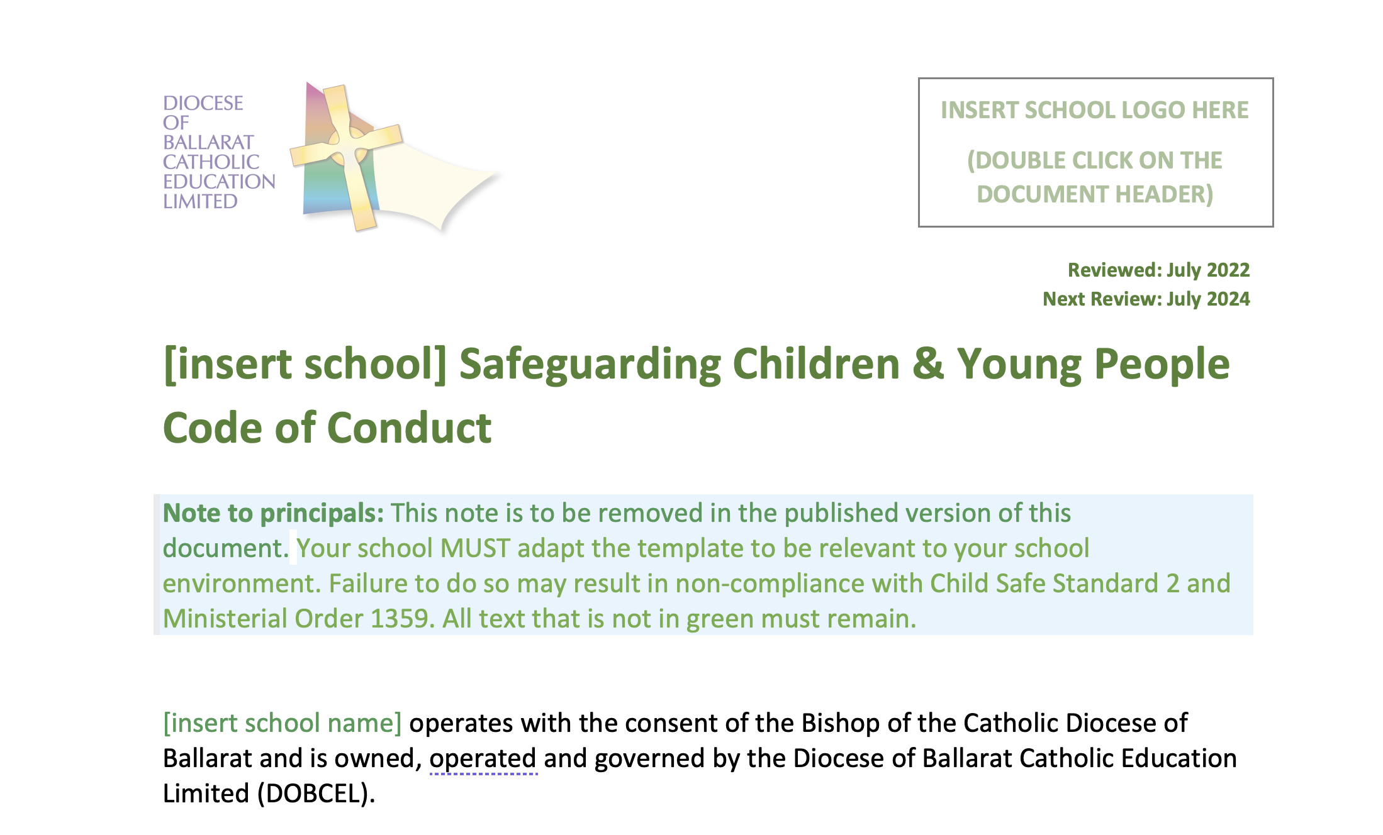
Cultural Safety
Promoting the cultural safety, participation, and empowerment of Aboriginal and Torres Strait Islander children (for example, by never questioning an Aboriginal and Torres Strait Islander child’s self-identification)
Treating all children and young people with respect, regardless of race, sex, gender identity, sexual orientation, language, religion, political or other opinion, nationality, cultural background, financial situation, disability or other characteristic
Never being racist towards anyone and reporting any instances of racism
Notes:
To ensure that schools are working towards compliance all staff need to be made aware of their new obligations under the new CSS. For example the new Safeguarding Children & Young People Code of Conduct requires that staff are aware of their requirements to promote cultural safety in particular for Aboriginal and Torres Straight Islander children. The new code also is explicit in regard to not being racist and not being a bystander to racism. For staff to be compliant to the new MO they need to made aware of the new expectations via the signing of the updated Safeguarding Children & Young People Code of Conduct.
We understand that as new policy is implemented an educative framework to embed such practices through professional learning opportunities will be required.
What is also important to note is that this update to the code of conduct is now an [insert school] document which means that schools are required to contextualise by adding their own information to the code of conduct. It is important that the black text is not altered, however schools are able to add additional points or include explanatory notes to further contextualise the behaviours expected.

Slide 5
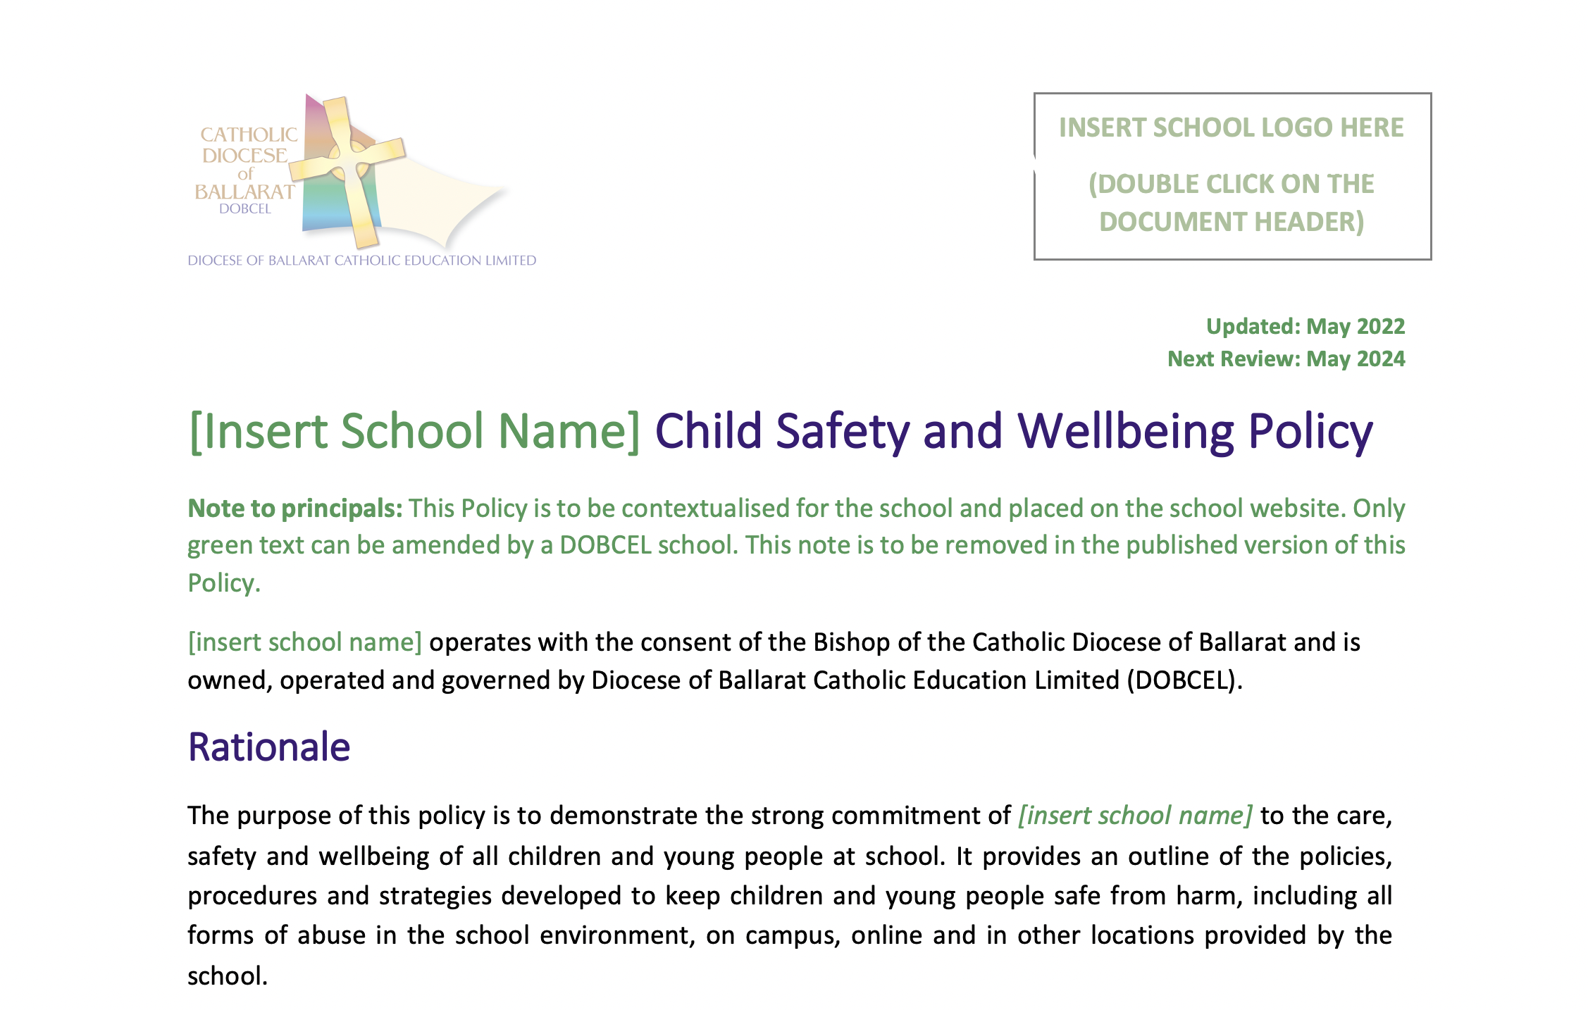
New policies
Notes:
The staff signing of the new code of conduct, also provides schools with an opportunity to highlight new policies. To date 10 CSS policies have been added to eSort as progress towards compliance to the new MO. It is important throughout Semester Two that staff have an awareness of the new policies and know where they can access them.

Slide 6
Thank you
Manager Safeguarding & Standards
jrighetti@dobcel.catholic.edu.au
0409 114 268
Notes:
We fully acknowledge that all school staff are experiencing many challenges. We also thank you knowing that the timing of this reform is not ideal. We have asked that schools ask staff to sign this new code of conduct by the end of this term to ensure that all staff are aware of the additions to child safety behavioural expectations as required by the new Ministeral Order 1359.
I invite you to please contact me if you have any further questions about the Safeguarding Children and Young People Code of Conduct, or any of the other policies which have shared via eSort to date.
Thank you, Jacqui

