Slide 1


2023 ANNUAL REPORT TO THE SCHOOL COMMUNITY (ARSC)
Catholic Leadership Centre
24 March 2023

Slide 2
House Keeping
You will get the slides via email
Ask questions
Tell us how we did in the survey

Slide 3
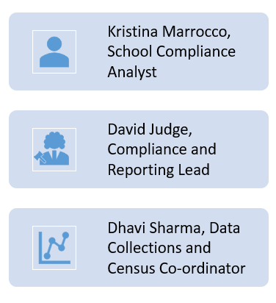
Agenda Speakers
Welcome
Kris Marrocco
Acknowledgement of Country
David Judge
Prayer
Dhavi Sharma
eduDOCS online Platform
Kris Marrocco
Principal Attestation
Kris Marrocco
ARSC
David Judge

Slide 4

Acknowledgment of Country
In recognition of Aboriginal and Torres Strait Islander people’s spiritual and cultural connection to Country,
we acknowledge the traditional custodians of the lands on which we meet and educate our children.
We recognise the continued care of the lands and waterways passed from generation to generation, wisdom that is shared, and life that is celebrated in harmony with the natural environment.
We honour the Elders past and present who have laid
the foundations, traditions, and culture for emerging Aboriginal and Torres Strait Islander peoples and we commit to working together for reconciliation and justice.
Bunjil the Spirit Creator
Archie, Year 3
Sacred Heart School, Sandringham
Notes:
David

Slide 5

Prayer
A prayer for teachers and leaders
Lord, bless the teachers and leaders who give their heart to teaching and leading.
Thank you for the special gift that you have given them, and for giving them a spirit of grace and compassion.
May they have strength and endurance to perform their many duties, and may they know and feel the deep gratitude of those who they teach and lead.
Amen
Notes:
Dhavi

Slide 6
eduDOCS online platform for the ARSC & Principal Attestation

Slide 7
What is eduDOCS?
eduDOCS is a workflow-enabled document management program. Enables users to share and collaborate on the ARSC. The workflow is visible to the principal, the dioceses and the CECV.
Notifications are automatic and will prompt users to complete sections allocated to them in the workflow.
Notes:
In 2021, the CECV implemented the eduDOCS online platform with a purpose to automate the Annual report and pre-populate as much data as possible. For example, all the school data including NAPLAN and to allow principals to delegate sections of the report
Document management features allow you to version, archive and securely store and retrieve documents.
Used to collaboratively create and edit the ARSC

Slide 8
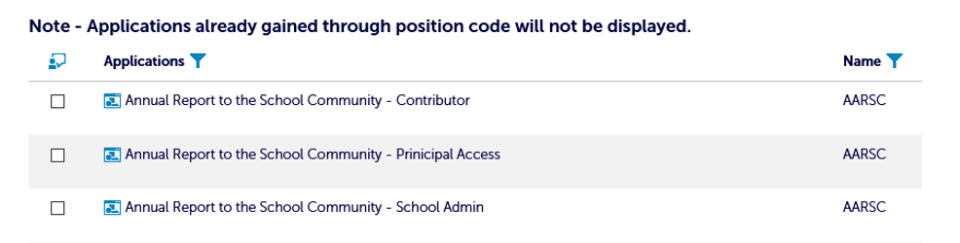
Staff access via Mystaff Portal
Principals provide access to staff via the MyStaff portal on the CEVN website
This will enable nominated staff to be assigned the role of ‘Contributor’ or ‘School administrator’.
Notes:
Principals can invite Contributors
Principals have automatic access. There is no need to change roles in the CEVN MyStaff
Principals should only assign one role per user. Staff at the school can be assigned the role of ‘School Administrator’ or ‘Contributor’.
Contributor access will allow staff to complete sections allocated to them. They will only see the sections assigned to them.
School Admin access will give that staff member privileges similar to the Principal. The Principal will still need to complete the attestation and verify the report but all other tasks can be controlled by the School Admin.
Principal access is automatic.

Slide 9
Principal Attestation

Slide 10
Purpose - Principal Attestation checklist
All Principals must attest that their school was compliant with all requirements (State and Federal) during the previous school year or indicate if they were not compliant
Checklist Purpose:
  To give assurance to the CECV Board, Diocesan education company boards, and those of other governing authorities, ongoing compliance with requirements of the Victorian minimum standards and Commonwealth requirements
  To help principals understand the requirements and feel confident in making the attestation
  To identify any non-compliances
  An assurance and accountability mechanism between the school, diocese and CECV
Notes:
Respective Boards must be satisfied that schools are compliant
In recognition of significant governance reforms within Catholic sector schools, principal attestation in relation to the school governance standard has been modified to only reflect responsibilities of school principals in this regard.
Why is this important?
The Victorian Registration and Qualifications Authority (VRQA) is the regulator of registered schools in Victoria.
CECV is required to report to the VRQA, the Federal DET and the ACNC about the compliance of schools. This attestation is one of the assurance and accountability mechanisms in place between the school, the diocese and the CECV.
VRQA updates the minimum standards for school registration each year and the attestation picks up any new changes for principals to be made aware of e.g. new MO1359 introduced 1 July 2022 and school boarding premises
Long time between school reviews (4 to 5 years), annual attestation helps remind principals about the requirements of the minimum standards.
All Principals must attest that the school was compliant with all requirements (State and Federal) during the previous school year, or indicate if they were not compliant.
New principals – you need to do this even if you were not at the school. In this context, you will make the attestation on the basis that to the best of your knowledge, with the information you have available, the school was compliant with all requirements.
In the past, Principals were asked to complete a paper based ‘compliance checklist’ prior to making an attestation in their Annual report to provide assurance to the CECV Board
The paper based ‘compliance checklist’ functioned as a self assessment tool retained by the school

Slide 11
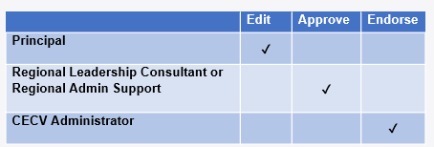
Workflow - Principal Attestation checklist
Workflow steps:
Principal receives a notification in eduDOCS to complete the attestation checklist
Once the Principal completes and submits the attestation this will trigger a notification in eduDOCS for the Consultant to ‘approve’ the attestation. ‘Approve’ means to check that the attestation checklist has been completed
The last step is for the CECV administrator to endorse the attestation to complete the workflow.
Notes:
RLC APPROVAL
If a school is non-compliant, the ARSC will be prefilled with a modified attestation and the Consultant will not be able to approve.
Principals will add text to explain a non-compliance
A notification is sent to the Consultant in eduDOCS
Consultants will also be able to detect on screen when viewing the checklist

Slide 12
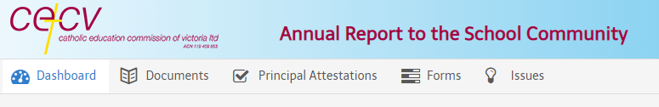
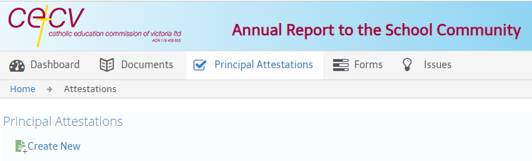
eduDOCS - Principal Attestation checklist
Notes:
In eduDOCS, go to the Principal Attestation tab and select Create new which will open the checklist form.

Slide 13
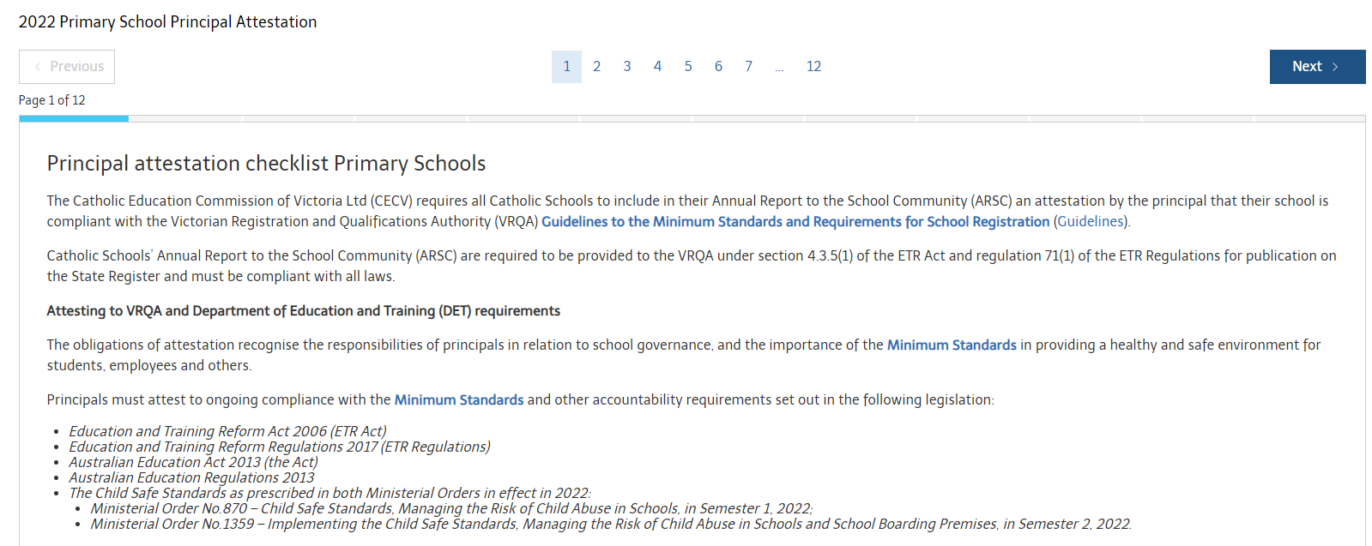
Principal Attestation Checklist
Notes:
It will open the checklist form
Click compliant, not compliant or n/a where applicable
Complete the attestation checklist and submit

Slide 14
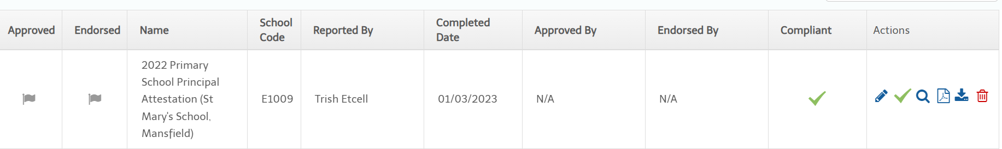
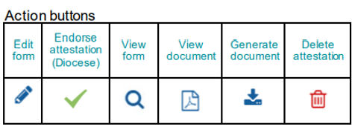
Submitting your attestation
Notes:
Once you submit your attestation you will be able to view it and download. It will also trigger a notification to the relevant Consultant to ‘approve’ and it will then be sent to the CECV for endorsement.
Approved by Consultant
Endorsed by CECV Administrator

Slide 15
Questions & Feedback
Notes:
Any challenges?

Slide 16
ANNUAL REPORT TO THE SCHOOL COMMUNITY (ARSC)
30 minutes

Slide 17
VIC Catholic Schools
499 publish and ARSC each year
CECV Schools
Melbourne 334 schools
Sale 45 schools
Sandhurst 56 schools
Ballarat 64 schools
Notes:
The CECV co-ordinates the ARSC process to ensure the ARSCs of all Victorian systemic Catholic schools are submitted to the VRQA by 30 June each year.

Slide 18
Purpose of the ARSC
Legislative and regulatory requirement:
Education and Training and Reform Act 2006
Education and Training Reform Regulations 2017
Australian Education Act 2013
Specific information must be included e.g. NAPLAN
Informing the school’s community of the school’s performance, successes, activities and achievements throughout the year
Mechanism for Principal to attest the school is compliant with legislative and regulatory requirements
Notes:
The ARSC is an important document that schools must publish, to not only meet state and federal government accountability obligations but to also provide principals with an opportunity to share the year’s achievements and progress with the school community and to attest that the school is meeting all its compliance requirements.
Education and Training and Reform Act 2006, Education and Training Reform Regulations 2017, Australian Education Act 2013 and the Australian Education Regulations 2013 and Ministerial Order 870 - Child Safe Standards, Managing Risk of Child Abuse in School and new MO 1359 Implementing the Child Safe Standards – Managing the risk of child abuse in schools and school boarding premises.
Each year, all Victorian Schools are required to publish an Annual Report to the School Community (ARSC) which must be made publically available e.g. on the school website
Schools must include specific information required under the Education and Training Reform Regulations 2017 and the Australian Education Act 2013 such as:
Student results in NAPLAN annual assessments
Student attendance rates for each year of schooling and how non-attendance is managed
Parent, student and teacher satisfaction with the school
The purpose of the ARSC is also to inform parents and the wider school community of the school's successes, activities and achievements throughout the year. It is also an opportunity for a school to reflect on its achievements and use this to support future planning.
The ARSC is important as it is where Principals attest that the school has been compliant with all accountability requirements set out in the legislation and regulations including the Australian Education Regulations 2013 (Cth).
This is one of the ways in which principals provide assurance to the CECV that the school is complying with the requirements of a registered school, as well as to its school community.

Slide 19
VRQA State Register
The 2021 Annual Reports to the School Community are publically available on the VRQA State Register.
Schools may find and download their Annual report.
https://www.vrqa.vic.gov.au/StateRegister/Search.aspx/Search
Notes:
The Annual Report to the School Community (ARSC) must be made available to the school community and then provided to the school regulator, VRQA.

Slide 20
Changes to the Annual Report templates this year
Populate Section button which populates the previous year’s data which can then be edited for the current annual report.
Some section headings have changed to be consistent across all CECV schools
Reference to Ministerial Order 1359 Implementing the Child Safe Standards – Managing the risk of child abuse in schools and school boarding premises
New Principal Attestations for primary schools and non primary schools.
Notes:
Alert: The Populate Section button will overwrite any new information in the section. Click Populate Section before adding any new information.
The Populate Section button is optional.

Slide 21
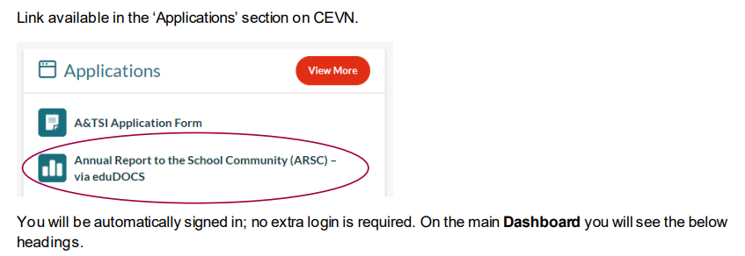
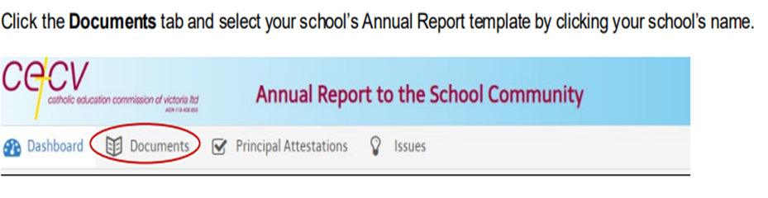
How do I access eduDOCS via CEVN?

Slide 22
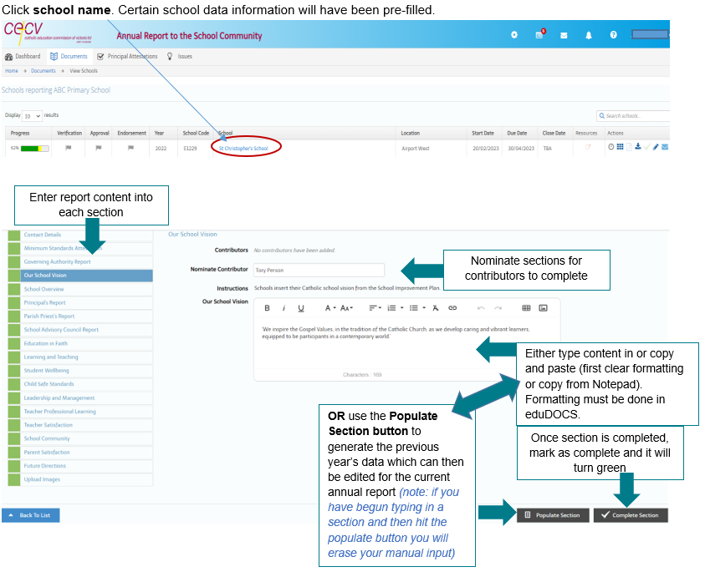
Entering report content

Slide 23
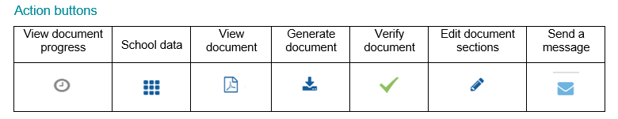
School Performance Data
School data is automatically populated in your report
Can be seen once your Annual report has been generated
View data on screen by clicking the tiled action button
Notes:
Other pre-populated data
school logo
diocese logo
school address
principal name
telephone
email
website
school E number
Registered School Number.

Slide 24
Example of school data (Primary)
School Performance Data Summary

Slide 25

Images in Annual Reports
Please upload one photo for the front cover only
Schools may add photographic images without limitation to their Annual Report (outside of the eduDOCS platform) for publishing on the school's website.
Notes:
Please do not insert additional photographic images in other sections of this report. All reports must be in a standardised format for submission to the Victorian Registration and Qualifications Authority (VRQA).
The ARSC help desk can assist in preparing the photo for the report, please email arsc@macs.vic.edu.au

Slide 26
Images - instructions
Image should be in standard landscape orientation with a ratio of 3:2 width/height
A photo taken from a mobile phone in landscape orientation will work
Image should be in PNG or JPEG format
The file size of the photo should not exceed 5 MB, if it is more than this, please use editing tools to compress the size
The ARSC help desk can assist in preparing the photo for the report, please email arsc@macs.vic.edu.au

Slide 27
Generate your report
Once all sections are completed and marked green, click ‘Generate document’ to ensure your ARSC report has the latest information
Failure to Generate document may cause some information to appear missing from your report

Slide 28


View, verify and download your report
View your report to ensure all sections are complete
Once all sections are completed and you have clicked ‘Generated document’, the ARSC can be ‘verified’.
Click the ‘Resources’ button to open your completed report. Select your report in docx and/or pdf and download.
Notes:
Download report for your records and to publish to your school’s website
Words and pdf formats available
CECV will provide to VRQA

Slide 29
Resources and key dates
eduDOCS ARSC Guide
eduDOCS Principal Attestation Checklist Guide
Key dates:
Principal Attestation checklist no later than Friday 31 March
Annual Report to the School Community no later than Friday, 5 May

Slide 30
Contact/Enquiries
For all enquiries, please contact your local diocese or regional office:
Ballarat – Dr Susan Crowe on 03 4344 4350 or scrowe@dobcel.catholic.edu.au
Sale – Mr Richard Wans on 03 5622 6600 or rwans@doscel.catholic.edu.au
​Sandhurst – Ms Joanne Iwanuch on 03 5443 2377 – jiwanuch@ceosand.edu.au
Melbourne Census Helpdesk– Ms Dhavi Sharma on 03 9267 0422 (option 4) or arsc@macs.vic.edu.au
Melbourne Census Helpdesk – Mr David Judge on 03 9267 0422 (option 4) or arsc@macs.vic.edu.au

Slide 31

Questions?

