Slide 1
Information sharing and family violence reforms
Child Information Sharing Scheme (CISS)
Family Violence Information Sharing Scheme (FVISS)
Multi-Agency Risk Assessment Management (MARAM) Framework
Notes:
Information sharing and family violence reforms
This powerpoint is designed to be presented by school leaders to staff.
Guidance notes are provided for each slide.
Allow 30-40 minutes for the presentation (this will be dependent upon the level of detail covered in the explanation of the content & time for discussion of school procedures)
School leaders should contextualise slides 17 & 18 prior to the presentation to ensure school procedures are reflected.

Slide 2
Support
This presentation addresses issues of family violence.
If you are concerned for your safety or that of someone else, contact the police & call 000 for emergency assistance.
If you have experienced violence or sexual assault and require immediate or ongoing assistance, contact 1800 RESPECT (1800 737 732) to talk to a counsellor from the National Sexual Assault and Domestic Violence hotline.
For confidential support and information, contact Safe Steps 24/7 family violence response line on 1800 015 188.
If you need to talk to someone:
  speak to principal / leadership team member about arranging appropriate support
  contact ACCESS EAP 24/7 for confidential counselling.
You can also talk to your GP or an allied health professional.
Notes:
Prior to commencing - discuss with staff the sensitive nature of the reforms.
Each has their own personal circumstances where they or members of their family / friends may have been impacted.
Practice self care and briefly note support available from the details on the slide.

Slide 3
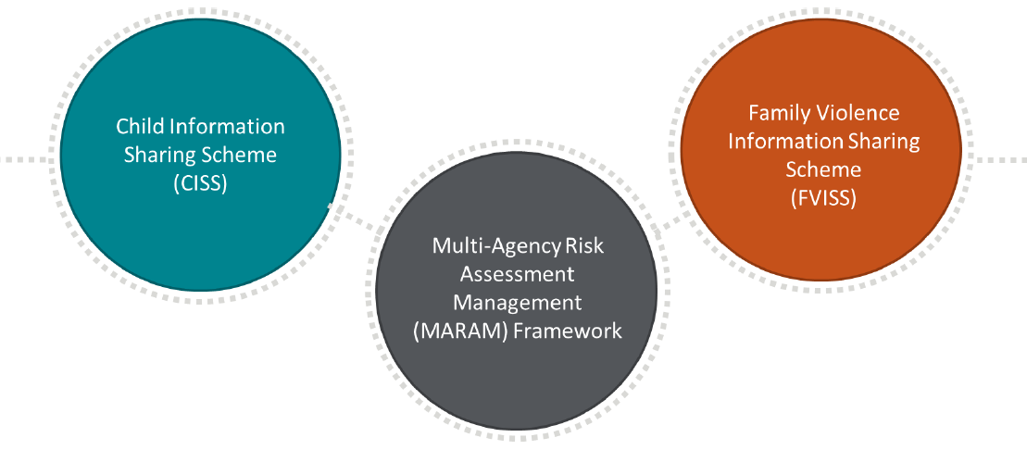
What are the Reforms?
3 interrelated reforms
integral to reducing family violence & promoting child wellbeing or safety
Notes:
Three interrelated reforms, which includes two separate Information Sharing Schemes.
Child Information Sharing Scheme (CISS)
CISS enables authorised organisations and services to share information to promote the wellbeing or safety of children.
CISS prioritises wellbeing and safety over privacy. This allows professionals to collaborate and share information, without consent, where they can prevent potential future harm or help a child thrive.
Family Violence Information Sharing Scheme (FVISS)
FVISS enables authorised organisations and services to share information to facilitate assessment and management of family violence risk to children and adults.
Consent is not required to share information from anyone when a child is involved. Where no children are involved, consent from the adult victim survivor is required, only when it is appropriate, safe and reasonable to do so.
Information sharing requests made under FVISS must relate to one of the following purposes:
for a family violence assessment purpose
for a family violence protection purpose (to manage risk, including ongoing risk assessment and management).
Under the FVISS, prescribed organisations/workforces can share perpetrator (or alleged perpetrator) information without consent.
Multi-Agency Risk Assessment and Management Framework (MARAM)
MARAM sets out the responsibilities of different workforces in identifying, assessing and managing family violence risk across the family violence and broader service system.
MARAM will guide information sharing under both information sharing schemes wherever family violence is present.
CISS & FVISS aim to:
streamline information sharing arrangements and are designed to work together to supplement existing legislation.
expand legal permissions to support professionals that work with children, families, victim survivors and perpetrators of family violence and help to create a more collaborative, integrated system to improve safety and wellbeing outcomes for all Victorians.

Slide 4


Why information sharing and family violence reforms?
Information sharing is key to improving outcomes for children, young people and families through:
          fostering collaborative practice
          enabling earlier identification, response, support and intervention
          empowering professionals to make informed decisions
          MARAM provides guidance on knowing what to look for and supports asking the right questions to obtain information to share in relation to family violence
Information sharing to:
  promote the wellbeing or safety of children
  facilitate assessment and management of family violence risk to children and adults.
Notes:
The Victorian Government is progressing child information sharing and family violence reforms to make it easier for professionals to collaborate with each other, and better support the children and families they are working with.
Whole of Government Reforms, not just within education.
From 19 April (start of Term 2), the information sharing schemes expand to include a range of Victorian education workforces (includes: authorised early childhood services; schools; system and statutory bodies; and education health, wellbeing and inclusion workforces)
The Reforms:
expand the circumstances (ie. extra tools/permissions) in which confidential information can be shared between professionals, where that information could serve to promote a child or young person’s wellbeing or safety, or identify and respond to family violence
complement what is already in place to enable sharing to occur in the best interest of students.

Slide 5
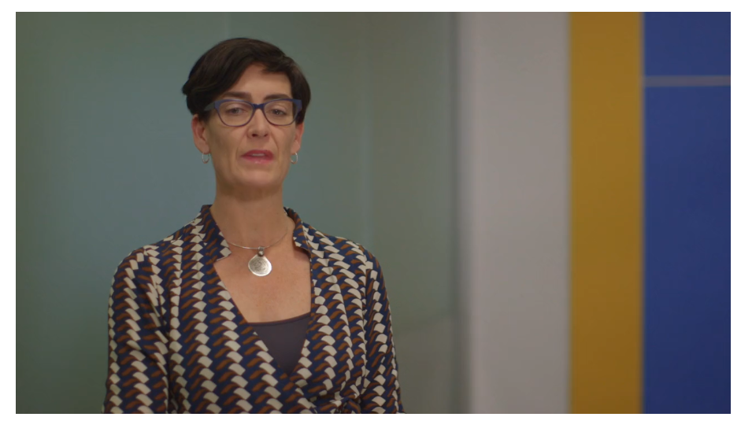
How sharing can make a difference ?
Liana Buchanan, Commissioner for Children and Young People
Click on the link below to watch the video (2 mins):
https://www.vic.gov.au/child-information-sharing-scheme#how-sharing-can-make-a-difference
Notes:
Watch the video (2 mins) to hear about how sharing can make the difference.

Slide 6
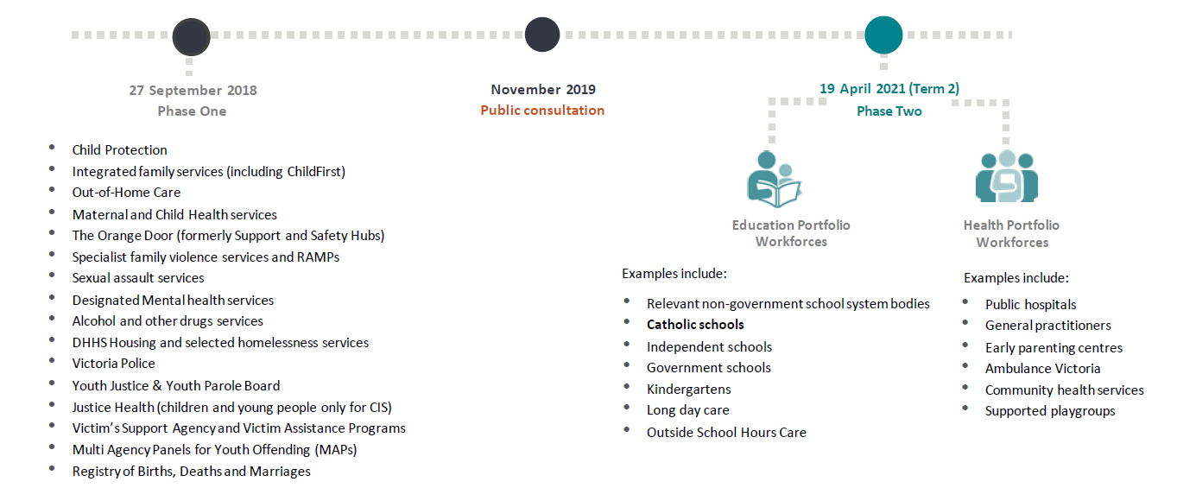
Who can use the Reforms?
Prescribed Information Sharing Entities (ISEs)
Notes:
Only authorised/prescribed Information Sharing Entities (ISEs) are permitted to operate under the Schemes.
From 19 April, all education workforces, including Victorian schools and early learning services, enter as Phase 2 ISEs.
Other ISEs (ie. police, child protection) entered the Schemes in late 2018 under Phase 1.
Information Sharing Entities (ISE):
Must share on request (must respond to a request, but do not have to share if doesn’t meet thresholds) with another ISE
Can request information from another ISE
Can share proactively with another ISE.

Slide 7
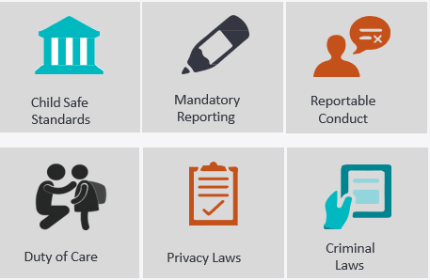

Child wellbeing and safety obligations
Existing obligations continue to apply, including mandatory reporting
CISS and FVISS provide additional permissions to share relevant information
Notes:
Existing obligations continue to apply, including mandatory reporting, Child Safe Standards, Reportable Conduct, Duty of Care, Privacy Laws & Criminal Laws.
CISS and FVISS provide additional permissions to share relevant information.

Slide 8
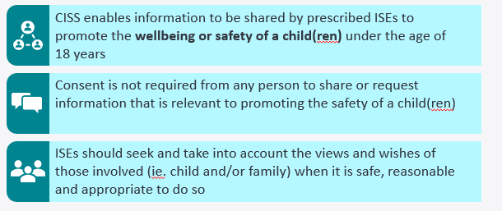
Child Information Sharing Scheme (CISS)
CISS is established under Part 6A of the
Child Wellbeing and Safety Act 2005
Three part threshold test must be met to
share information with
another ISE
Notes:
CISS – sharing information to promote the wellbeing or safety of children
CISS is established under Part 6A of the Child Wellbeing and Safety Act 2005
CISS enables information to be shared by prescribed ISEs to promote the wellbeing or safety of a child(ren) under the age of 18 years
Consent is not required from any person to share or request information that is relevant to promoting the safety of a child(ren)
ISEs should seek and take into account the views and wishes of those involved (ie. child and/or family) when it is safe, reasonable and appropriate to do so
Examples:
Seek information from a government school when a student has transferred our school (or vice-versa).
Seek information from an Early Learning Service regarding one of our students.
Three part threshold test must be met to share information with another ISE.

Slide 9
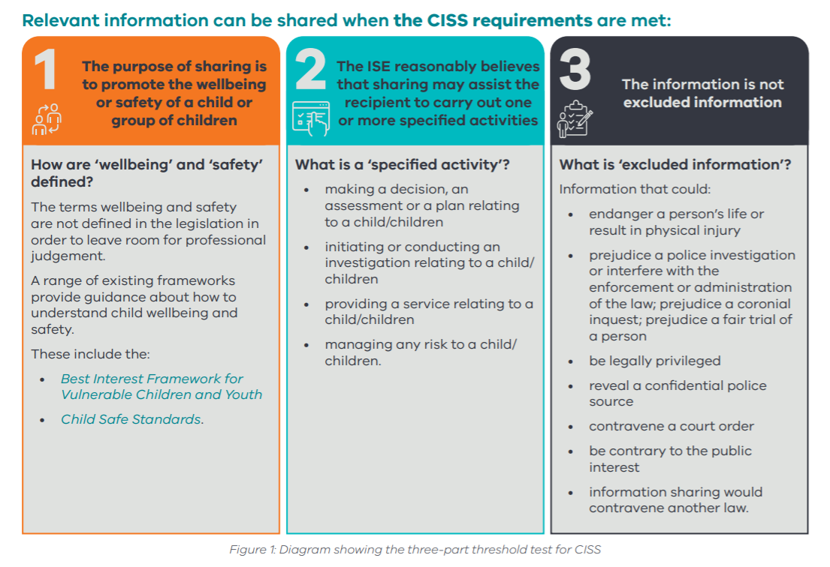
Three part threshold test must be met to share information with another ISE
Information Sharing and Family Violence Reforms Toolkit p.12
Notes:
Threshold Part 1: Promoting child wellbeing or safety
An ISE can request or disclose information about any person for the purpose of promoting the wellbeing or safety of a child or group of children.
Threshold Part 2: Sharing to assist another ISE
The disclosing ISE must reasonably believe that sharing the information may assist the receiving ISE to carry out one or more of the following activities:
making a decision, an assessment or a plan relating to a child or group of children
initiating or conducting an investigation relating to a child or group of children
providing a service relating to a child or group of children
managing any risk to a child or group of children.
Threshold Part 3: The Information is not excluded information (refer to the slide)
What is ‘excluded information’?
Information that could:
• endanger a person’s life or result in physical injury
• prejudice a police investigation or interfere with the enforcement or administration of the law; prejudice a coronial inquest; prejudice a fair trial of a person
• be legally privileged
• reveal a confidential police source
• contravene a court order
• be contrary to the public interest
• information sharing would contravene another law.

Slide 10
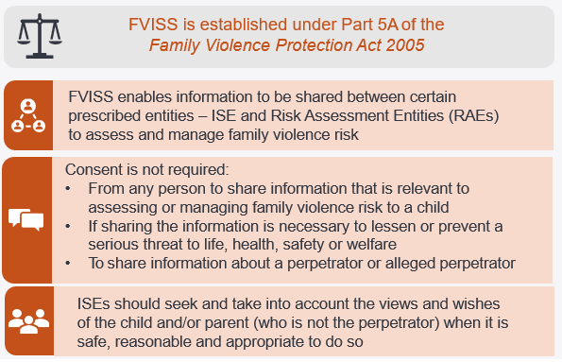
Family Violence Information Sharing Scheme
Three part threshold test must be met to
share information with
another ISE
Notes:
FVISS – sharing information to assess or manage the risk of family violence
FVISS is established under Part 5A of the Family Violence Protection Act 2005
FVISS enables information to be shared between certain prescribed entities – ISE and Risk Assessment Entities (RAEs) to assess and manage family violence risk
Consent is not required:
From any person to share information that is relevant to assessing or managing family violence risk to a child
If sharing the information is necessary to lessen or prevent a serious threat to life, health, safety or welfare
To share information about a perpetrator or alleged perpetrator
ISEs should seek and take into account the views and wishes of the child and/or parent (who is not the perpetrator) when it is safe, reasonable and appropriate to do so
Three part threshold test must be met to share information with another ISE.

Slide 11
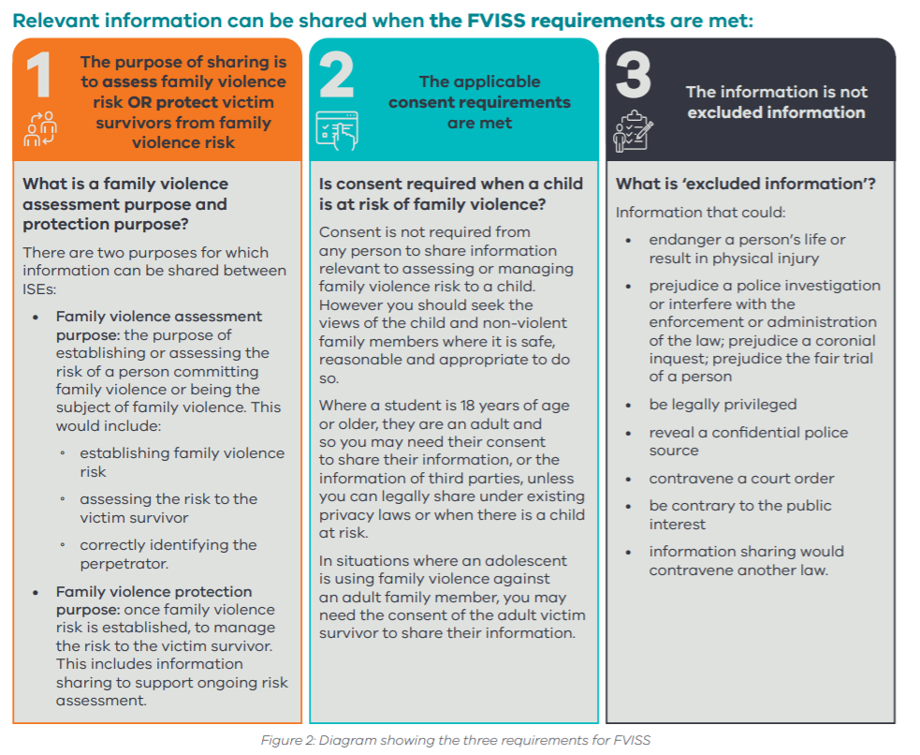
Three part threshold test must be met to share information with another ISE
Information Sharing and Family Violence Reforms Toolkit p.13
Notes:
Threshold Part 1: The purpose of sharing is to assess family violence risk OR protect victim survivors from family violence risk
There are two purposes for which information can be shared between ISEs
Family violence assessment purpose: the purpose of establishing or assessing the risk of a person committing family violence or being the subject of family violence.
Family violence protection purpose: once family violence risk is established, to manage the risk to the victim survivor. This includes information sharing to support ongoing risk assessment
Threshold Part 2: The applicable consent requirements are met
Consent is not required from any person to share information relevant to assessing or managing family violence risk to a child. However you should seek the views of the child and non-violent family members where it is safe, reasonable and appropriate to do so.
Where a student is 18 years of age or older, they are an adult and so you may need their consent to share their information, or the information of third parties, unless you can legally share under existing privacy laws or when there is a child at risk.
In situations where an adolescent is using family violence against an adult family member, you may need the consent of the adult victim survivor to share their information.
Threshold Part 3: The information is not excluded information (refer to slide – as per CISS)

Slide 12
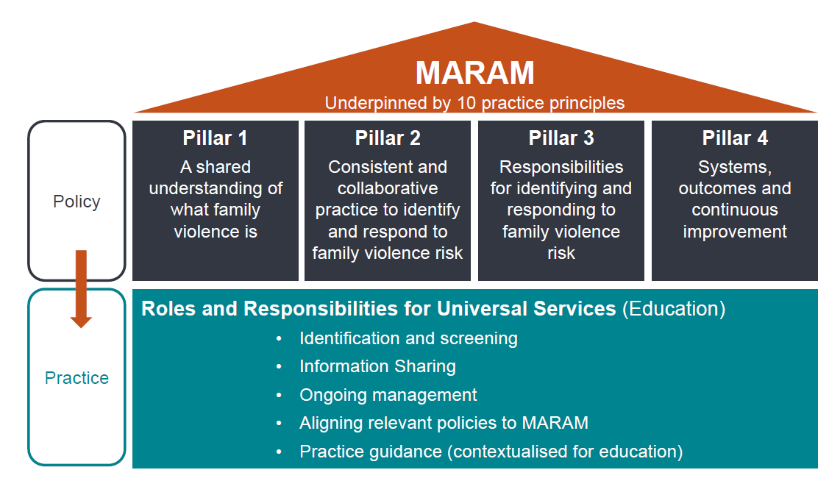
Multi-Agency Risk Assessment Management Framework (MARAM)
Notes:
Multi-Agency Risk Assessment Management (MARAM) Framework
The Family Violence Multi-Agency Risk Assessment and Management Framework (MARAM) ensures services are effectively identifying, assessing and managing family violence risk.
The aim of MARAM is to increase the safety and wellbeing of Victorians. It will do this by ensuring relevant services can effectively identify, assess and manage family violence risk.
This means organisations that are authorised through regulations, as well as organisations providing funded services relevant to family violence risk assessment and management, must align their policies, procedures, practice guidance and tools to the MARAM Framework.
For schools (shown in green box) there will be more detailed training regarding the MARAM during Terms 2 & 3. For now, our focus is on CISS & FVISS.

Slide 13
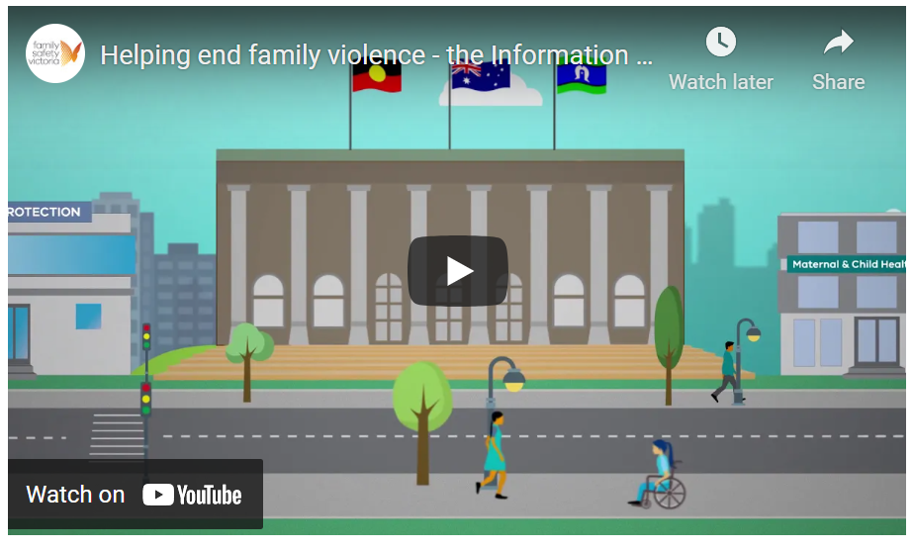
Click on the link below to watch the MARAM video (4 mins):
https://www.vic.gov.au/child-information-sharing-scheme#how-sharing-can-make-a-difference
Notes:
Watch the video (4 mins) to hear about MARAM and its links to CISS & FVISS

Slide 14
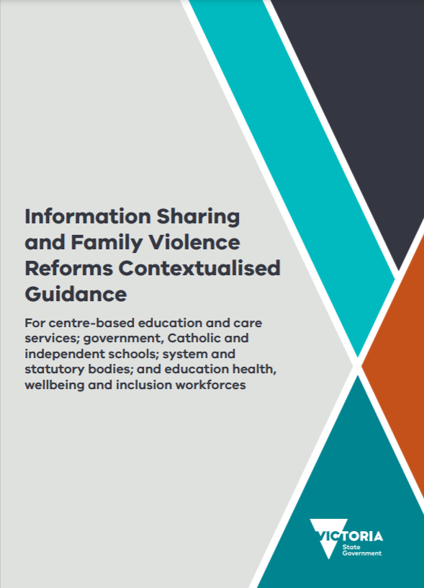
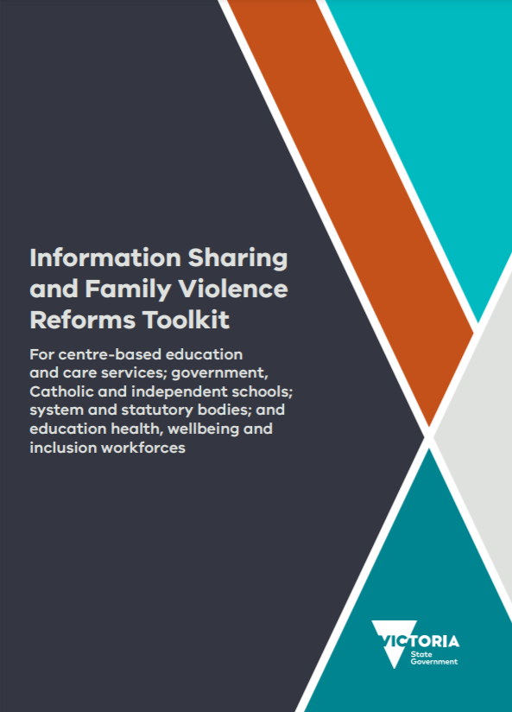
Guidance resources
Guidance for staff on specific information sharing requirements can be found on the DET PROTECT & CEVN Information Sharing webpages
https://www.education.vic.gov.au/school/teachers/health/childprotection/Pages/infosharing.aspx
https://cevn.cecv.catholic.edu.au/Melb/Student-Support/Child-Information-Sharing-and-Family-Violence
Notes:
This Information Sharing and Family Violence Contextualised Guidance resource and Toolkit are part of a suite of training resources that sits alongside, and complement, face-to-face training sessions and eLearning modules.
These are evolving reforms. Resources / information will be forthcoming during Term 2 and beyond as the reforms take effect.
All staff should have an awareness of the reforms.
There are clear procedures in our school for who can share information and the way we will respond to requests.

Slide 15
Information sharing and
family violence reforms
School Processes & Procedures

Slide 16
What does this mean for our school?
Under CISS and FVISS, our school:
Will be required to:
respond to requests for information to promote child wellbeing or safety, and/or manage risk of family violence
comply with record keeping requirements
review and develop/update policies and procedures – DOBCEL will provide further guidance during Term 2.
Can:
request and proactively share information to promote child wellbeing or safety, and/or manage risk of family violence.
Notes:
Refer to information on this slide.

Slide 17
School preparation for implementation
School leaders have completed Leaders Briefing
  May wish to include the name/s staff members
Identified a school Information Sharing Coordinator (ISC)
  May wish to include the name/s staff members
Staff identified as Information Sharers have completed Practical Workshops
  May wish to include the name/s staff members
Newsletter communication to parents / carers about the Reforms add date
  there may be a mixed response or concerns from parents about the Reforms especially as consent is not required. Seeking the views and wishes of children and families, when it is safe, reasonable and appropriate, is our priority
  direct all enquiries to the principal or the ISC.
School policies to be updated during Term 2 with guidance from DOBCEL.
Notes:
Add relevant details to the slide / or edit as required.

Slide 18
School procedures
School Information Sharing Coordinator (ISC) – <insert name and role>
Refer to school flowcharts (if developed and available).
If you receive an information sharing request or a query from a parent/carer, direct them to the ISC.
If you take a phone call regarding an information sharing request, make a note of caller’s name, position/role, organisation and provide details to ISC to follow-up.
If you feel information about a student is needed or should be shared proactively with another ISE, discuss with the ISC.
Notes:
The school’s Information Sharing Coordinator (ISC) has oversight on all requests.
No staff member should be acting in isolation. There are very specific thresholds for sharing information.
The school’s Information Sharing Coordinator (ISC) will address all requests in conjunction with the principal.
These Reforms enable us to develop a more holistic picture of students in our care. All staff members should feel able to discuss the possibility of seeking additional information from a range of authorised Information Sharing Entities (eg. early learning, government schools etc) to better enable us to support the wellbeing, safety and learning outcomes of young people.
I would encourage you to discuss your professional judgements in this space with the ISC or with me (the Principal). The Schemes are here to support and protect young people as well as enable professionals to have a more coordinated response approach. Importantly, we must remember that any request for/sharing of information must meet the thresholds and be actioned through appropriate processes. These Schemes operate within firm boundaries and I don’t want to give the impression that we can seek any and all information if it doesn’t meet the thresholds.
As always, the Schemes do not replace our professional obligations, including mandatory reporting, reportable conduct etc. If you form the belief that a young person is at risk of harm, particularly in relation to family violence, you must act in accordance with the established PROTECT protocols and our school procedures.

Slide 19
What’s next?
Evolving whole of government reforms
Updated documentation from DOBCEL developed over Term 2
Ongoing staff updates as required
Further reading/professional learning:
  Contextualised Guidance & Toolkit (accessible to all)
  https://www.education.vic.gov.au/school/teachers/health/childprotection/Pages/infosharing.aspx
  Self-guided eLearning modules (accessible to all)
  https://elearn.childlink.com.au/login/index.php
  Practical Workshop for Professionals (staff nominated by principal)
  https://www.eventbrite.com.au/e/practical-workshop-for-professionals-registration-129621692973
Adapted and used with acknowledgment of MACS for shared resource.
Notes:
Encourage all staff to familiarise themselves with the reforms. Self-guided eLearning modules can be accessed at any time.
Staff should note the school procedures for information sharing.

