Slide 1
Principals
Enterprise Bargaining Update
Understanding the proposed changes

Slide 2
Benefits for our people
Wage and allowance increases secured
Significant improvements to support teacher workload
Improved classification structures for Education Support and School Services staff
Ongoing commitment to improved ways of working and consultation
Improved and additional leave entitlements
Notes:
The proposed agreement provides significant benefits to all employees covered by the new CEMEA.
This includes:
Salary increases of 1% in both January and July for the term of the agreement
A 1% position allowance payable annually to most of the classifications in the CEMEA
Improvements to support teachers workload
Improved classification structures for Education Support and School Services staff
An ongoing commitment to improved ways of working and consultation
Improved and additional leave entitlements

Slide 3
Benefits for our people
Inclusion of workload commitments between the parties to support the workload of teachers and principals
Inclusion of a provision to ensure consultation occurs with principals when an employer proposed to introduce a major change which may impact on the workload of Principals.
changes to the payment an employee receives while accessing LSL if they have had a change in FTE in the 104 weeks immediately before the period of LSL. This change and provision is consistent with the LSL Act.
Notes:
The inclusion of employer commitments to support the workload in schools
Changes to the consultation to around major change which may impact on principal workload
Improvements to the calculation of LSL when you may have changed your hours in the 2 years prior to accessing leave

Slide 4
Key Areas of Change
Parties and coverage
Casual employment
Wages and allowances
Allocation of Teacher work
Teacher workload commitments
  Termination of Employment
  Leave entitlements
  Accident Makeup Pay
  Redundancy
  Consultative Committee
Notes:
A number of Catholic school employers covered by the VCEMEA will no longer be covered by the CEMEA, namely:
Diocese of Sale Catholic Education Limited; and
Catholic College Sale
The CEMEA will include Jesuits Social Services Limited. This has resulted in the name change of the agreement from VCEMEA to CEMEA
This agreement will also provide changes to
Casual employment for both teaching and non-teaching staff
Wages and allowances for all classifications under the agreement
The introduction of a new model for the Allocation of teacher work - the 30+8 model and the introduction of TIL for teachers
Workload commitments for teachers and principals under the agreement
Clarification in the timing of giving notice in the Termination clause
Favorable leave entitlements to all classifications under the agreement, including parental leave, Family and Domestic Violence leave and personal leave
Increased accident make-up pay from 26 to 39 weeks
Changes to the Redundancy payments structure resulting in a more generous entitlement for reduced years of service
Minor changes to Consultation & Consultative Committee clauses

Slide 5
Wages & Allowances

Slide 6
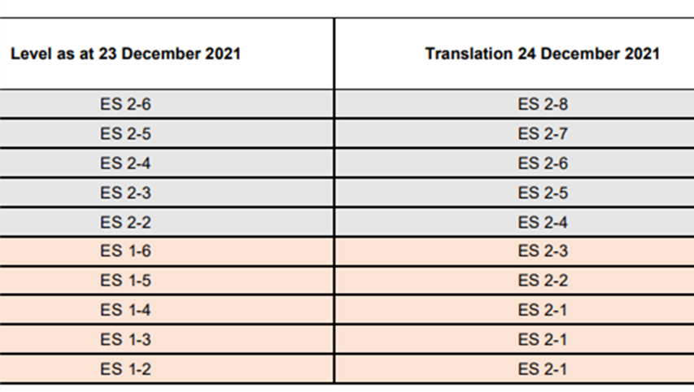
Education Support
Level 1 Reclassification & Salaries
Education Support Level 1 employees have all now been reclassified to Level 2.
A previous ES Level Cat B Level 1-2, salary prior to the change and increases was $49,730.
In July of 2023 their salary will be $56,477 which is an increase of 13.57% from their salary prior to the changes
Over the life of the agreement the employee will receive a 22.53% increase, from their previous salary prior to the changes
Notes:
The new CEMEA offers Significant structural adjustments to Education support classifications with greater opportunity for advancement and improved salaries
These changes occurred last year and salary increases and back-payments have already been applied.
Level 1 has been quarantined for Education Support Trainees
Existing Level 1 staff have been reclassified to level 2
Additional yearly increments have been added to the level 2 structure
And significant salary increases have been applied over the live of the agreement
For example previously an ES cat b level 1.2 salary was $49,730. as of July 2023 with the reclassification their salary would be $56,477 which is an increase of 13.57%

Slide 7
School Services Officers Salaries
Significant structural adjustments to all levels of SSOs.
The table provides for the percentage increases which were applied to SSO’s back dated to 24 December 21
Level | October 2020 salaries | 24 December 21 | Percentage increase
SSO 4-5 | $67,416 | $74,125 | 9.95%
SSO 4-4 | $66,222 | $73,410 | 10.85%
SSO 4-3 | $65,025 | $73,000 | 12.26%
SSO 4-2 | $63,833 | $72,520 | 13.61%
SSO 4-1 | $62,637 | $71,959 | 14.88%
SSO 3-5 | $62,933 | $71,010 | 12.83%
SSO 3-4 | $61,422 | $70,460 | 14.71%
SSO 3-3 | $59,912 | $67,550 | 12.75%
SSO 3-2 | $58,400 | $66,240 | 13.42%
SSO 3-1 | $56,888 | $65,350 | 14.87%
SSO 2-5 | $56,828 | $65,288 | 14.89%
SSO 2-4 | $56,015 | $63,325 | 13.05%
SSO 2-3 | $54,669 | $61,015 | 11.61%
SSO 2-2 | $53,590 | $59,555 | 11.13%
SSO 2-1 | $52,509 | $57,931 | 10.33%
SSO 1-4 | $51,362 | $54,912 | 6.91%
SSO 1-3 | $49,595 | $53,730 | 8.34%
SS0 1-2 | $47,831 | $52,677 | 10.13%
SSO 1-1 | $46,062 | $51,644 | 12.12%
Notes:
Significant structural adjustments have been made to all levels of School services officers.
The table on the screen provides details of the percentage increases which were applied to School services officers back dated to 24 December 21.
These changes were made to more closely align the salaries in our agreement to the equivalent salaries in the VGSA.

Slide 8


School Services Officers Salaries
SSO Level 1-1 has gone from $46,062 to $51,644 in December 2022, which is a 12.12% increase
Over the life of the Agreement, the starting salary point for an SSO Level 1-1, will increase by 21.41%.

Slide 9
Primary Principal Salaries
Primary Principals received a 7.55% increase back dated to December 2021
By the end of the agreement the commencement salary for a principal at the bottom level (Level 2) will be $163,706 which is an increase of over $23,139 over the life of the agreement

Slide 10
Deputy Principal Salaries – Cat A
Cat A Deputy Principal commencement salary at the bottom level as of Jan 23 is $128,490
A Cat A Deputy Principal at the top of the scale will receive an additional $7,802 over the life of the agreement through the position allowance payments

Slide 11
Deputy Principal Salaries – Cat B
Cat B Deputy Principal commencement salary at the bottom level as of Jan 23 is $122,651
A Cat B DP at the top of the scale will receive an additional $7077.93 over the life of the agreement through the position allowance payments

Slide 12
Teacher Salaries
A T2-6 Teacher’s salary will increase from $108,003 to $118,063 over the life of the agreement.
A full-time T2-6 Teacher will also receive a total $4,585 through the position allowance over the life of the agreement

Slide 13
Casual Relieving Teachers
Daily Rate has increased from $383.13 to $423.23.
This rate will increase further in July.
Notes:
Emergency teachers previously under the VCEMEA will be renamed “casual relief teachers”. Casual relief teachers can be appointed up to 30 consecutive days prior to being put onto a contract.
. There are improvements to the daily rate, increasing from $383.13 to $423.23, with further increases in July of this year.

Slide 14
Position Allowance
Position allowance equivalent to 1% of the total salary an employee is normally entitled to as of 1 December each year is payable to:
Teachers
Deputy principals (both primary and secondary)
Education support employees at Level 2-8, and all of Levels 3, 4 and 5. This applies for Categories A, B and C
Notes:
The CEMEA introduces a yearly position allowance (1% of the total salary to which an Employee is entitled as at 1 December each year), which will be paid as a lump sum to the following Employees (other than Casual Employees):
Teachers;
Deputy Principals;
Education Support Employees at Levels ES 2-8 and above; and
CEO staff covered by the CEMEA.
The allowance is to be paid on 1 December of each year from 2022 to 2025.
The allowance was paid to applicable employees in December 2022.
There are categories and levels of employees are not eligible to receive the position allowance due to receiving a higher structural increase or a translation which provides for greater increases through incremental progression compared to other categories of employees:
• education support employees at Level 1 and Level 2-1 to Level 2-7
• school services officers (all levels and subdivisions)
primary and secondary principals.

Slide 15
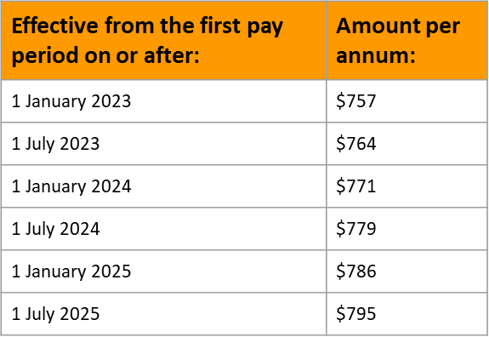
Allowance Increases
Medical support allowance increase in line with the below table.
Meal allowance increase from $22 to $26.
Tool allowance to increase:
  from $20 to $22 per week for non-carpenter or joiner.
  from $36 to $39 per week for a carpenter or joiner.

Slide 16
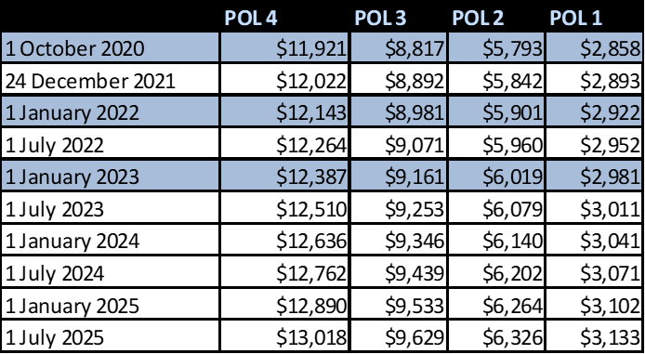
Allowance Increases
Positions of Leadership
Pool arrangements for Positions of Leadership have increased.
Position of Leadership allowances increased.
Higher Duties
Changes to higher duties provisions to provide higher duties allowance for most circumstances from 10 days rather than 15 days.
Notes:
The pool arrangements for Positions of Leadership have also increased. This is effective from the commencement of the 2023 school year, based on the rates shown here on the screen.

Slide 17
Improved Entitlements & Conditions

Slide 18

Flexible Leave
An employee is entitled to apply to take up to a maximum of one day (7.6 hours) per school year from their paid personal leave balance as flexible leave.
Flexible leave can be taken for any reason and is not cumulative.
Notes:
Annually Employees can access a day (7.6 hours) of their personal leave balance as “flexible leave”. This leave can be accessed for any reason.
An employer may refuse to approve flexible leave where the Employee’s absence on that day cannot be reasonably managed due to operational requirements.

Slide 19
Paid Parental Leave
Paid parental leave increases from 14 weeks to 16 weeks.
Paid partner level increases from 1 week to 4 weeks (to be taken within two terms of the birth of the child).
The qualifying period for paid parental leave reduces from 42 term weeks to 30 term weeks or 3 full school terms.
The first 12 months of parental leave counts towards incremental progression.
Notes:
Benefits of changes to parental leave include:
paid parental leave increases from 14 weeks to 16 weeks.
paid partner level increases from 1 week to 4 weeks (to be taken within two terms of the birth of the child).
the qualifying period for paid parental leave reduces from 42 term weeks to 30 term weeks or 3 full school terms.
the first 12 months of parental leave counts towards incremental progression.
These provisions are backdated to the commencement of the 2023 school year.
In relation to paid parental leave, any employee who either started or completed a period of paid parental leave in Term 1 or 2, 2023 under the terms of the VCEMEA 2018 (14 paid weeks) will be provided with an additional two weeks of paid parental leave
In relation to paid partner leave, any employee who either started or completed a period of paid partner leave in Term 1 or 2 2023 under the terms of the VCEMEA 2018 (one paid week) will be provided with an additional three weeks of paid partner leave
Where a request is made for parental leave in 2023, we will review the service record of the employee in question, noting that the employee is entitled to paid parental leave where they have completed either three school terms or 30 school weeks of continuous service.
The provision of the first 12 months of parental leave being counted towards incremental progression where applicable, is to be backdated from the commencement of the 2023 school year.

Slide 20
Paid Parental Leave
Prenatal leave of up to 38 hours for primary carer to attend prenatal appointments
Pre natal leave of up to 15.2 hours for employees whose spouses are pregnant to attend prenatal appointments
Paid superannuation on the first 12 months of parental leave for the primary carer
Increases to paid adoption leave from 14 weeks to 16 weeks (subject to the conditions of that clause)
Introduction of 2 days of paid leave on up to five (5) occasions per child, for employees who provide short-term foster or kinship care
Notes:
Additional Benefits to the parental leave changes include:
The availability of Prenatal leave of up to 38 hours for primary carer to attend prenatal appointments
Pre natal leave of up to 15.2 hours for employees whose spouses are pregnant to attend prenatal appointments
With these leave, subject to evidence requirements and a requirement to schedule appointments to minimise disruption and/or the requirement to engage replacement staff for the absence. This entitlement is in addition to the entitlement to use up to five days of any accrued personal leave to attend pre-natal appointments;
Superannuation will be paid on the first 12 months of parental leave for the primary carer
Increases to paid adoption leave from 14 weeks to 16 weeks (subject to the conditions of that clause)
Introduction of 2 days of paid leave on up to five (5) occasions per child, for employees who provide short-term foster or kinship care introduces two days of paid leave on up to five (5) occasions per child, for employees who provide short-term foster or kinship care as a primary caregiver to a child as a result of an eligible child protection intervention, following the child's placement

Slide 21

Long Service Leave
Long Service Leave will be calculated based on an Employee's FTE immediately before the Long Service Leave except:
  where their FTE changed in the 104 weeks immediately before the Leave.
  In this instance, their applicable weekly hours of work will be calculated in accordance with the Long Service Leave Act.
Notes:
The changes to the LSL clause will continue the way in which we process LSL now, following the variation to the VCEMEA that occurred last year. This means that LSL will be calculated based on an Employee's FTE immediately before the Long Service Leave except where any employee has changed their hours in the 2 years immediately prior to the leave. In this instance LSL will be calculated in accordance with the LSL Act

Slide 22
Other Leave
Family and Domestic Violence Leave
Staff now have access to 20 days of paid family and domestic violence leave for all categories of employees (except Casual staff who will have 10 paid days).
Sexual Abuse Survivors Support
Includes a new entitlement to up to 20 days' paid leave for employees, other than casual employees, who have been victims of historical sexual abuse.
Notes:
Increases to the following leave types will also apply in the CEMEA
Family & Domestic Violence Leave
This is one type of leave for employees who are experiencing family or domestic violence as defined by the Fair Work Act
Increase from 10 to 20 days per year for all employees other than casuals who receive 10
Does not accrue, and is not payable on termination.
Employers are prohibited from reporting the taking of family and domestic violence leave as a form of leave on an employee’s payslip.
By no later than 4 June 2023, payslips must refer to family and domestic violence leave as ordinary hours of work, overtime worked or as a bonus payment or an allowance
Sexual Abuse Survivors Support
Up 20 days per year for all employees other than casuals who are victims of historial sexual abuse.
Does not accrue, and is not payable on termination.

Slide 23
Consultative Committee
Introduction of a requirement to hold discussions in relation to the workload of non-teachers at Consultative Committee meetings.
Where a principal makes a decision which is inconsistent with a proposal or recommendation (if a recommendation is made) put forward by at least three members of the Consultative Committee:
  the reasons for the decision will be provided in writing to staff.
  the decision will not be implemented until the reasons for the decision have been communicated in writing to the committee members.
A record of each meeting of the Consultative Committee will be kept.
The Consultative Committee will be enabled to provide recommendations/proposals prior to the principal making decisions on matters covered by the Consultative Committee
Paid leave for union training on the Consultative Committee for employee representatives, provided that:
  The training is to be taken at a time mutually agreed with the Principal
  It is limited to one day per school year for each member; and
  The training leave is non-cumulative
Notes:
Where a principal makes a decision which is inconsistent with a proposal or recommendation (if a recommendation is made) put forward by at least three members of the consultative committee, reasons for the decision will be provided in writing to staff.
A record of each meeting of the consultative committee will be kept. The record will contain decisions made and any recommendations/advice contrary to the decision. The record will be made available to staff.
The consultative committee will be enabled to provide recommendations/proposals prior to the principal, as the Employer’s representative, making decisions on matters covered by the CC
Where a principal makes a decision which is inconsistent with a proposal/recommendation made by at least three members of the consultative committee, the decision will not be implemented until the reasons for the decision have been communicated in writing to the committee members.
Paid leave for union training on the consultative committee for employee representatives on the consultative committee subject to:
Taken at a time mutually agreed with the Principal
Limited to one day per school year for each member; and
Non-cumulative.

Slide 24
Teacher Workload Improvements

Slide 25
Teacher Workload Improvements
Teacher workload improvements include:
Maximum SCT for teachers to reduce by 1 hour in 2023 and a further 30 minutes in 2024
Allocation of teacher work with the introduction of the 30+8 model.
Restrictions on directing duties during the instructional time of the day when the teacher is not teaching.
A cap on meetings outside the school day to a maximum of two per week for one hour each.
Time in lieu for structured and directed school activities outside the school day in any week exceeding 38 hours for a full-time teacher(pro-rata for part-time teachers).
Continuation of Professional Practice Time with 10 hours (2 days) available in 2023, and five hours (1 day) available in 2024, and 2025.
Notes:
Teacher workload improvements include:
Maximum SCT for teachers to reduce by 1 hour in 2023 and a further 30 minutes in 2024
New maximum for full-time primary school teachers in 2023 is 21.5 hours
New maximum for full-time secondary school teachers in 2023 is 19 hours.
Introduction of the 30/8 model which seeks to provide more regulation to a teachers working week.
Time in lieu for directed activities outside regular hours for teachers (38 hours per week or pro-rata for part-time teachers).
Restrictions on directing duties during the instructional time of the day when the teacher is not teaching.
A cap on meetings outside the school day to a maximum of two per week for one hour each.
Continuation of Professional Practice Time- with 10 hours (2 days) available in 2023, and five hours (1 day) available in 2024, and 2025

Slide 26
Employer Workload Commitments
The parties are committed to working together in developing strategies to support the workload of teachers and principals, this includes:
Strategically planning school based and employer based calendars to support the workload of teachers and principals during peak periods.
Fostering collaboration at schools and between schools to enable the sharing of resources and teaching materials.
Developing best practice guidelines for schools on the management of NCCD Data collection and input.
Using purposeful communication to ensure efficient use of emails, meetings and other communication tools.
Promoting clear boundary setting for teachers and principals through consistent communication and email policies
Reviewing and considering the best ways to manage time spent on non-teaching tasks to ensure that teachers can focus on teaching and learning.
Developing guidelines to support teachers and principals manage their time effectively.
Notes:
The CEMEA introduces a commitment from the parties to take certain steps to support the Workload of Teachers and Principals.

Slide 27
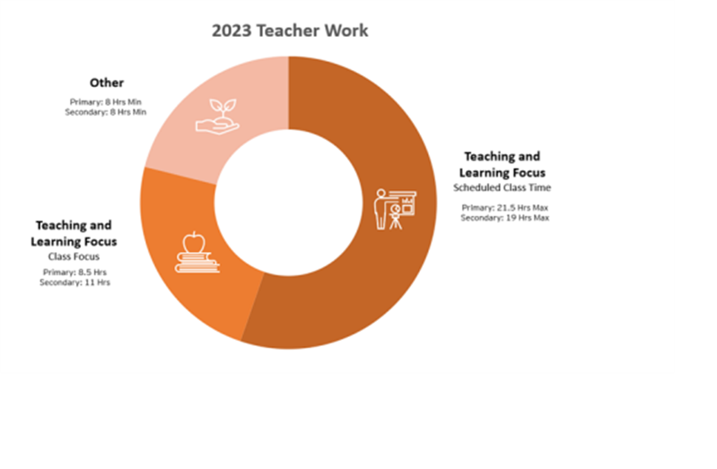
30+8 Model
The 30+8 model is a model used to regulate a teacher's working week.
This 30 hours incorporates maximum SCT and the work associated with teaching which includes, collaboration, planning, assessment, marking etc.
The 8 in the 30+8 model is the additional duties a teacher is required to perform during a week outside of the work they perform directly related to teaching and learning.
The 8 hours includes- yard supervision, before and after school supervision, attendance at meetings, lunch breaks for teachers (30 minutes per day free from duties)
There is a minimum of 7 hours of attendance per day, however current application of teacher attendance time remains in that Teachers may opt to absent themselves occasionally in appropriate circumstances
Notes:
In the 30 and 8 model Maximum face-to-face teaching hours to be allocated is 30 hours per week.
Within these 30 hours, Teachers will undertake the work directly related to the teaching and learning program of their class or classes.
The teaching and learning focus categorised scheduled class time will be 21.5 hours for primary and 19 hours for secondary in 2023. These duties include:
all scheduled classes allocated to the teacher whether that class consists of a single student or a group of students
activities scheduled during normal class time
replacement classes
all scheduled classes allocated to the teacher from the time that students are required to be in attendance (primary school)
scheduled assemblies
scheduled home room duties (secondary school).
The teaching and learning focus categorised as “class focus duties” is what was more commonly known as “release time”, will be 8.5 hours for primary and 11 hours for secondary in 2023.
The class focus duties, are duties such as:
planning
preparation
assessments
collaboration
self directed professional development
extras in secondary schools.
Then there is the 8 hours that are relating to “other duties” such as meetings, lunch breaks and yard duties. We will go into more detail on the next page.
Of course these provisions apply on a pro rata basis to teachers employed part-time.

Slide 28

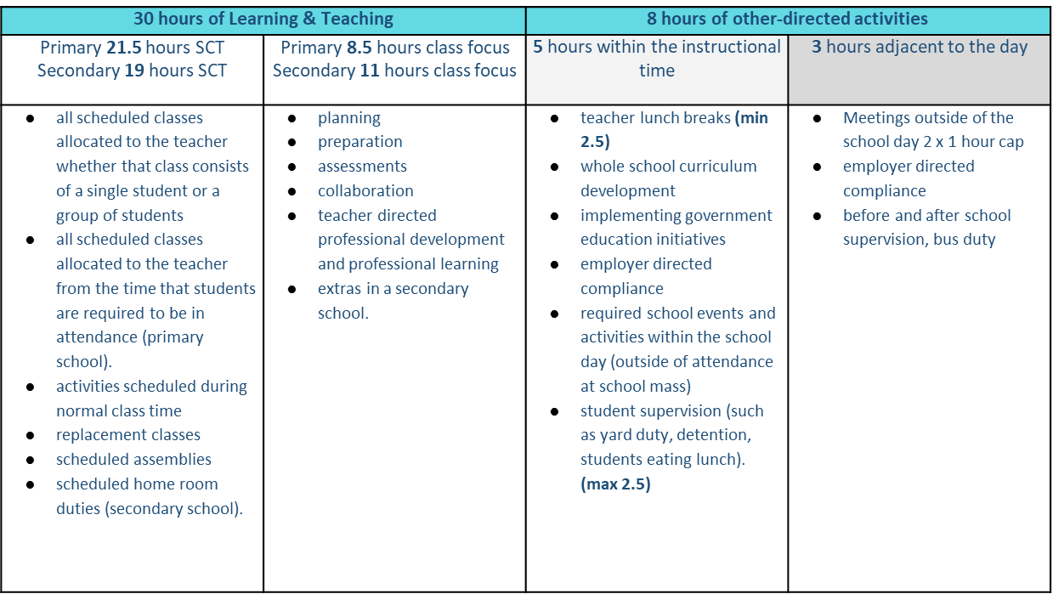


30+8 Model - 2023
Notes:
In the 30 and 8 model Maximum face-to-face teaching hours to be allocated is 30 hours per week.
Within these 30 hours, Teachers will undertake the work directly related to the teaching and learning program of their class or classes.
The teaching and learning focus categorised scheduled class time will be 21.5 hours for primary and 19 hours for secondary in 2023..
The teaching and learning focus categorised as “class focus duties” is what was more commonly known as “release time”, will be 8.5 hours for primary and 11 hours for secondary in 2023. The duties are included are detailed on the screen
Then there is the 8 hours that are relating to “other duties” such as meetings, lunch breaks and yard duties. Of course these provisions apply on a pro rata basis to teachers employed part-time.

Slide 29
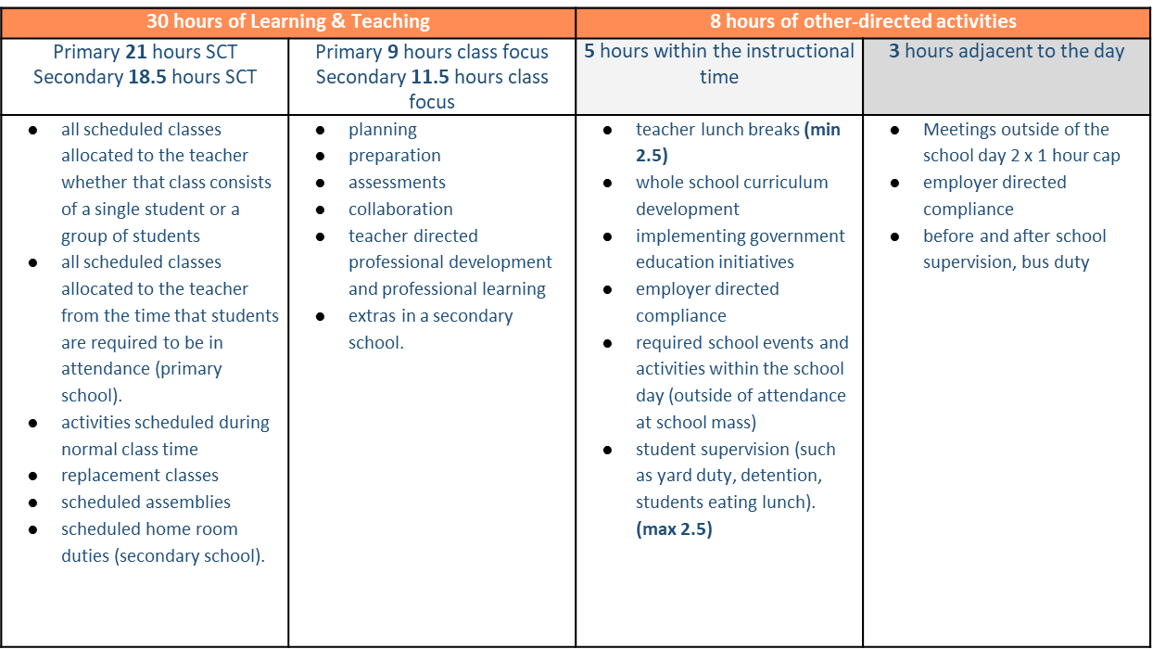



30+8 Model 2024
Notes:
The only change we will see in 2024 is the further reduction of SCT for a further 30 minutes.

Slide 30
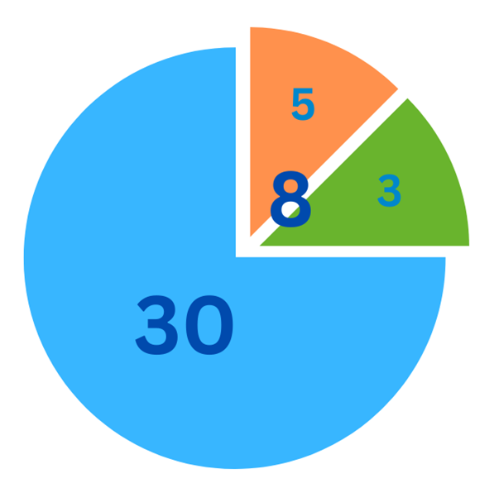
The 8 Hours
Five hours of other related duties within the student attendance time:
              2.5 hours of those are paid lunch breaks
2.5 hours are for other duties/supervision
Three hours of other related duties adjacent to the student attendance time:
including a maximum 2 x 1-hour meetings
1 hour for other duties/supervision
Notes:
When we look at the 8 it is broken down to the following further requirements 5 hours of other related duties within the student attendance time
A minimum 2.5 hours are for lunch breaks
The other a maximum 2.5 hours for other duties/supervision (such as yard duty, detentions and required school events and activities that fall within the student attendance time)
Then there are 3 hours adjacent to the teacher attendance time, including up to 2 x 1 hour meetings
2 hours of meetings of one hour in length outside the normal 7 hours of attendance per day. Cap on meetings outside the school day - 2 per week maximum and cannot exceed one hour unless otherwise agreed using the consultative provisions of the agreement.
It’s important to note that Leadership & Consultative Committee meetings adjacent to the school day are in addition to the 2 x 1-hour meetings without incurring TIL.
The other 1 hour would be for other duties/supervision adjacent to the student attendance time (such as busy duty or before and after school supervision)
How the 30 and 8 model is structured will be managed at a local level via the Consultative Committee. Just for noting, it will be very important for schools to have a functioning Consultative Committee.
Schools should be working towards implementing the 30+8 model by term 2

Slide 31
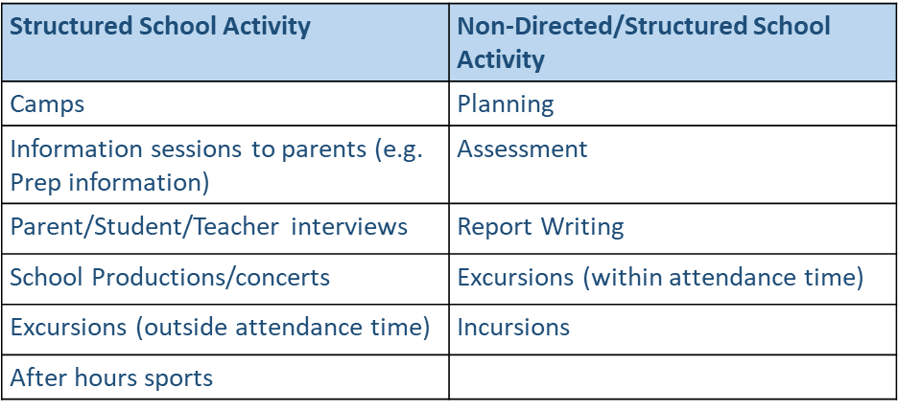
Time in Lieu – Teaching Staff
TIL to be applied to Teaching staff for structured school activities outside the school day hours in any week exceeding 38 hours for a full-time teacher.
The TIL provisions apply to school activities and do not apply to non directed school activities such as planning for classes, assessment and report writing that would normally occur in the 38 hours of work per week.
Notes:
The new provisions provide that the principal may require a teacher to undertake work and attend a school activity outside the normal hours of attendance (i.e. in excess of the 38 hours or normal hours for a part time teacher) and, when this occurs, it will attract time in lieu.
In the proposed agreement TIL will be applicable for Teaching staff who are directed to attend structured school activities outside the school day in any week that exceeds 38 hours for a full-time teacher. This includes directed duties such as camps, parent teacher interviews, school productions, excursions and after hours sports.
TIL provisions will not apply to activities such as planning for classess, assessment and report writing that would normally occur within the 38 hour week. TIL is also not applicable for voluntary additional duties, like assessment and marking from home.
The TIL will apply to all teaching staff including anyone that holds a POL, however it will not apply to Principals or Deputy Principals,
There are a number of ways that TIL can be acquitted and schools will plan, approve and acquit via the consultative committee. Its important to note that it will not be the employees choie on how TIL is acquitted, unless agreed to between the Principal and the employee.

Slide 32
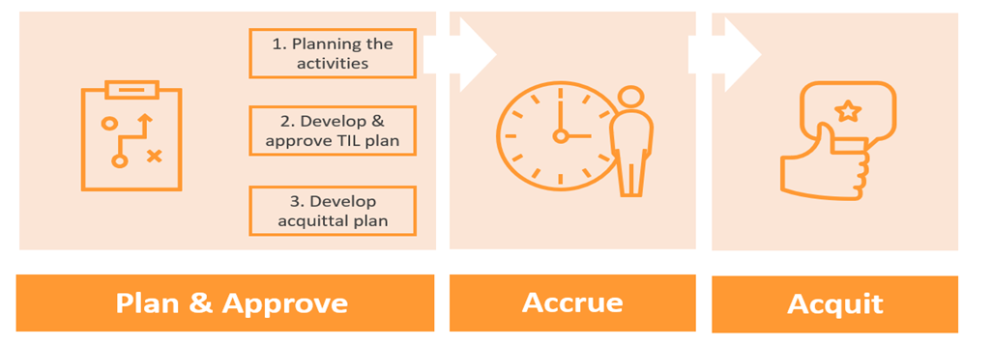
Time in Lieu – Teaching Staff
Consult via Consultative Committee
Comprehensive planning
Determine activities that attract TIL
Structured activities that are in excess of 38 hours per week (or ordinary hours for part time employee)
Pre-acquittal
Acquittal without replacement
Acquittal via CRT/other staff replacement
Payment
Notes:
The recommended process is a three step approach which you can see on the screen. Plan & Approve, Accrue and Acquit. The leadership team will be expected to plan for all structured school activities in term 4 and align
How many hours the whole activity may accrue
Position or teacher aligned to activity
How many hours that the teacher may accrue
Strategies for acquittal
They will then take it to CC for discussion. The school will then be required to advise each staff member their plan as per the TIL forecast i.e when they are directed to attend; how many hours it will accrue and how they intend to acquit
How time in lieu for teachers is provided will be discussed at the Consultative Committee at the beginning of the school year or end of the previous year.
All work required in excess of 38 hours per week for a full-time teacher (or on a pro-rata basis for a part time teacher) must be documented by the Employer.
The timing of the acquittal of the time in lieu is at the discretion of the principal
Currently schools are only required to be tracking camps in Term 1&2. It is likely they will have to acquit for this over the course of the year.

Slide 33
Teacher Time in Lieu
How time in lieu for teachers is provided will be discussed at the Consultative Committee at the beginning of the school year or end of the previous year.
The school activities that attract time in lieu will be determined by the principal using the school based consultative arrangements.
TIL provisions do not apply to work or school activities that are not required by a principal, and do not apply to activities such as planning for classes, preparation and assessments that would normally occur in the 38 hours.
Teachers will be informed by the principal in advance of work and activities that are required of them outside their normal working hours.
Notes:
How time in lieu for teachers is provided will be discussed at the Consultative Committee at the beginning of the school year or end of the previous year.
The Agreement defines school activity as a structured activity organised by the school such as a parent teacher meeting, camp, excursion, concert or parent information session. The school activities that attract time in lieu will be determined by the principal using the school based consultative arrangements.
The time in lieu provisions do not apply to work or school activities that are not required by a principal, and do not apply to activities such as planning for classes, preparation and assessments that would normally occur in the 38 hours. Teachers will be informed by the principal in advance of work and activities that are required of them outside their normal working hours.
TIL guidance and TIL tracker/calculator has been provided to support schools in the recording and management of TIL
TIL does not need to be provided within 14 days after the additional time is worked. Schools will be able to manage TIL throughout the school year in different ways.

