Slide 1

Diocesan Leadership Gathering
Pre-recorded
Week 8 Term 1 2024

Slide 2
Good News - Enrolments
February Census results
Total Students FTE increased 272.71 since last year to 18,645.11
  An increase of 109.95 Primary students to 10,178.15
  An increase of 162.76 Secondary students to 8,466.96
  Prep Enrolments remained the almost exactly same as 2023
  Year 7 enrolments increased by 87 FTE to 1,604

Slide 3

More Good News
“While there are many champions for inclusive education and of this book, I want to acknowledge some early standouts. Ballarat Catholic Education Diocese came straight out of the blocks, hosting a Principals’ forum and providing a copy of the book to each delegate in early 2020.” Linda J Graham

Slide 4
150 Anniversary
weekend
Bishop Paul is visiting each parish on a weekend over the course of the year
Monday morning
Bishop Paul is happy to be invited to visit the local school(s) on the Monday morning of his weekend visits.

Slide 5
Digitech Strategy
Digital Technology Open Day
Emmaus Catholic Primary School
17 May 2024
9:30am – 1:30pm

Slide 6
More Good news
School TV is proving very popular with over 10,000 views since the start of this term
Most popular videos
  Friendship Belonging
  Youth Anxiety
  Managing Screen Time
  School Transition
Country Education Project Autumn Series VC on YouTube
  Emily Clarke – Trauma Aware Care for First Nations Families

Slide 7
Strategic Planning Process
Our work with Pasi, Dave and friends is generating lots of momentum
School visits will continue in Term 2 along with other stakeholder engagements including our next DLG meeting in Horsham in Week 4 of Term 2

Slide 8
Federal Capital Grants
The Federal capital grants program is now open
Details in the 15 May VCEA communications
Speak to Ash Wiseman
Low DMI

Slide 9
DLG Week 4 Term 2
Friday 10 May may clash with Mother’s Day activities back at your school
We will have GM Sponsors on the Thursday and Friday

Slide 10
Compliance Training Schedule 2024 -2026
To meet our legal requirements under various Acts of Parliament we are required to undertake compliance training in a range of areas
Some compliance training is required for all staff
Some compliance training is only specific to certain staff – usually the leadership team
We will release the 2024 -2026 schedule as an ED Update today (18 March) with a more general release for all DOBCEL staff in Wednesday’s newsletter
Most online modules are now delivered through SALT

Slide 11
Compliance Training Schedule 2024 - 2026
In 2024 all staff are required to complete 2 modules, with leadership team members required to complete the Camps and Excursions module as well
Annual training requirements remain the same:
  All staff
    Mandatory Reporting module vis MARAM
    Anaphylaxis briefing
Diabetes Management Level 1 one off only (if not previously completed)
  Nominated staff
    First Aid, Anaphylaxis, Asthma & Diabetes Management Training

Slide 12
Compliance Training Schedule 2024 -2026
Staff that are new to DOBCEL schools must complete all modules within the year, unless they have evidence that they have completed modules with their previous employer
All training to be completed by the end of the year

Slide 13
Media & Comms Strategy
Resonate completed their report and recommendations 2 weeks ago
We are very keen to have a TV/radio and social media campaign to coincide with this year’s enrolment season

Slide 14
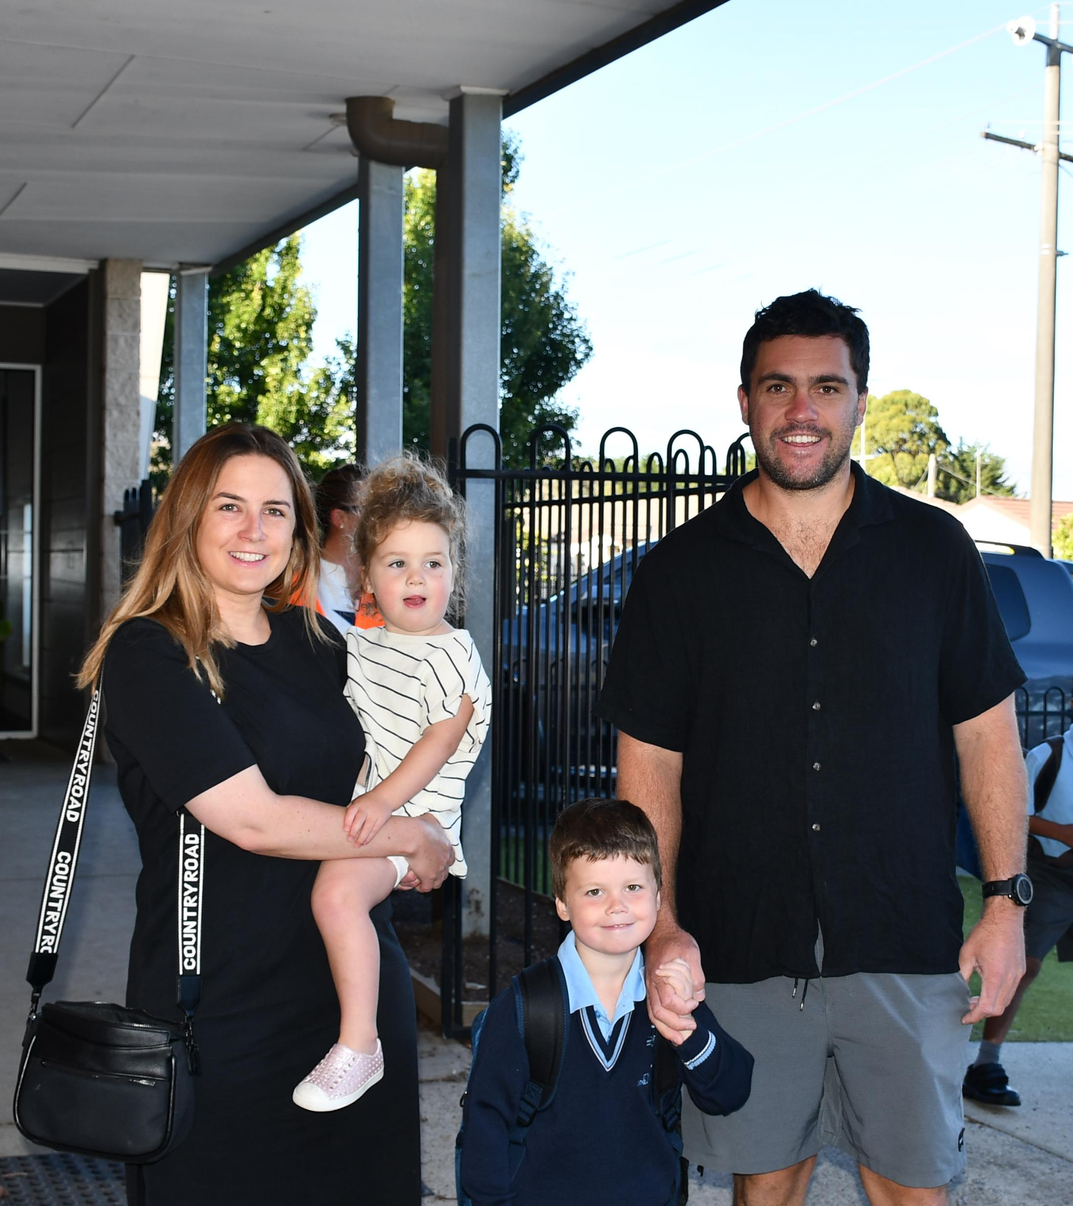
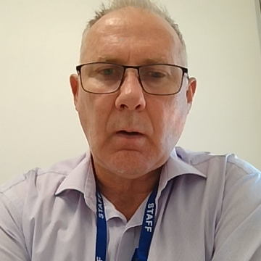
DOBCEL Schools
Marketing Project
UPDATE/OVERVIEW
March 2024

Slide 15
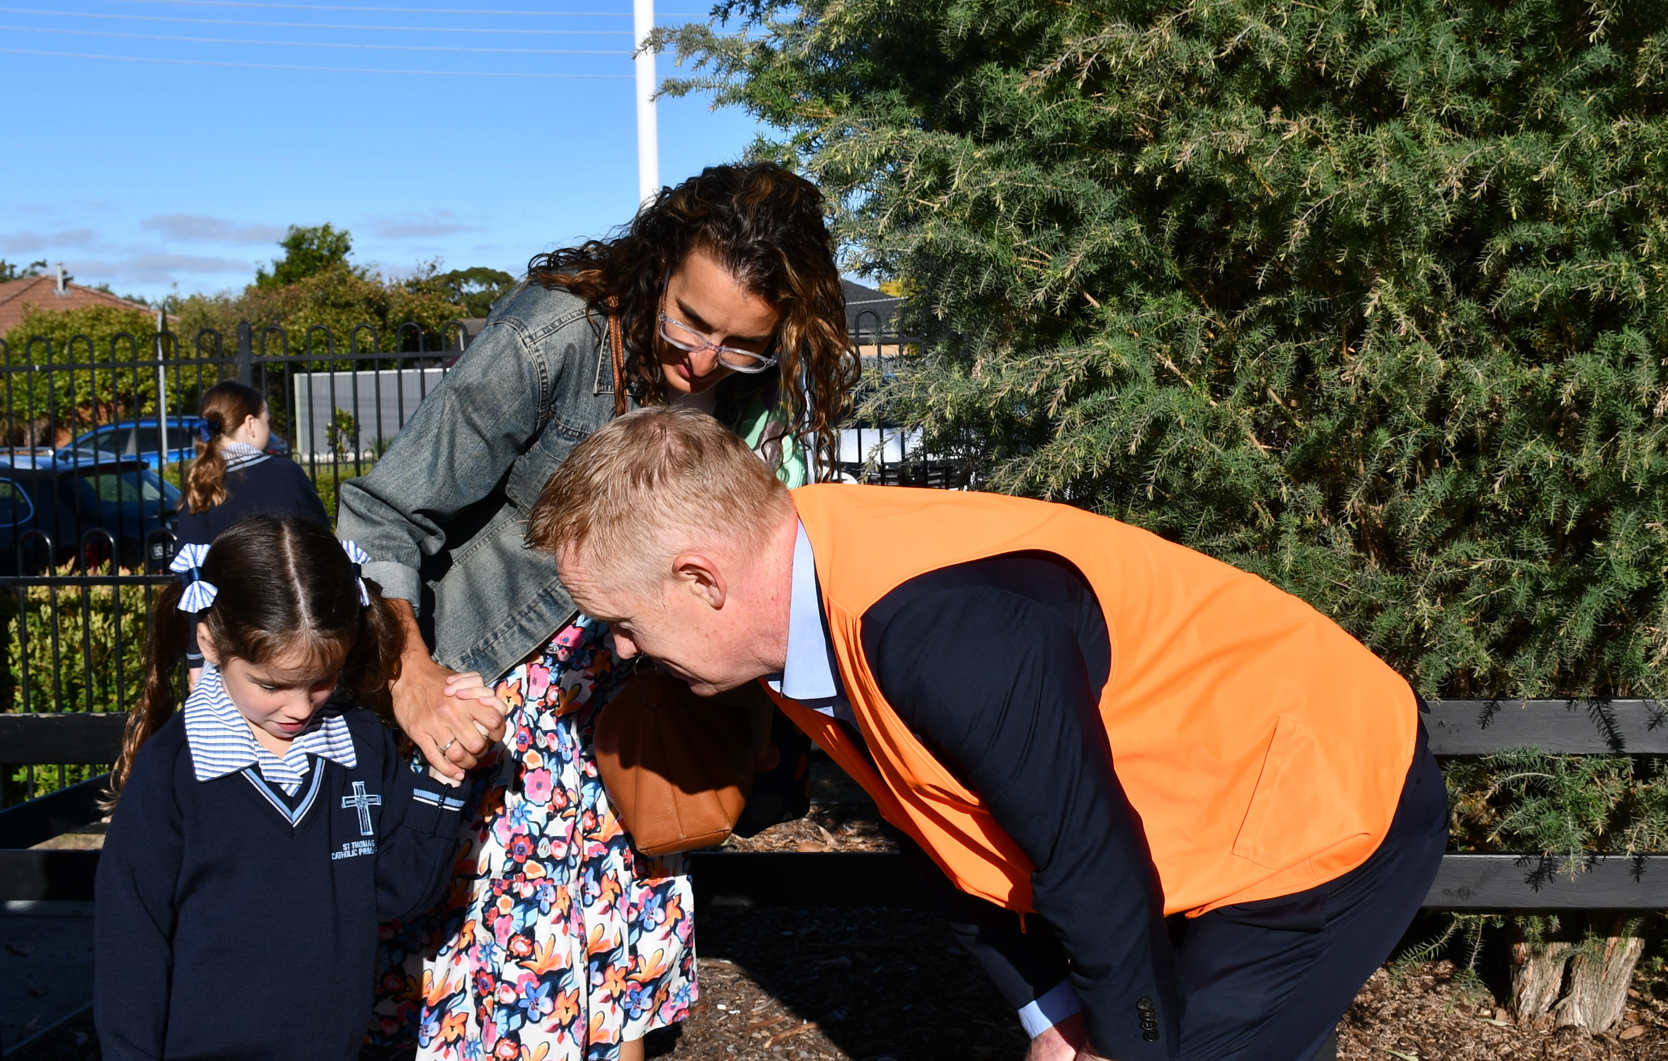
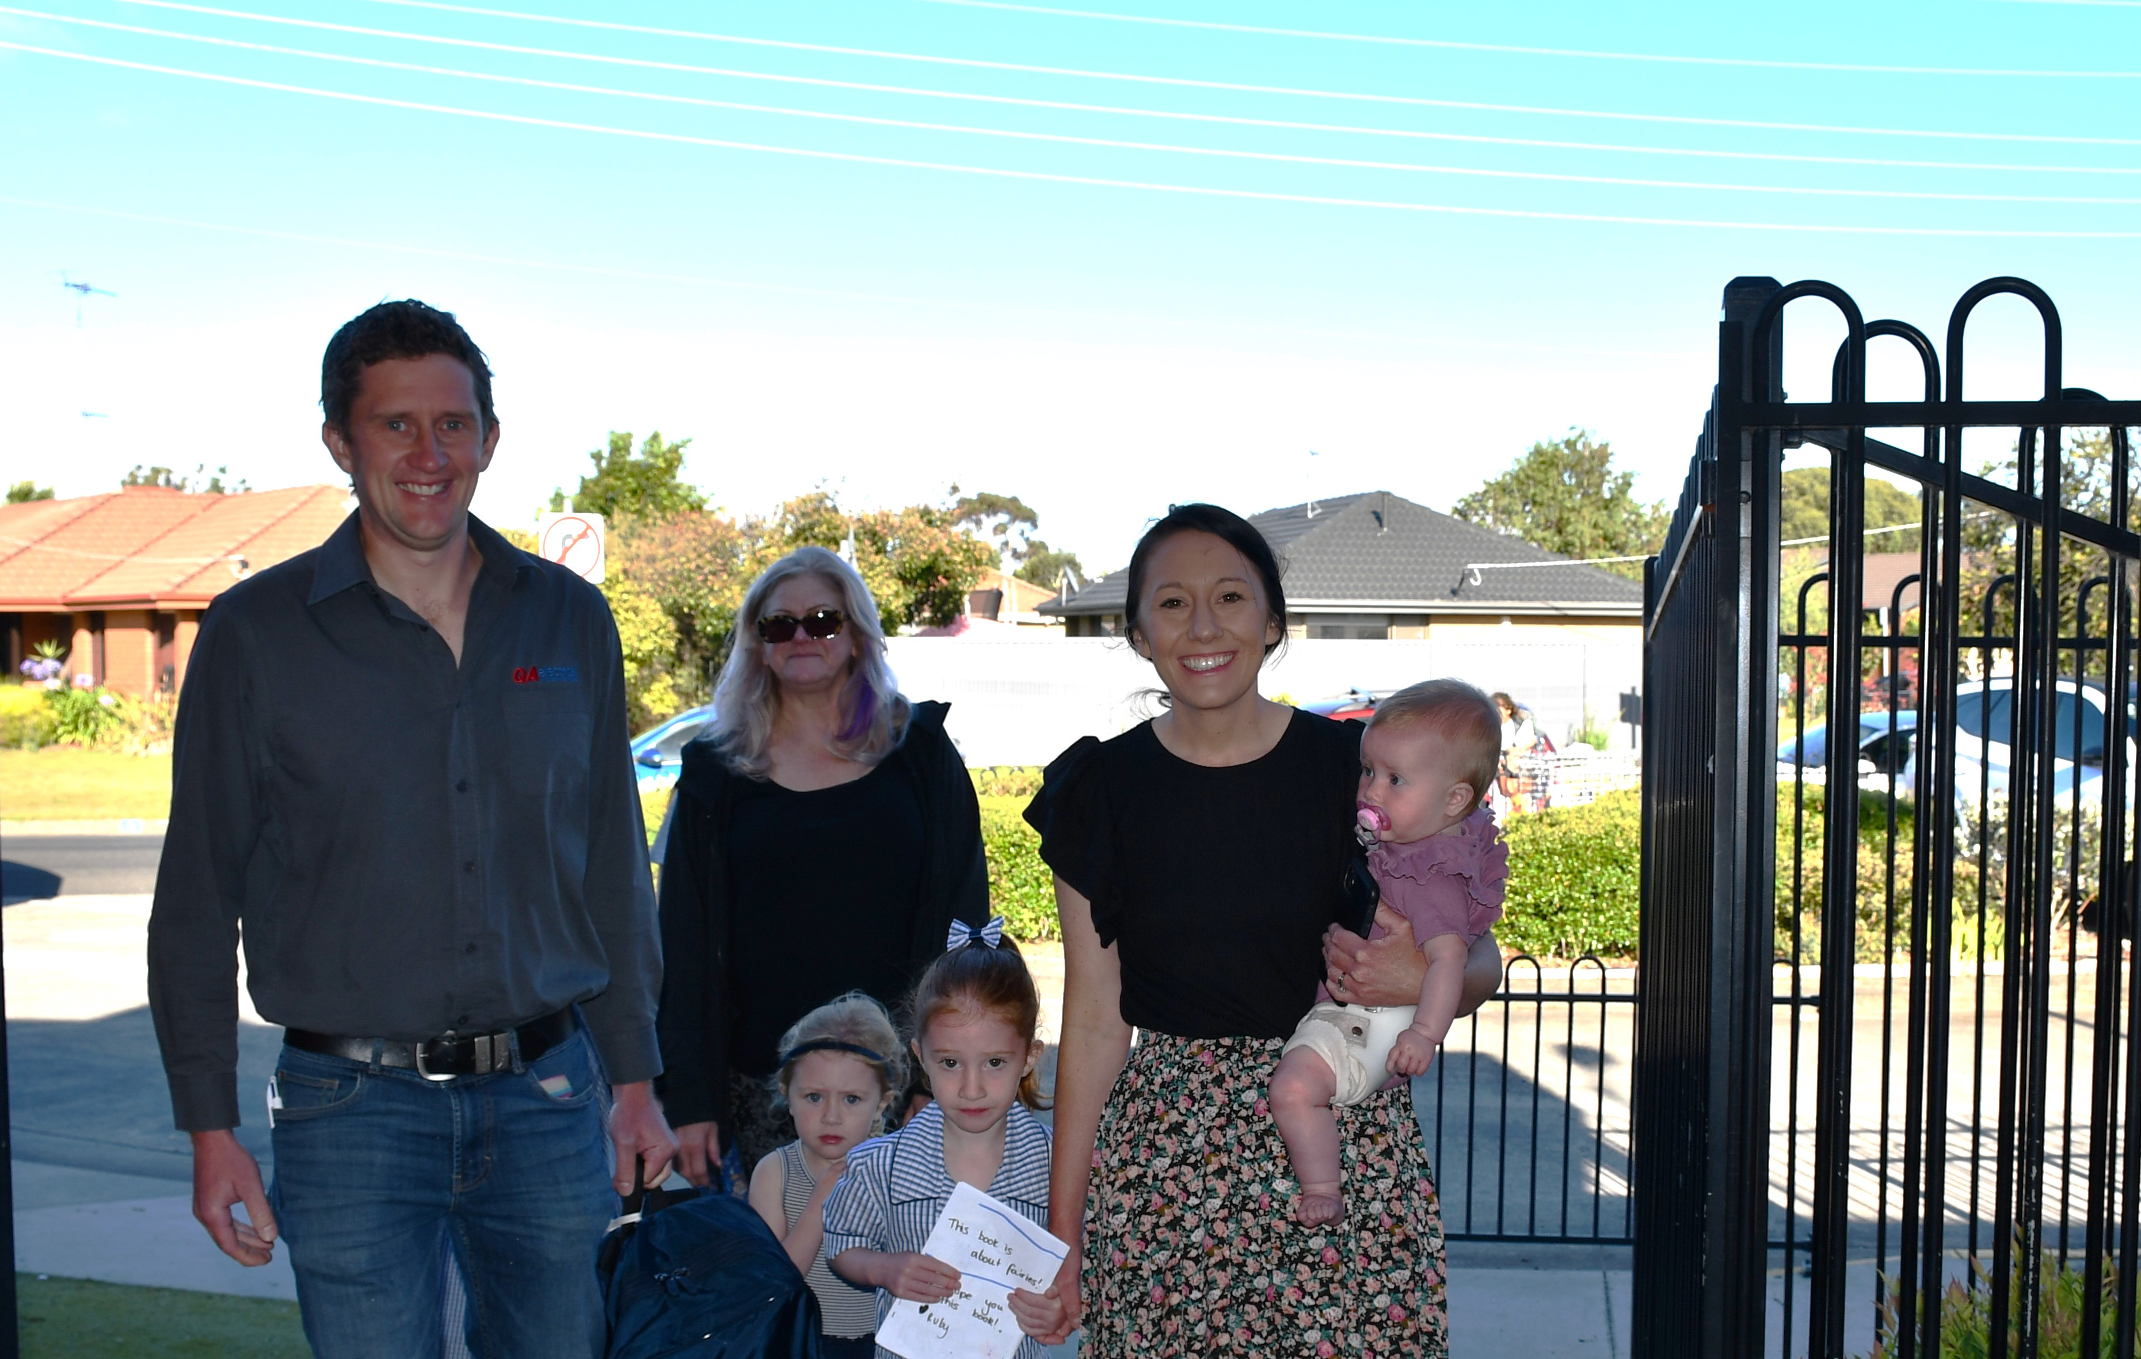
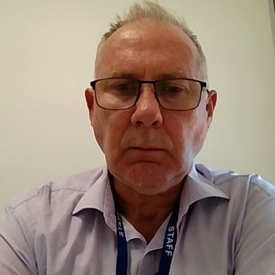
Background
A need was identified to better understand existing perceptions of Catholic schools in the diocese and drive improvement in marketing practices.
Project initiated and led by Executive Director, commencing mid-2023.
External consultant ‘Resonate’ was engaged to undertake qualitative market research and intelligence gathering, with schools and prospective parents across the diocese, to inform strategy and action phases.

Slide 16
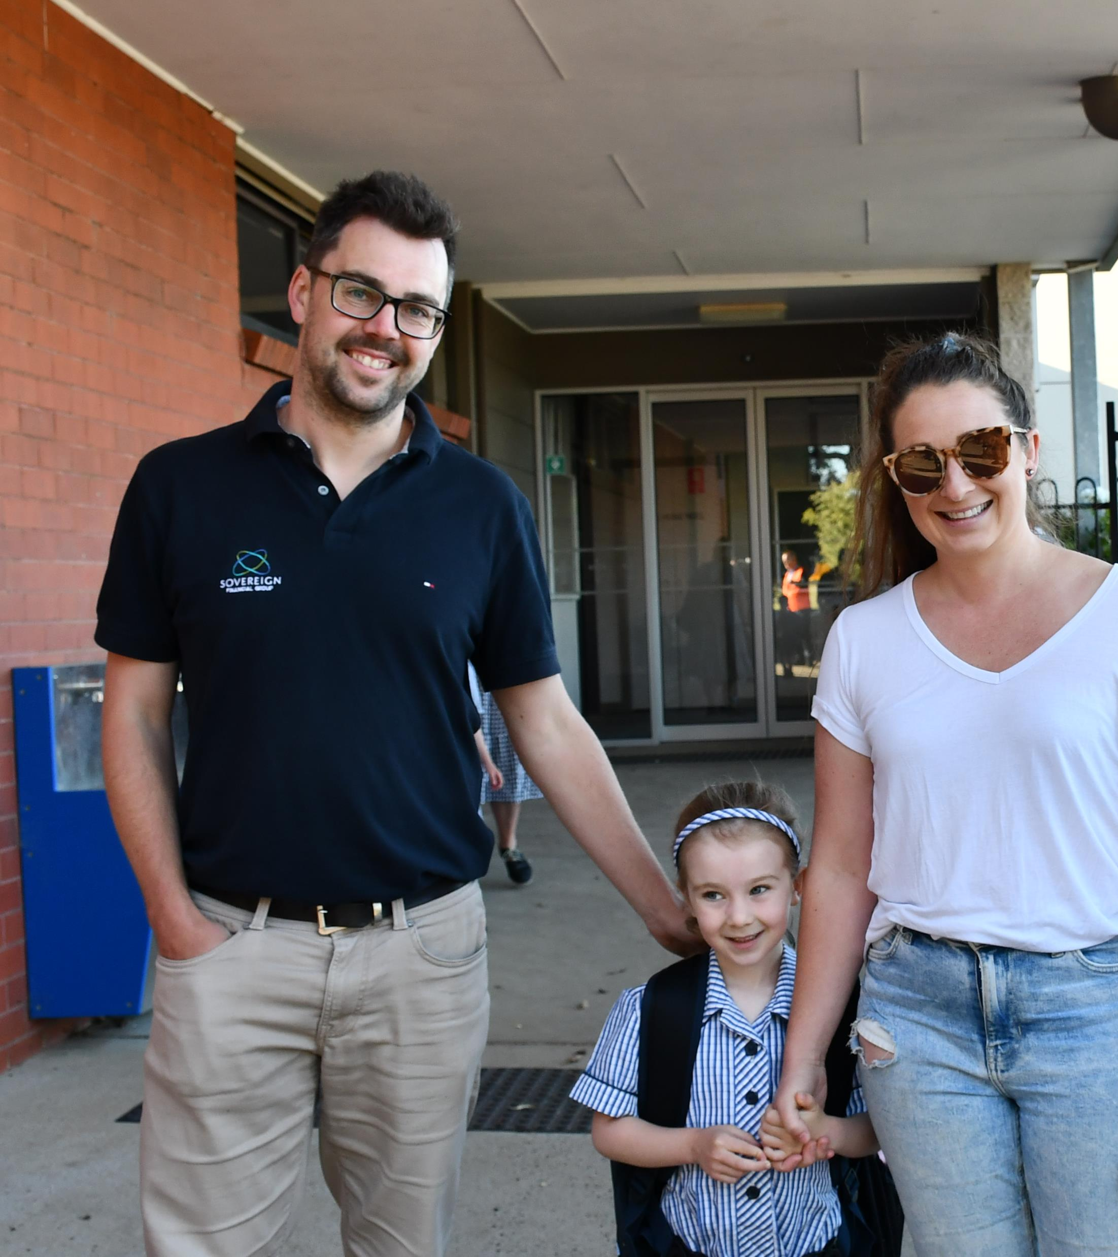
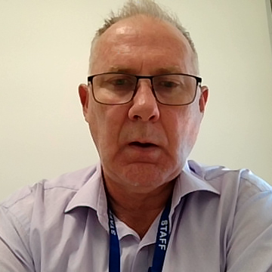
Project Objectives
Enrolment growth in key markets and consolidation in others.
Improved understanding of the most effective ‘value proposition’ or ‘pitch’ to their communities among schools.
Improved ability to communicate good news/successes
Ability to specifically target different/new market segments.
An enhanced Catholic education brand.
A sustainable marketing support model.
Enhanced ability to attract and retain staff.

Slide 17
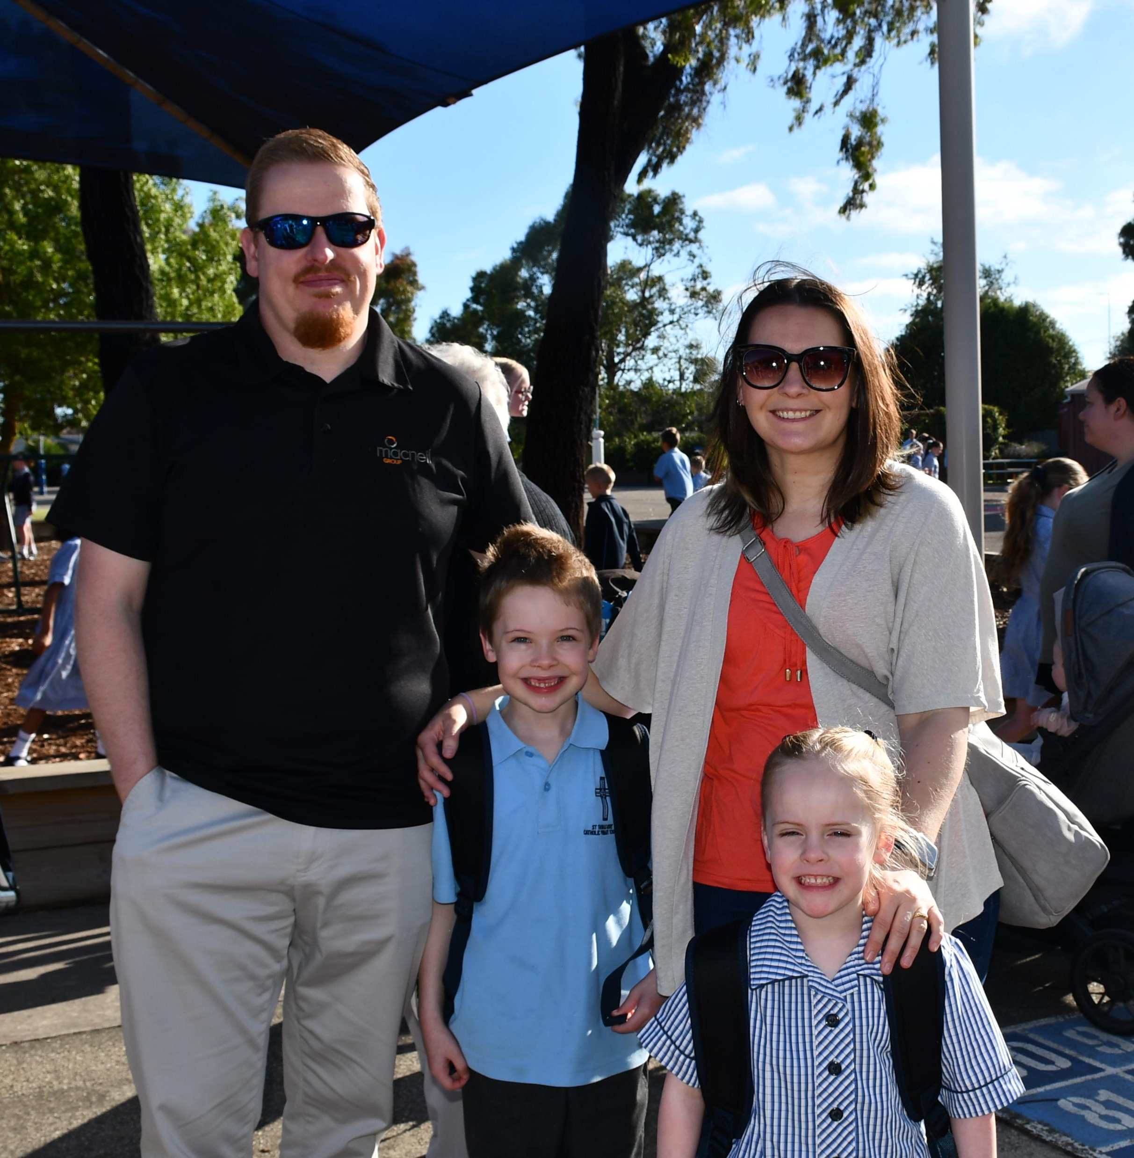
Topline research findings

Slide 18
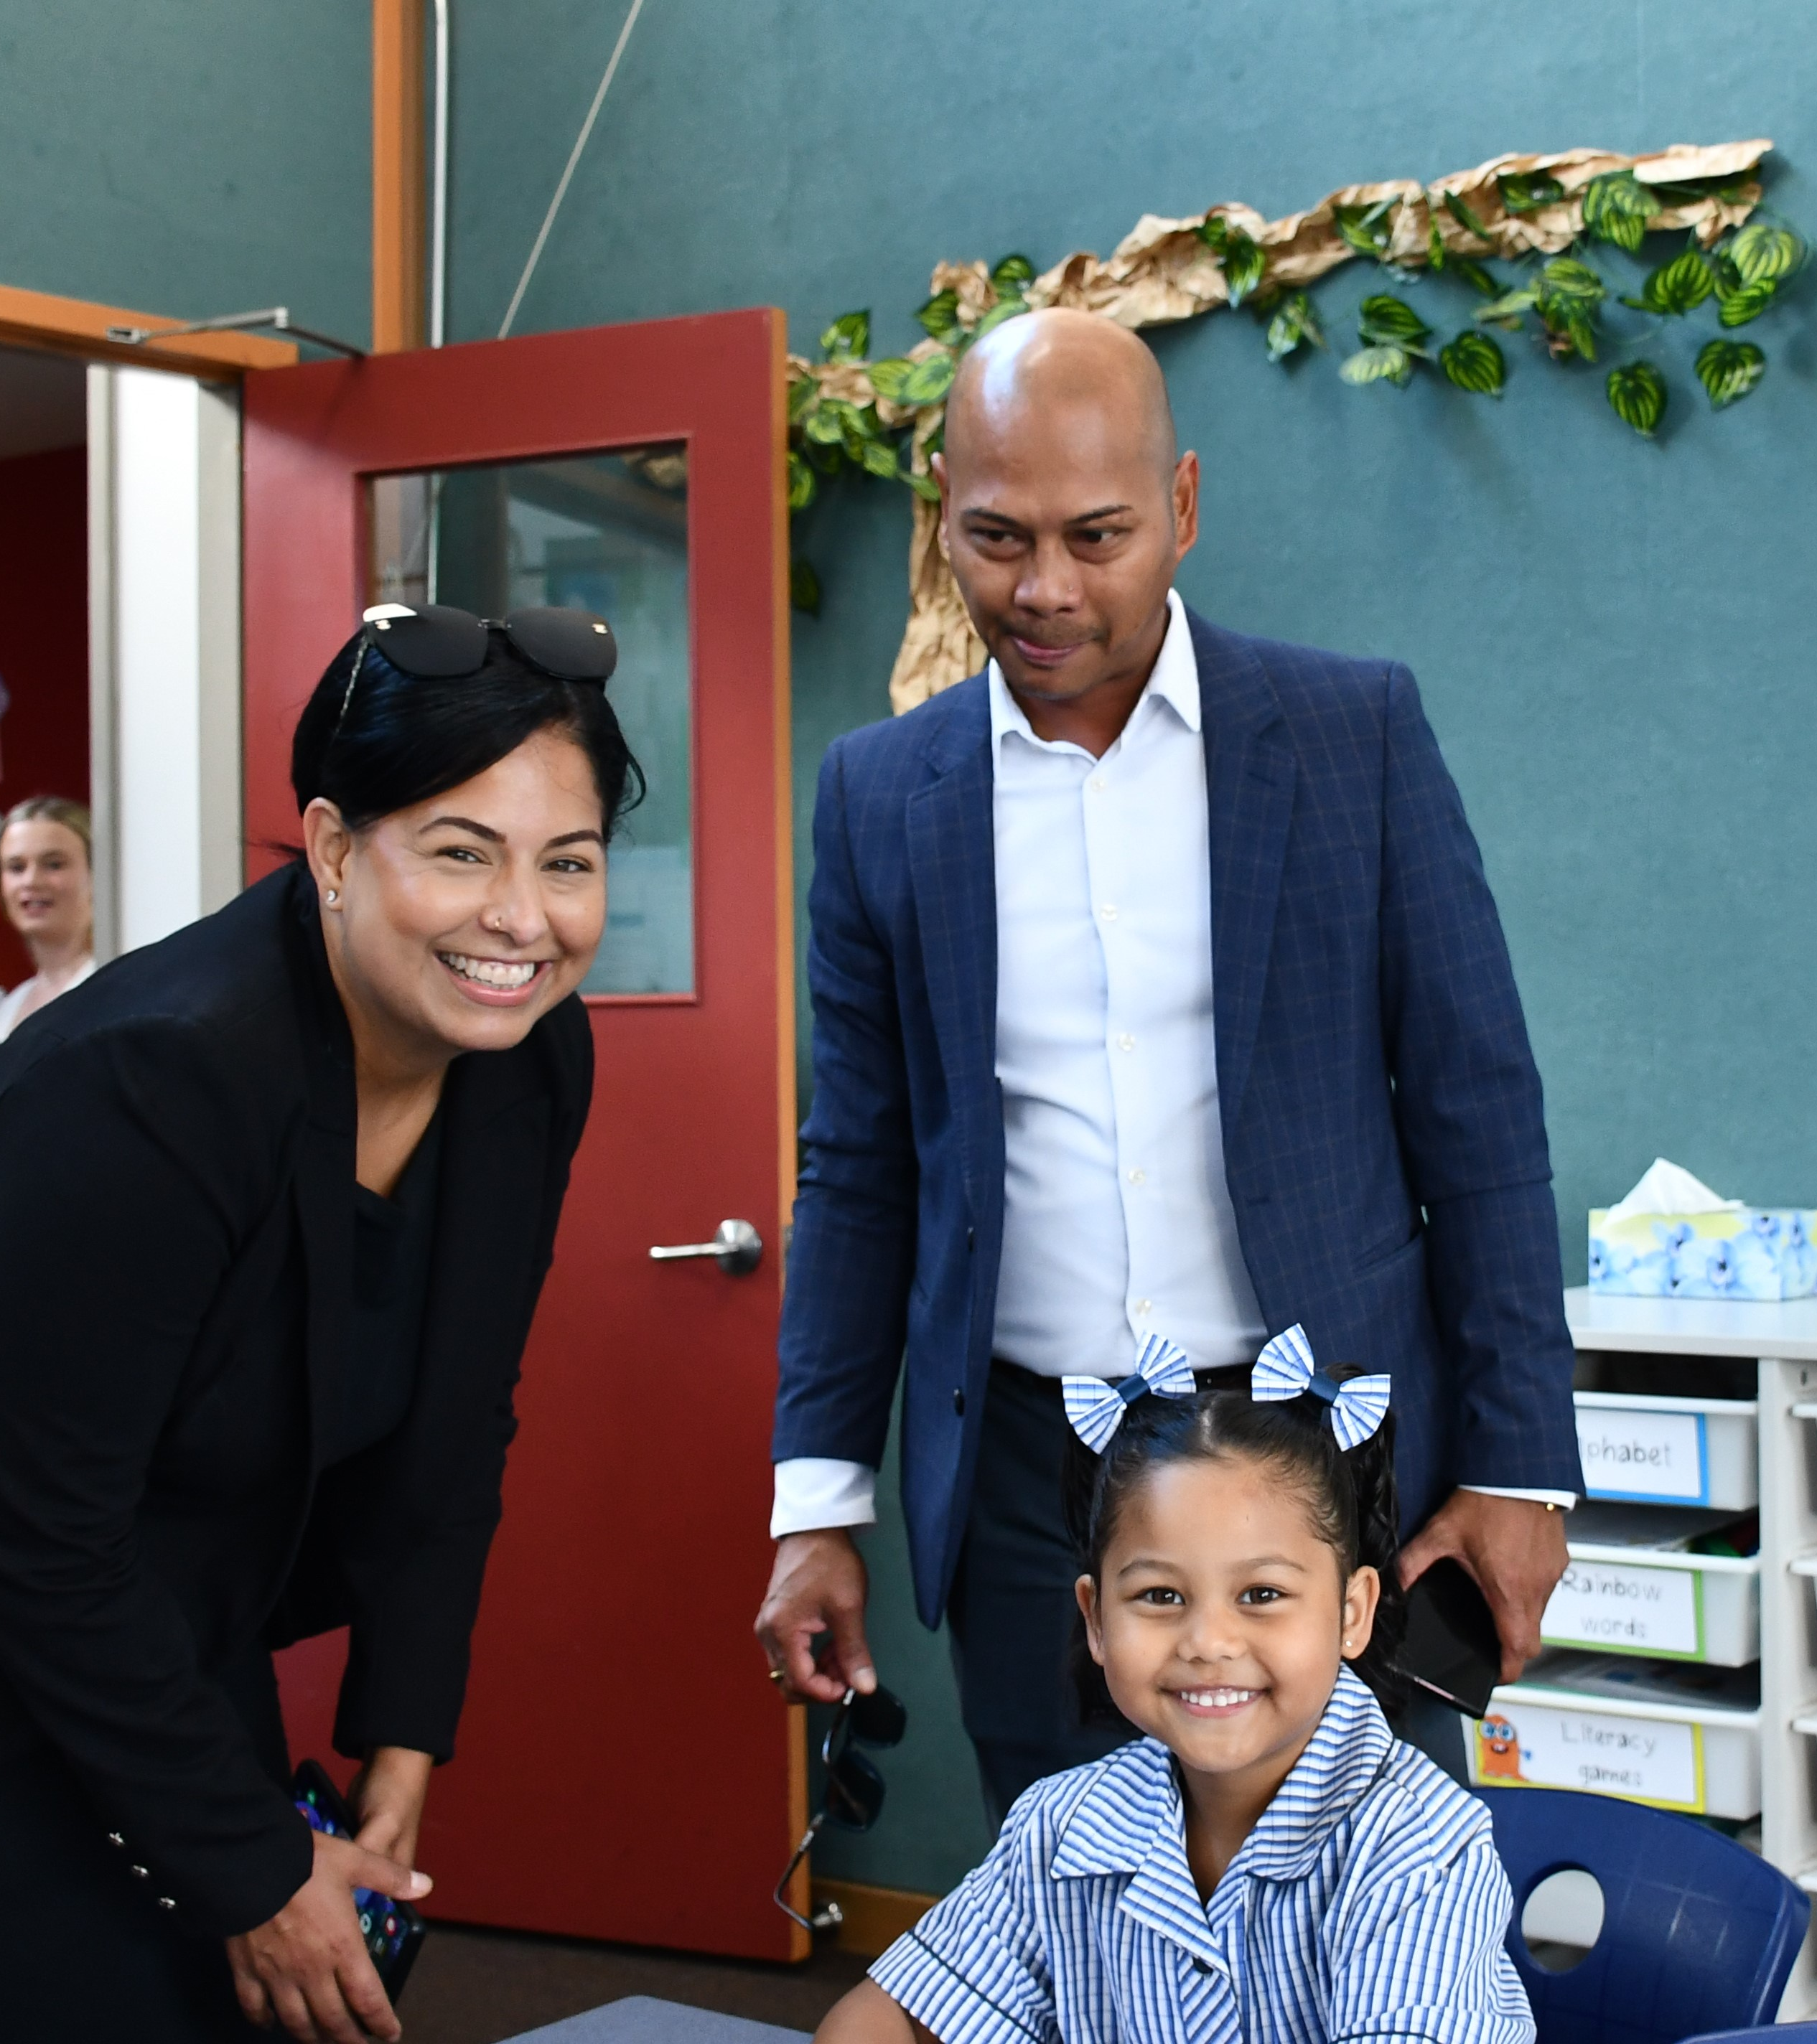
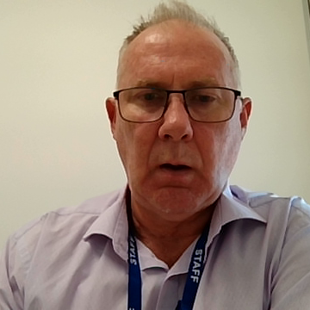
Influences and motivations
Some participants reported an inability to access trustworthy, quality information.
A valued offering
Many parents are choosing between a government option and a private religious option, and in this context the Catholic offer is generally well-regarded.
Barriers to inquiry
Generally understood that where space is available it is not a requirement to be Catholic. The bigger issue is: how welcome can we really be if we don’t share your faith traditions?
Religious education
Religious education and uncertainty surrounding objectives and prevalence was regularly raised as a barrier to consideration.

Slide 19
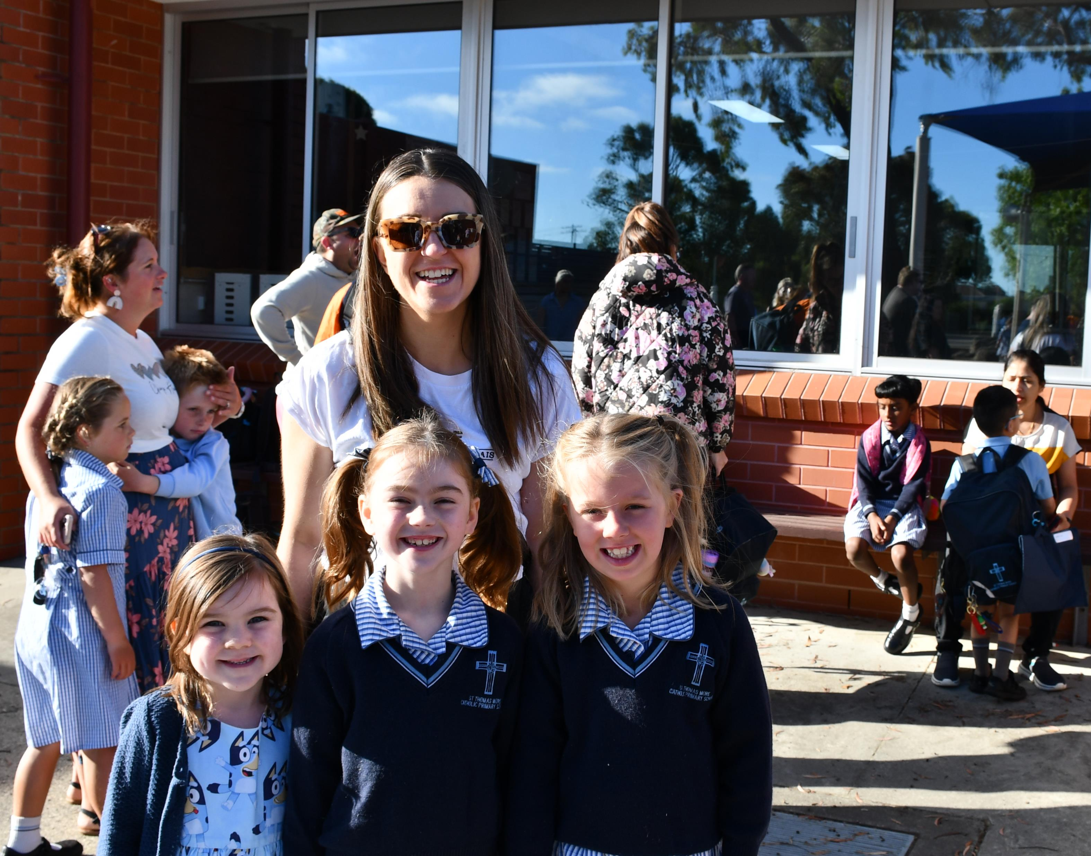
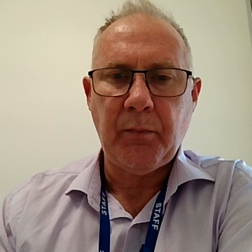
Pedagogy
Different approaches to teaching and learning were often raised as influential but few parents were able to articulate differences in approach.
Provision of Catholic schooling
Co-located kindergarten and long daycare in primary settings and K-12 and K-10 options is presenting challenges and opportunities.
Limited childcare places and wait lists are leading to increased anxiety on school availability – some prospective families don't believe they can readily access a place at Catholic/private schools.
Values and parent expectations
Catholic schools face a significant challenge to develop a compelling proposition that appeals to ideologically different market segments.

Slide 20
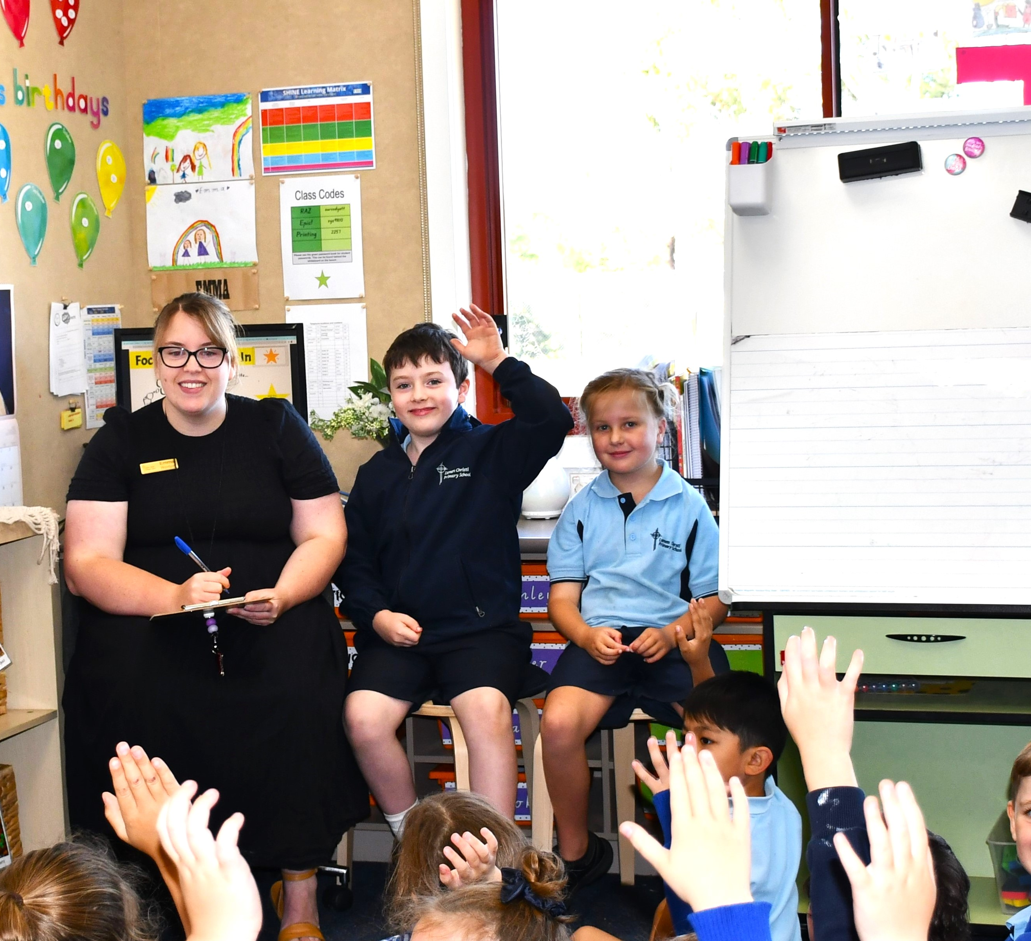
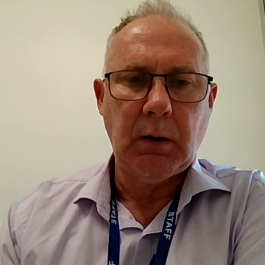
School reputation
Generally formed on perceptions of leadership in the absence of other measures or performance indicators.
Behaviour management is a perceived Catholic school strength.
Catholic schools are highly regarded for their sense of welcome, inclusivity and community - strengths poorly understood by prospective families.
Catholic schools were believed to foster respectful, kind, and compassionate students.

Slide 21
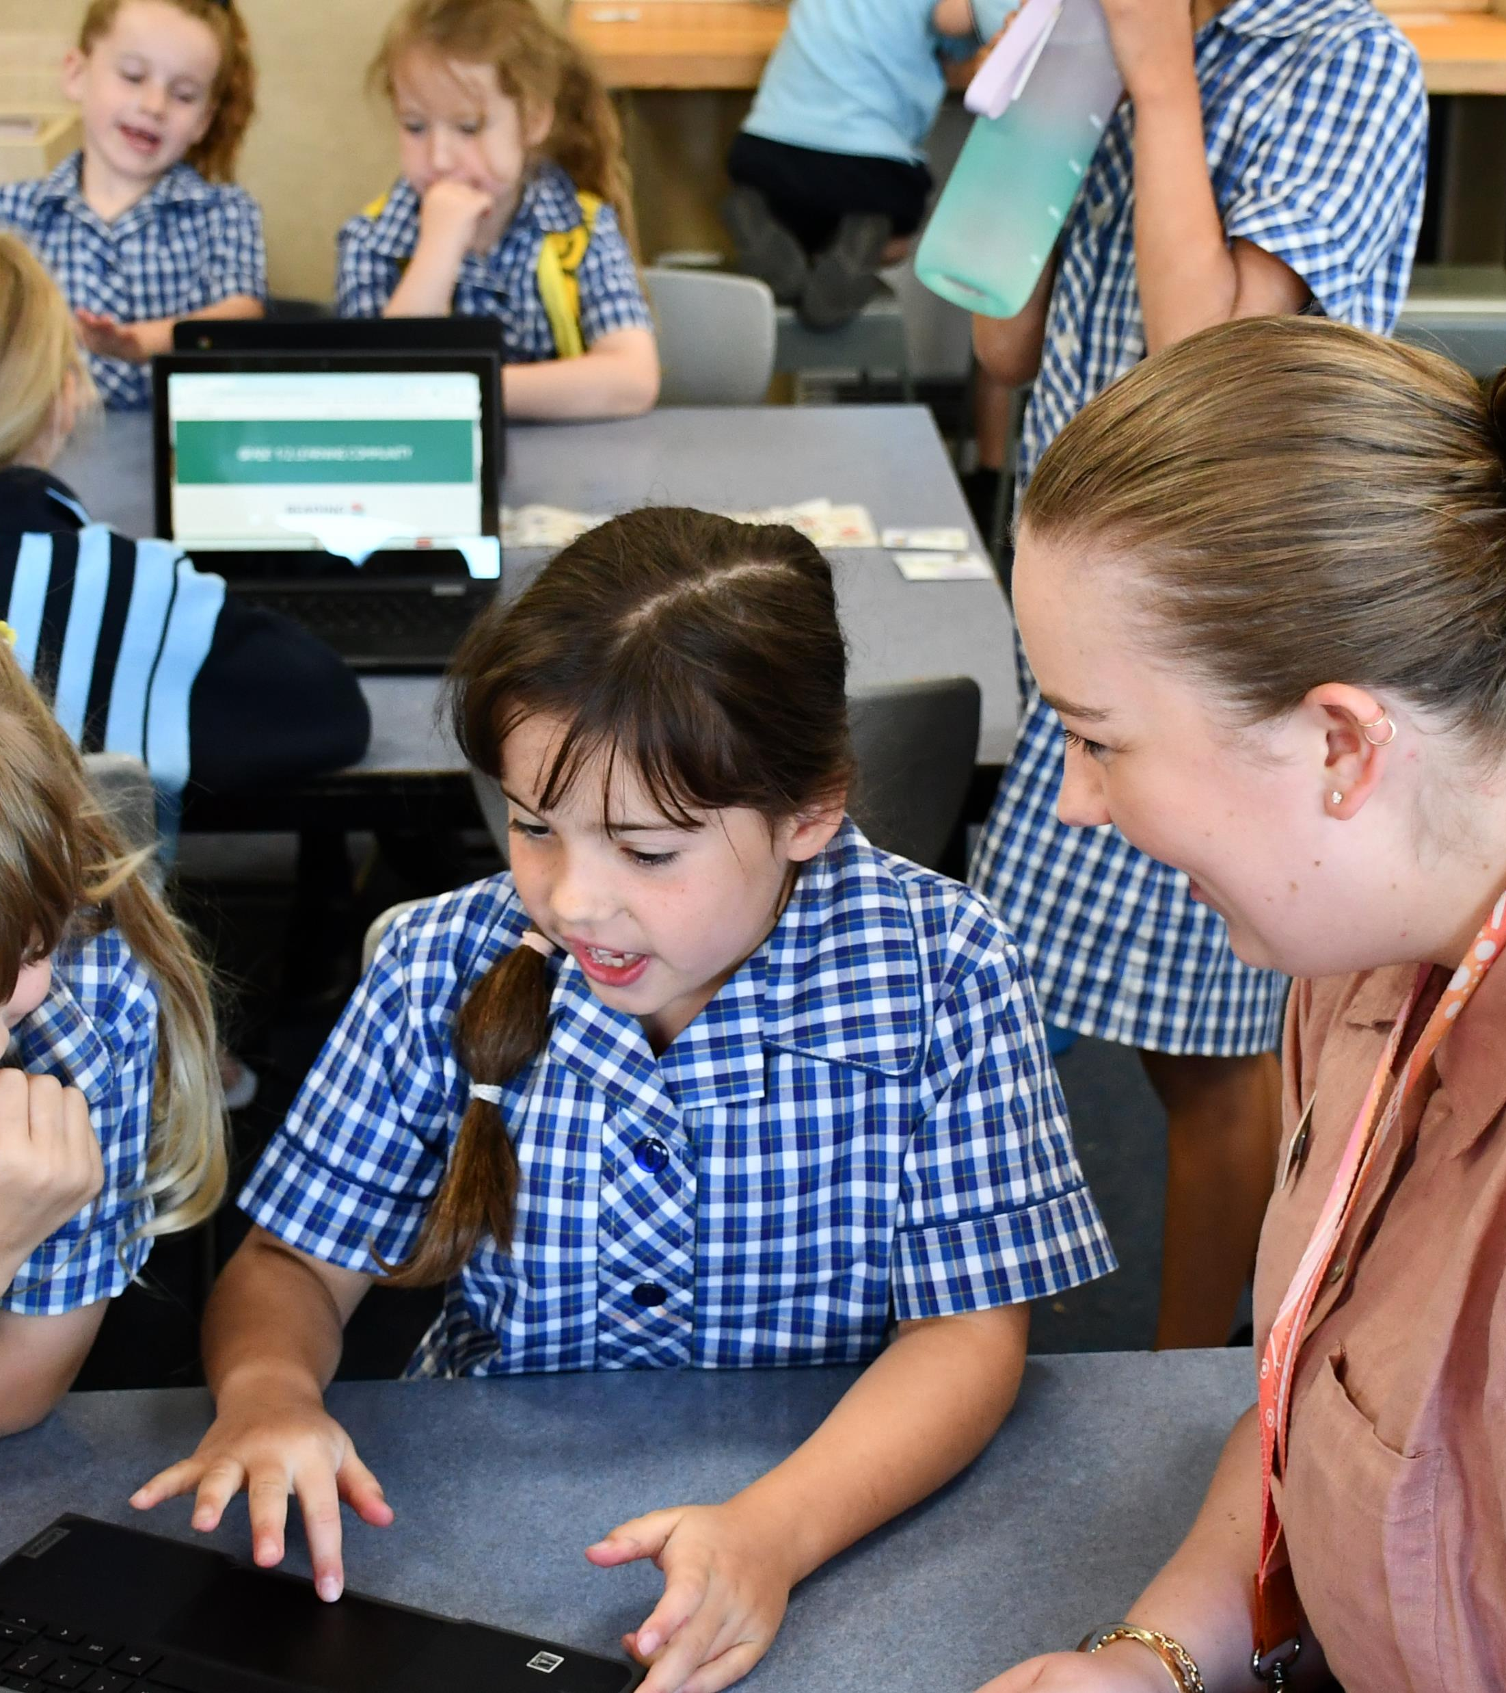
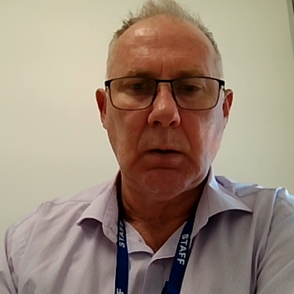
Education offering and school performance
Catholic schools generally do not appear to be consistently outperforming their government competitor (MySchool). This is contrary to the perception of many prospective families.
  Conservative market segments want to see greater focus on core curriculum delivery (literacy and numeracy) and respect for the role of parents as first educators on more contentious social/political issues. This is also considered a relative strength of the Catholic system over government.

Slide 22
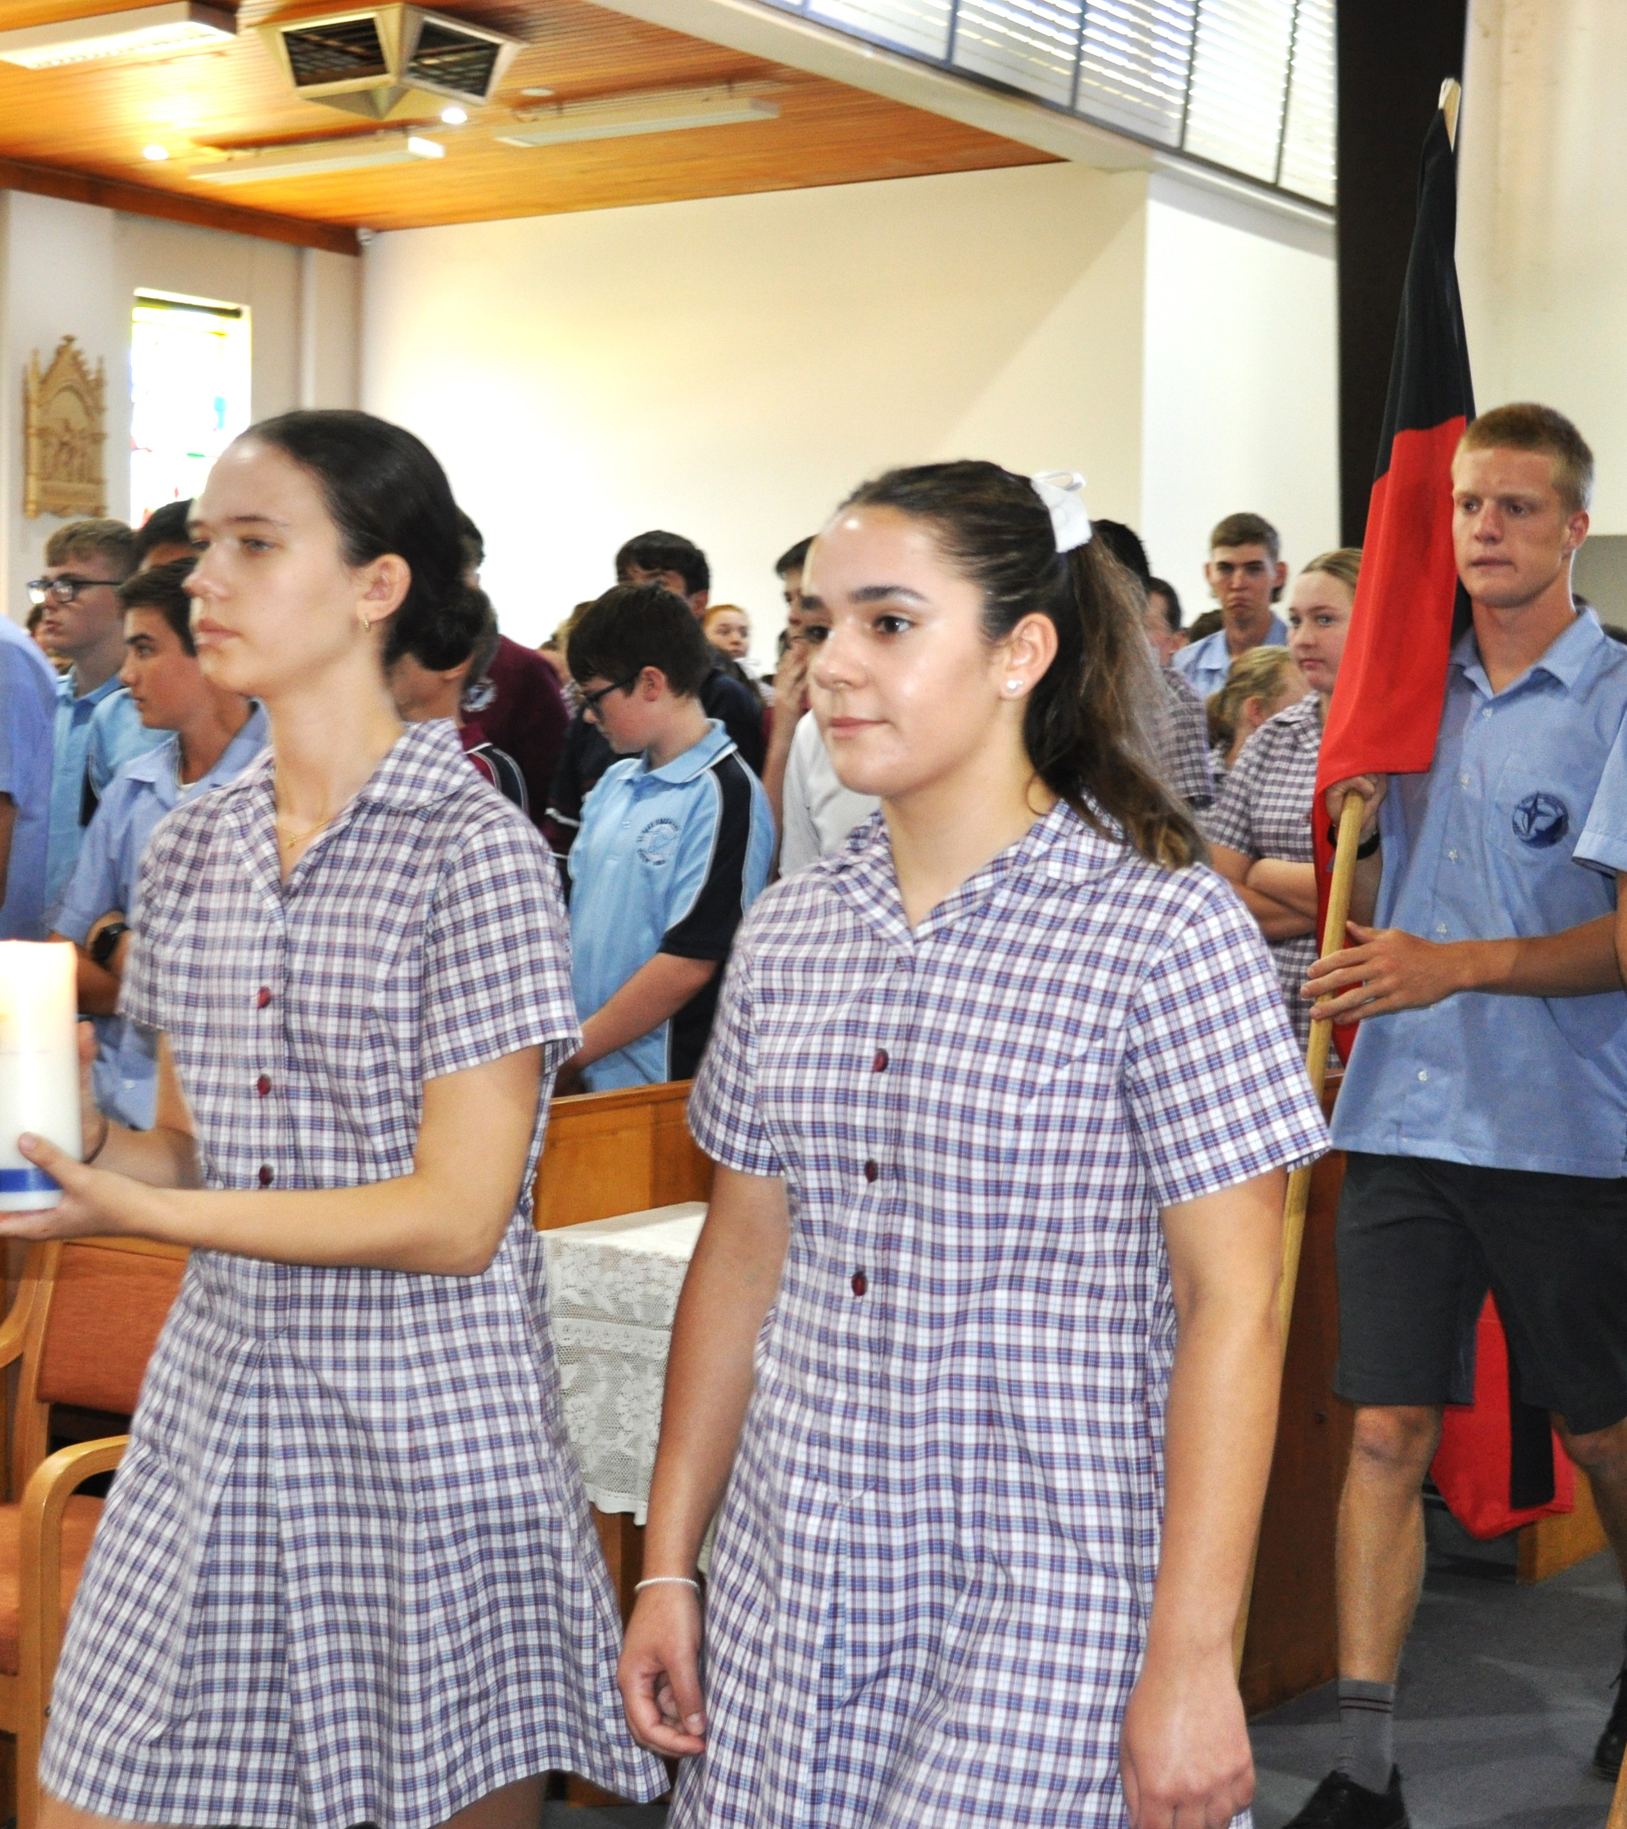
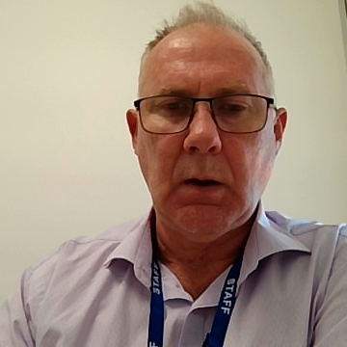
Barriers and challenges
  Lack of awareness of cost, family discounts and low-income support available. Overestimation of fees is hindering enrolment enquiry.
  Uncertainty around Catholicity and welcome of non-Catholic families.
  Facilities compared to government competitor - street appeal impacting first impressions.
  Often considered as private schools or private Catholic schools - creates misconceptions, particularly in low SES markets.
  Priority entry to desirable Catholic secondary colleges is a driver of primary school choice. This driver is reduced in markets where access to a quality Catholic secondary option is limited.
  Community barriers for regional secondary colleges (disloyal to leave town for regional Catholic school)
  Access to and ability to communicate evidence demonstrating performance and outcomes in key areas of student/school development.

Slide 23
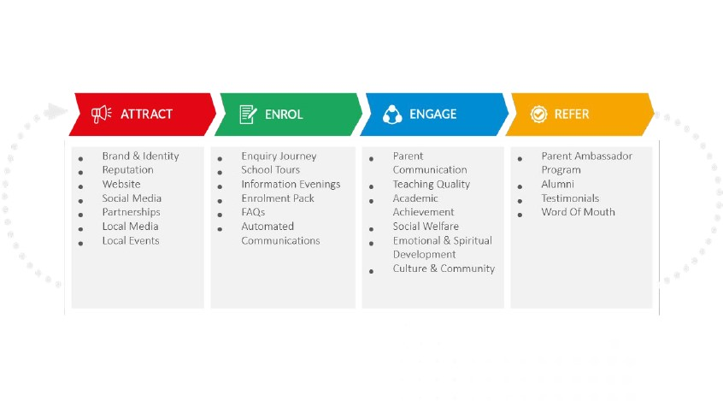
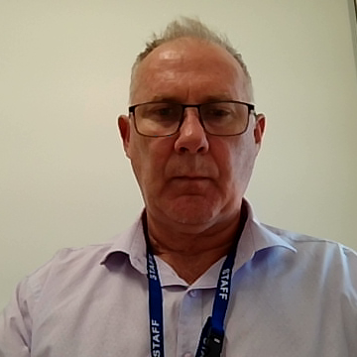
Responses/action planning
Over coming weeks and months DOBCEL will deliver:
Refreshed key messaging/value proposition, reflecting research findings.
Resources to build/support school capability across the marketing cycle (below)

Slide 24
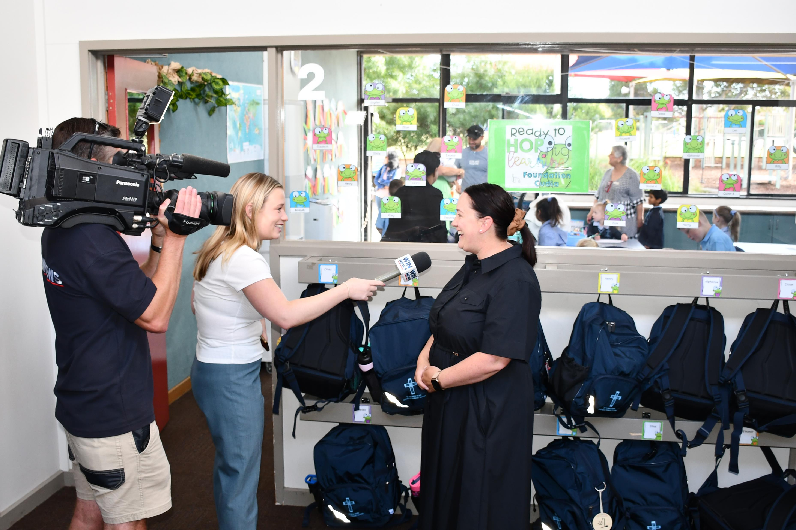
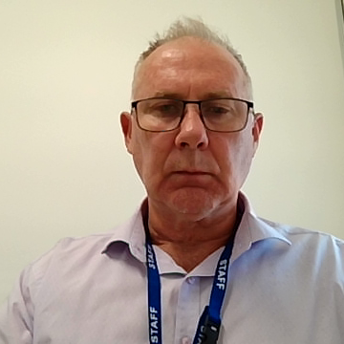
Diocesan-wide TV & Radio Advertising Campaign
  A 4-5 week TV and FM radio campaign, supported by social media assets, will be aired across the diocese from 21 April - 19 May.
  The campaign will aim to build brand awareness and help drive enrolment inquiries, particularly from market segments who may have feel they wouldn’t/couldn’t consider a Catholic education.
  The advertisement will focus on primary school enrolment, highlighting the ‘journey’ of Catholic education and, in a bid to dispel some of the myths highlighted in the market research, invite prospective families to ‘experience contemporary Catholic education’.
  The advertisement will call on families to ‘find your nearest Catholic school’.
  Schools are asked to ensure they have a clear enrolment inquiry pathway identified on websites. This should include information on fees, discounts, and financial hardship provisions.
  Schools are asked to monitor enrolment inquiries throughout the campaign period to assist with evaluation.

Slide 25
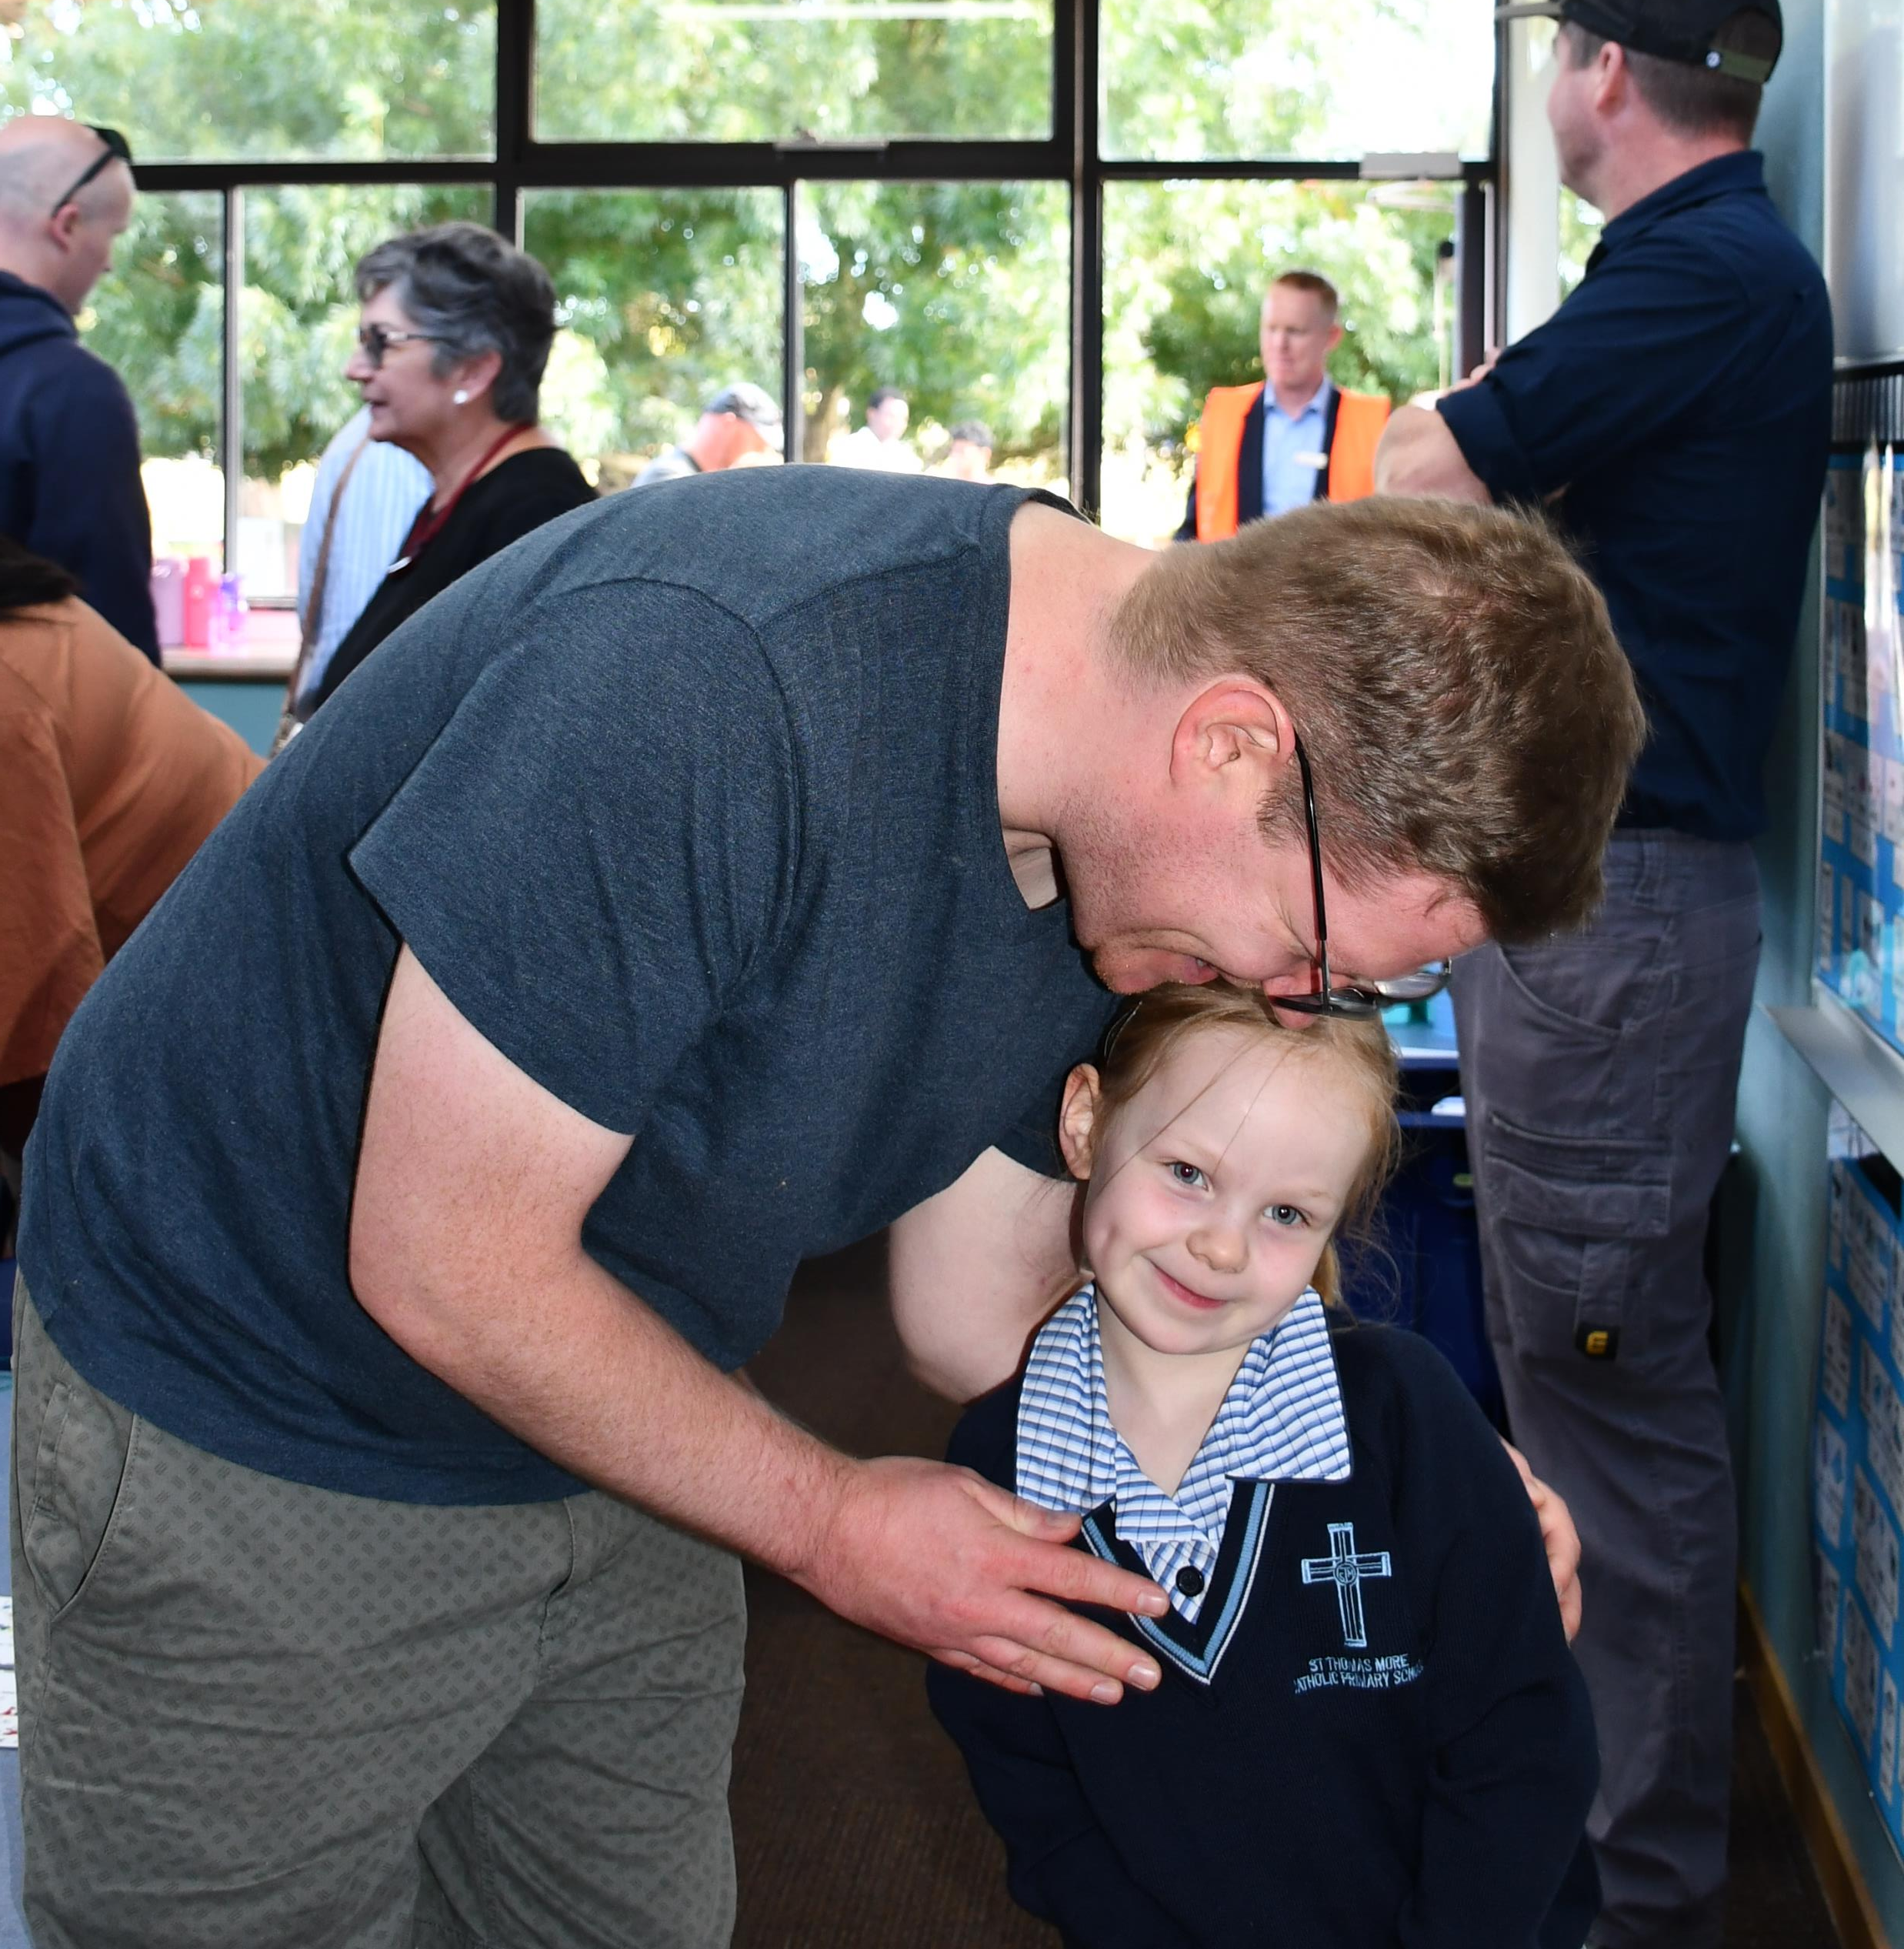
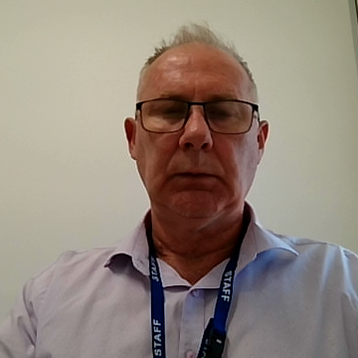
Any questions, queries or comments ?
Gerard Delaney (Manager, Communications and Marketing)
Ph 0413 274 176 E gdelaney@dobcel.catholic.edu.au

Slide 26
Thank You and Happy Easter

