Slide 1
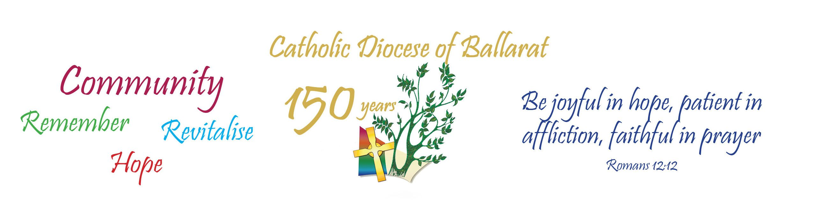
Rite of Reception of Message Stick

Slide 2
Acknowledgment of Country:
In recognition of Aboriginal and Torres Strait Islander people’s spiritual and cultural connection to Country, we acknowledge the **** People, the traditional custodians of this land and value the many different lands on which we meet across our Diocese.
We recognise the continued care of the lands and waterways passed from generation to generation, wisdom that is shared, and life that is celebrated in harmony with the natural environment.
We honour the Elders past and present who have laid the foundations, traditions, and culture for emerging Aboriginal and Torres Strait Islander Peoples and we commit to working together for reconciliation and justice.

Slide 3
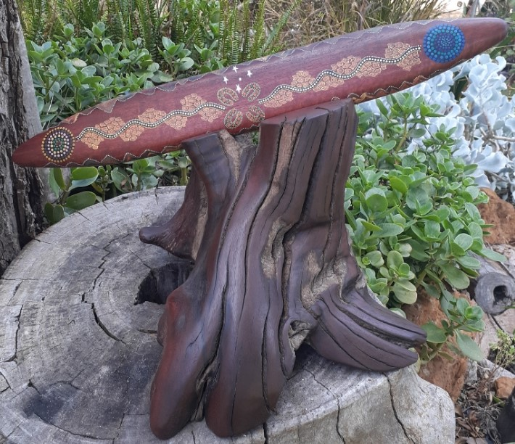

Slide 4
Together, We Build our Place (Roger Hillman)
We are called to be your hands we are called to be your feet
Called to reach out with your love to everyone we meet
Be strength to all the broken, light to all who seek your face
To walk your ways to live each day together
We build our place
Each of us has come to share our story
To share our gifts our wisdom faith and love
To celebrate the work we do together
Linked with others journeying in faith.

Slide 5
We are called to be your hands we are called to be your feet
Called to reach out with your love to everyone we meet
Be strength to all the broken, light to all who seek your face
To walk your ways to live each day together
We build our place
We meet as friends and gather at the table
Not strangers but companions in our God
To celebrate our task in faith together
A path for those who turn to “come and see”.

Slide 6
We are called to be your hands we are called to be your feet
Called to reach out with your love to everyone we meet
Be strength to all the broken, light to all who seek your face
To walk your ways to live each day together
We build our place
Each of us is called to work for justice
And walk together in God’s light and love
To recognise God’s face in every person
And work to build your kingdom here on earth.

Slide 7
We are called to be your hands we are called to be your feet
Called to reach out with your love to everyone we meet
Be strength to all the broken, light to all who seek your face
To walk your ways to live each day together
We build our place.
© Roger Hillman. 2024 All rights reserved.
Used with permission in the Diocese of Ballarat

Slide 8
Why we have gathered:
Leader:
When we celebrate a birthday, we often reflect on the years that have passed, as well as wishing the person happiness in the present and blessings for the time ahead. Celebrating the anniversary of a diocese is something like that. A community anniversary provides an occasion to reflect on the past, affirm people in the present and look hopefully to the future. We can see these elements in the themes for 150th anniversary of our Diocese of Ballarat. The word “Community” highlights the fact that a diocese is essentially a community drawn together by Christ. The word “Remember” refers us to the history of the diocese. In this remembering, we acknowledge the strengths and weaknesses of that history, celebrating the achievements and recognising the failures to live our Christian faith to the full. The word “Revitalise” calls us to invest ourselves in bringing new life to the community today. The word “Hope” encourages us to look forward to the future with confidence in God.
(Bishop Paul Bird)

Slide 9
Introduction of Message sticks:
Leader:
Today we celebrate the arrival of one of five Message Sticks that will be travelling across our Diocese in honour of 150 years.
Four of these Message Sticks will be carried from school to school to remind us of the inter-connectedness of all our school communities - from the Murray to the Sea.
In Aboriginal culture, Message Sticks were passed between different clans and language groups to establish information and transmit messages. They were often used to invite neighbouring groups to corroborees, initiation ceremonies, right of entry to country and invitation to religious rituals.

Slide 10
To mark the 150th anniversary of the birth of the Ballarat Diocese, five Message Sticks were gifted to carry the message to:
Be joyful in hope,
patient in affliction,
faithful in prayer
(Romans 12:12).
From the Murray to the Sea the Creator Spirit spoke to the Ancestors thousands of years before Abraham and Moses. The Creator Spirit touched the sacredness of country and all that had been created, gifting the Ancestors with the Law to care for country, the water ways, care for the animals and co-exist with all that has been created.
When a Message Stick is handed to you from another person, you are the custodian of an Aboriginal artefact and it should only be passed to another worthy custodian.
(Vicki Clark OAM)

Slide 11
Gathering Prayer:
Leader:
As we come together, we acknowledge those who have contributed to the journey to 150 years of our Diocese. We remember our parish community and all members of the education community – families, students, teachers, and staff and the many gifts they have shared and the hopes and dreams they have for those gathered today. We renew our commitment to the growth of all through shared stories, ideas and support of each other.
We answer the call to open our hearts and ask the Holy Spirit to help us along our different yet connected journeys in life and to help us live in harmony with one another.
Through Jesus Christ
All: Amen.

Slide 12
Penitential Rite:
Leader: The way forward is revealed in Jesus. A future of faith, hope and love, where no needy person is neglected and no bidding of the Spirit is ignored.
Reader 1: We accept all people as our friends and treat them with dignity.
Lord Have Mercy
All: Lord Have Mercy
Reader 2: We open our hearts and minds and accept the beauty in all Creation.
Christ Have Mercy
All: Christ Have Mercy
Reader 3: Our lives reflect the presence of the Holy Spirit working through us.
Lord Have Mercy
All: Lord Have Mercy

Slide 13
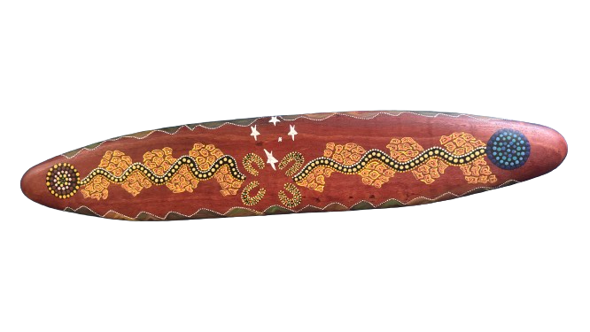
Scripture Reading:
Leader:
Today’s Scripture verse, chosen for our 150th anniversary year, talks to what a Christian community experiences. The words are drawn from a passage in St Paul’s letter to the Romans in which the apostle lists qualities appropriate for a community inspired by Christ. As the years go by, most communities experience times of difficulty as well as times of gladness. Through it all, their trust in Christ calls them to be joyful in hope and patient in affliction - in times of trial. Christian communities like our school, will recognise that they need God’s help constantly and so they will be faithful in prayer day by day.

Slide 14
A Reading from Paul to the Romans… (Romans 12: 9 – 13)
Love must be sincere.
Hate what is evil; cling to what is good.
Be devoted to one another in love.
Honor one another above yourselves.
Never be lacking in zeal, but keep your spiritual fervour, serving the Lord.
Be joyful in hope, patient in affliction, faithful in prayer.
Share with the Lord’s people who are in need.
Practice hospitality.
The Word of the Lord.
All: Thanks be to God
QUIET REFLECTION

Slide 15
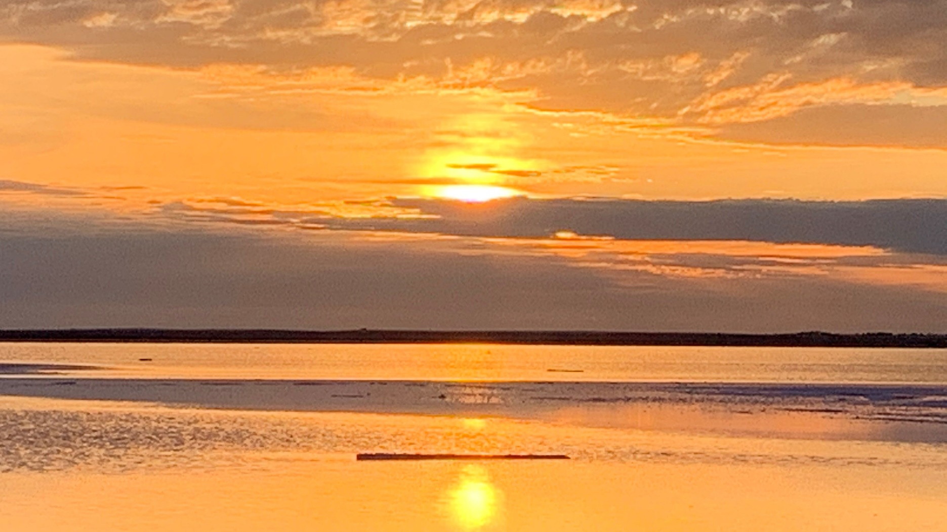

Slide 16
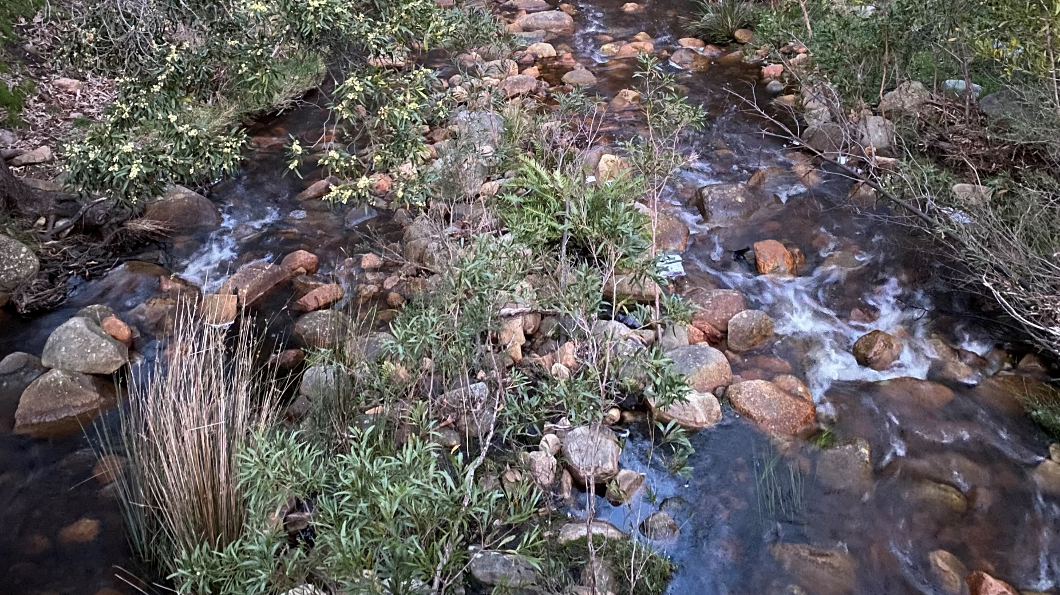

Slide 17
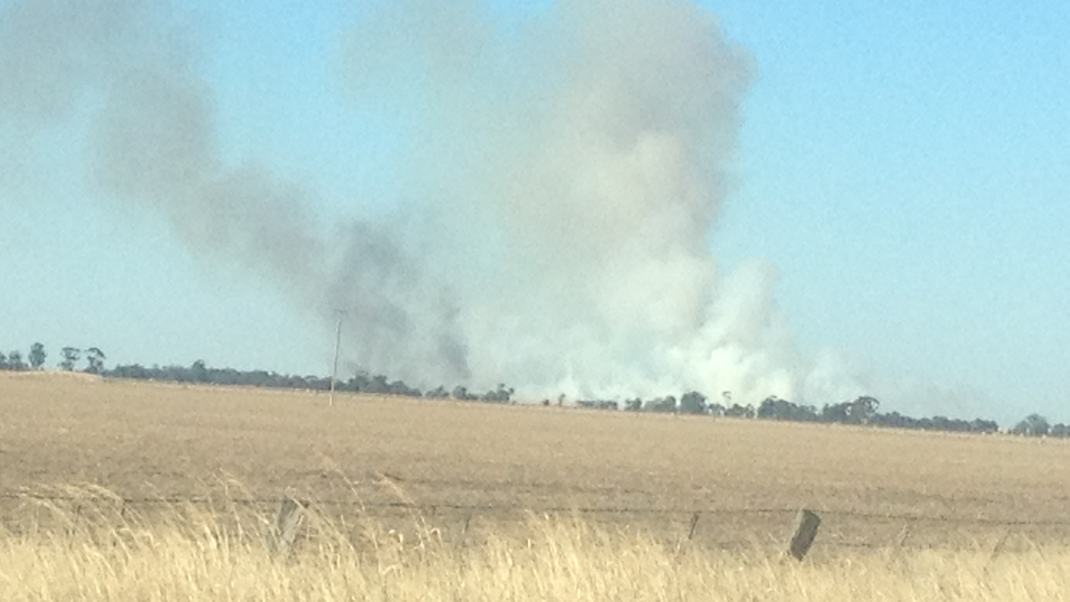

Slide 18
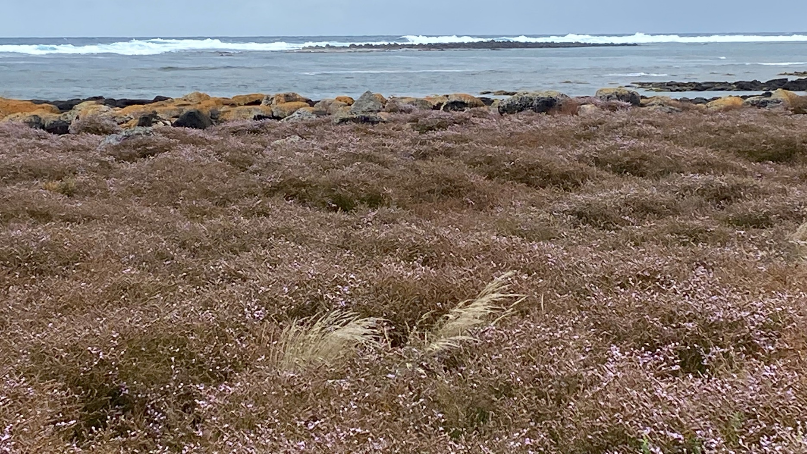

Slide 19
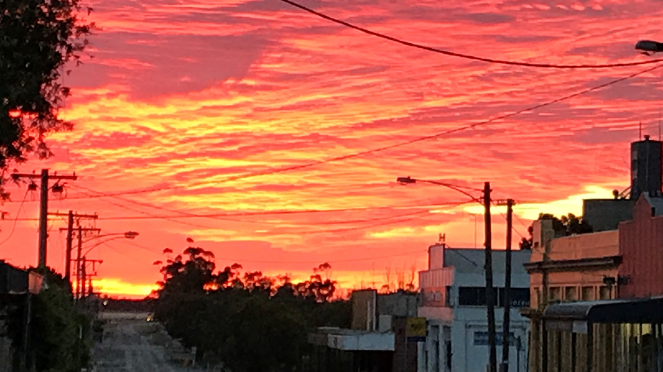

Slide 20
Presentation of Message Stick.
Reader 4:
From the Murray to the Sea, we gather on holy ground.
We gather on this ancient land, a precious gift from God.
We rejoice in every noble aspiration.
We rejoice in the pursuit of fullness of life for all.
We pain in the ongoing struggle of First Nations Peoples,
Who were dispossessed of land, country, language and culture.

Slide 21
Reader 5:
We believe in God’s compassion.
We believe in resurrection, in mutual uplifting.
We believe in God’s steadfast love.
The sending out and bringing together of Message Sticks
is a ritual that is millennia old.
Symbols of connection;
Then symbols of disconnect;
Then connection again.

Slide 22
Reader 6:
The ritual of the Message Stick
is equally important to First Nations Peoples today.
We still bring them together;
And we still send them out.
Similarly, all of us from St*****’s School
Are sent forth as messengers of love to share the Word of God.

Slide 23
Leader:
There are five message sticks.
The Mother Stick, likened to God’s Word, is always central to our journey and will be kept in the DOBCEL main office. It is the constant to which each of the other four Message Sticks is connected. Through the Mother Stick we acknowledge our Creator God for our connections to country, our connections to people, and our connections to all living things.
Each of the smaller Message Sticks represents the connections of each of our school communities across the diverse geography of the Diocese:

Slide 24
Reader 7: As the sun rises in the East with the promise of a new day, so Christ is our guiding light throughout the day, so that we can look forward in hope.
Reader 8: We look to the West with hopes and dreams of peace to move into our future. From the west comes the promise of gentle sleep, reflection, contentment and rest from our labour.
Reader 9: The North represents the wisdom of the ancient sources from the past. The land is like the scriptures in that it speaks to us through sacred stories and signs. Wisdom comes through reflection.
Reader 10: The South represents truth from within, insights from the stories, the teachings, the history and the ceremonies. The insights reveal the presence of the Creator Spirit. The Southern Cross hangs over Australia in blessing and protection of our nation.

Slide 25
Leader:
Creator Spirit, Source of all Life, we ask that you guide the custodians of each Message Stick.
As the Message Stick is passed on, may your Spirit and those of our ancestors, stay with them, as the Message Stick continues its journey in trust and hope.

Slide 26
ALL:
For all who walk this land:
May we always stand as tall as a tree
Be as gentle as the morning mist, and
as strong as the earth under our feet.
May the warmth of the campfire be in each of us,
And may the Creator Spirit, Source of all Life, always watch over us.
Amen. (Betty Pyke)

