Slide 1
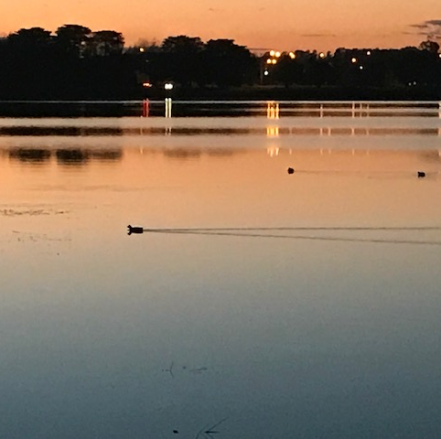

Finding God in All Things
St. Ignatius of Loyola

Slide 2

Acknowledgement of Country
Today we stand in footsteps millennia old.
We acknowledge the traditional custodians of the land on which we live and work, whose culture and customs have nurtured, these lands, since men and women awoke from the great dream. We honour the presence of the ancestors who reside in the imagination of this land and whose irrepressible spirituality flows through all creation.
As part of the Diocesan educational community, we recommit to hope, justice, peace and reconciliation for all.

Slide 3
Invitation to Prayer…
Let us be still and become aware, aware of how we are today. Take a moment for yourself, become aware of your breathing. Aware of what your body is telling you.
Each of us and our families has our own sacred stories, we bring our stories and lived experience to this place today, all stories are welcome, some of us may be in faith, some may not, others may be a faith other than Christian, every single person’s story and lives are sacred.
From a Catholic Christian perspective all of humanity reflects the Image of God. We treasure and celebrate each of our unique stories. Our richness.
During this time, you are invited into a time of contemplation, a time for space.
Everyone is most welcome to join prayer. This may be in silence, or in a way that is guided by your own spirit.

Slide 4
St. Ignatius of Loyola
St. Ignatius of Loyola’s Feast Day is 31st July
Ignatius had a famous saying of ‘finding God in all things”
As we gather for prayer, I invite you to take your phone out and scroll through your photos for a moment – through your photos maybe you are reminded of the presence of God, that is finding God in the ups and downs of your life.
(Pause the presentation allowing participants to look through their photos)

Slide 5
Our prayer today
Through the remainder of our prayer, we have images from across the Diocese.
Each of these images may reveal to you something of God.
There is a quote from St. Ignatius on each slide that I invite you to read as we progress through each slide.

Slide 6
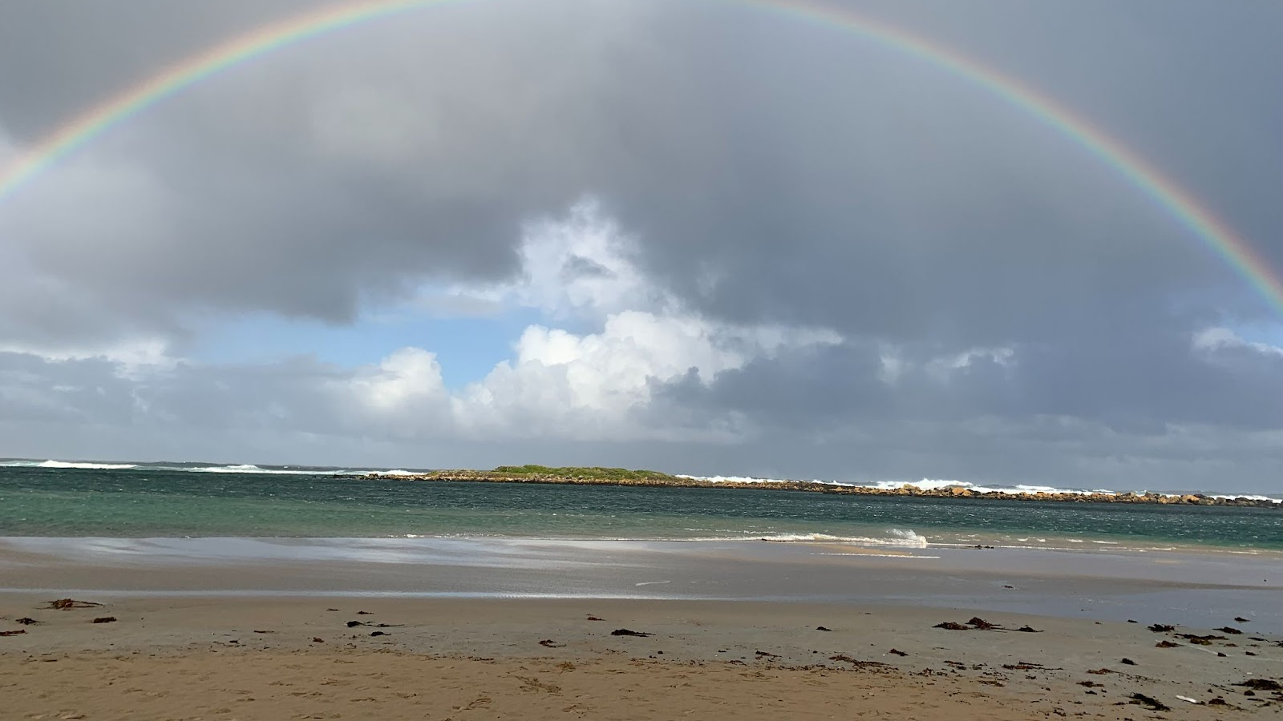
“Laugh and grow strong.”
St. Ignatius of Loyola

Slide 7
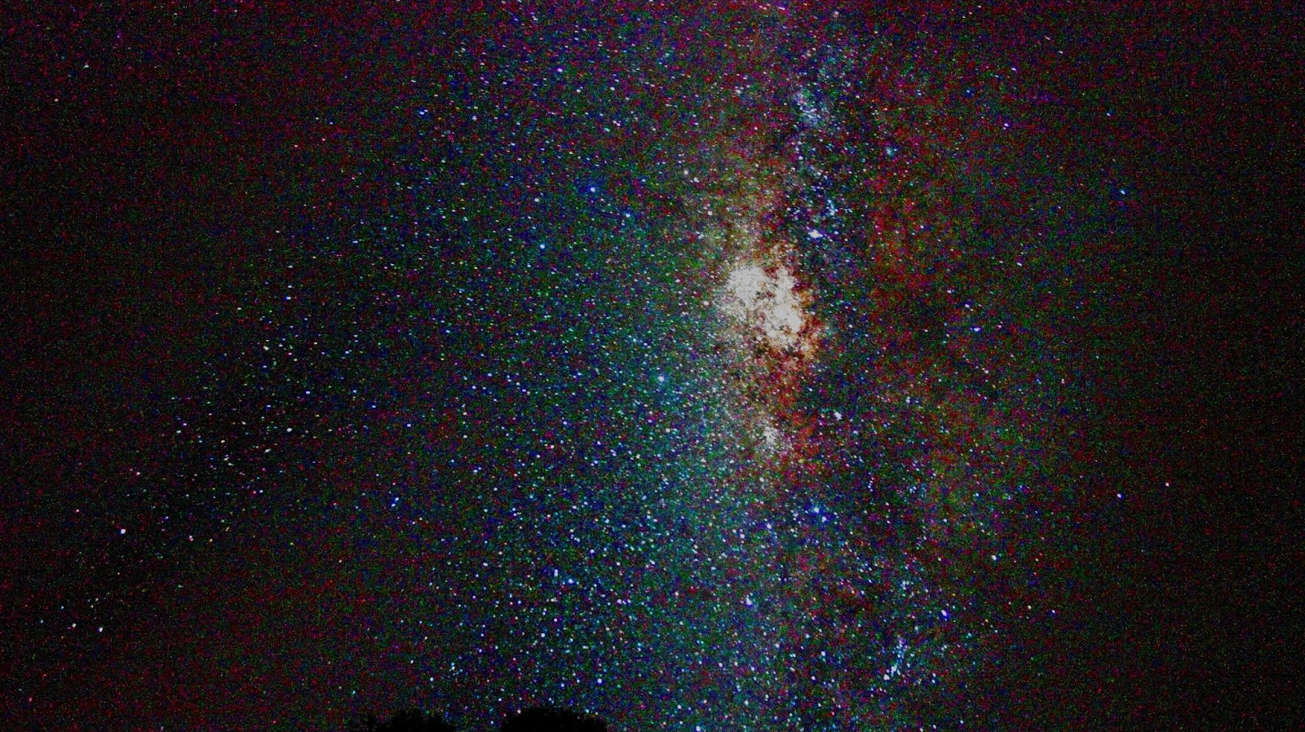
“Love ought to show itself in deeds more than in words.”
St. Ignatius of Loyola

Slide 8
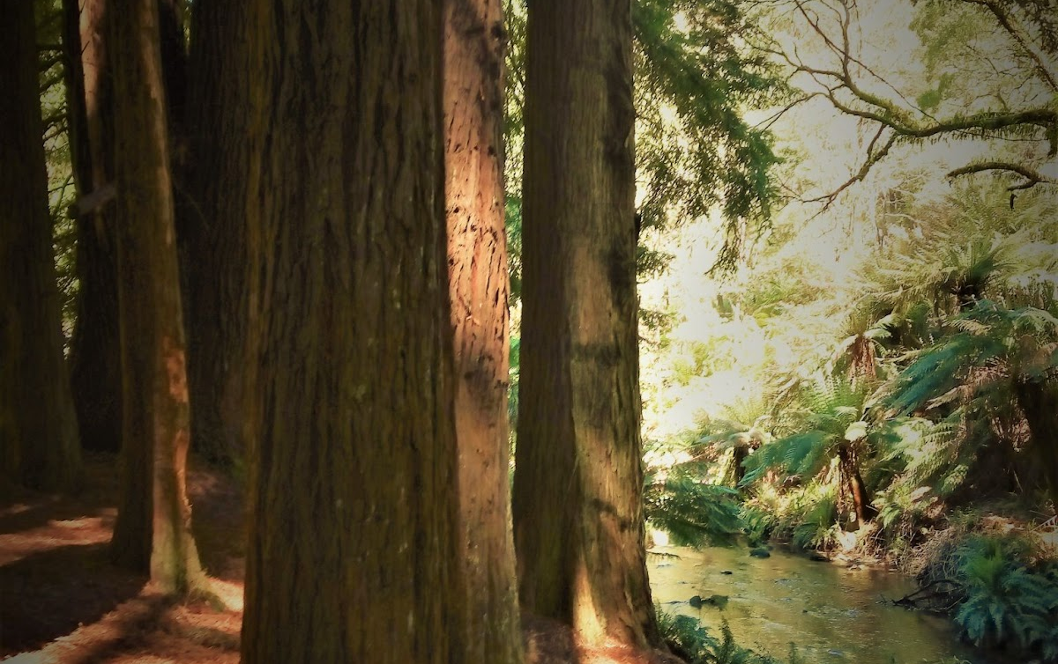
“God gives each one of us sufficient grace”
St. Ignatius of Loyola

Slide 9
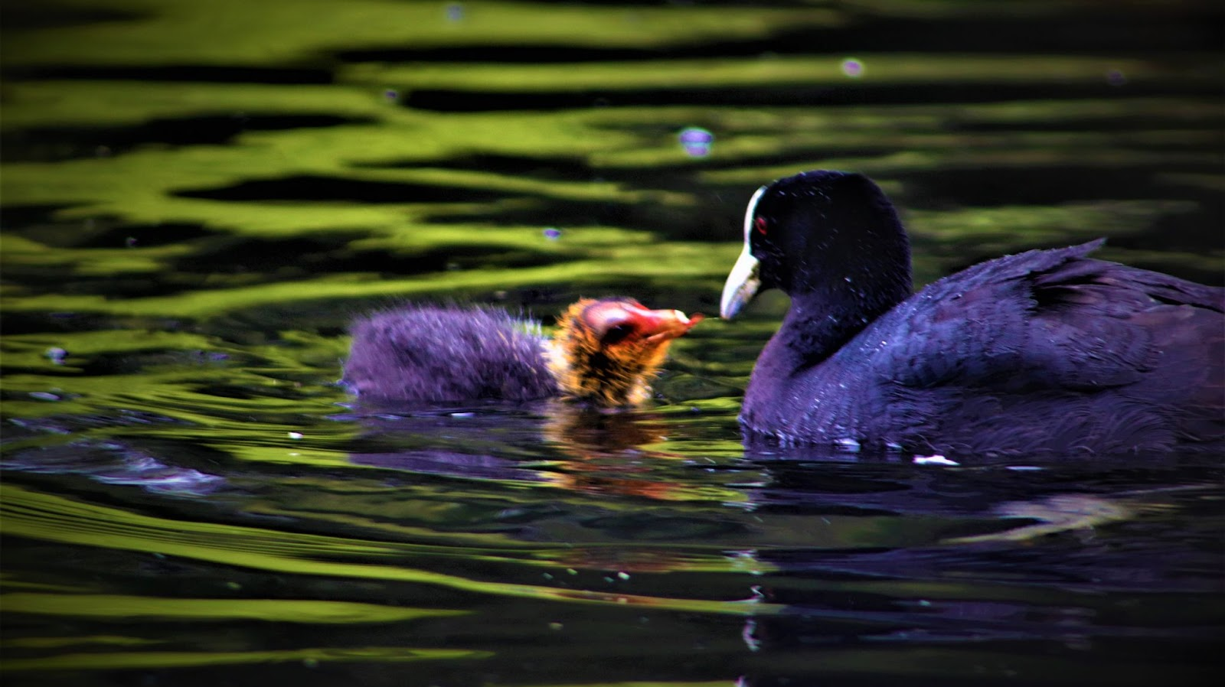
“For those who love, nothing is too difficult,
especially when it is done in love. ”
St. Ignatius of Loyola

Slide 10
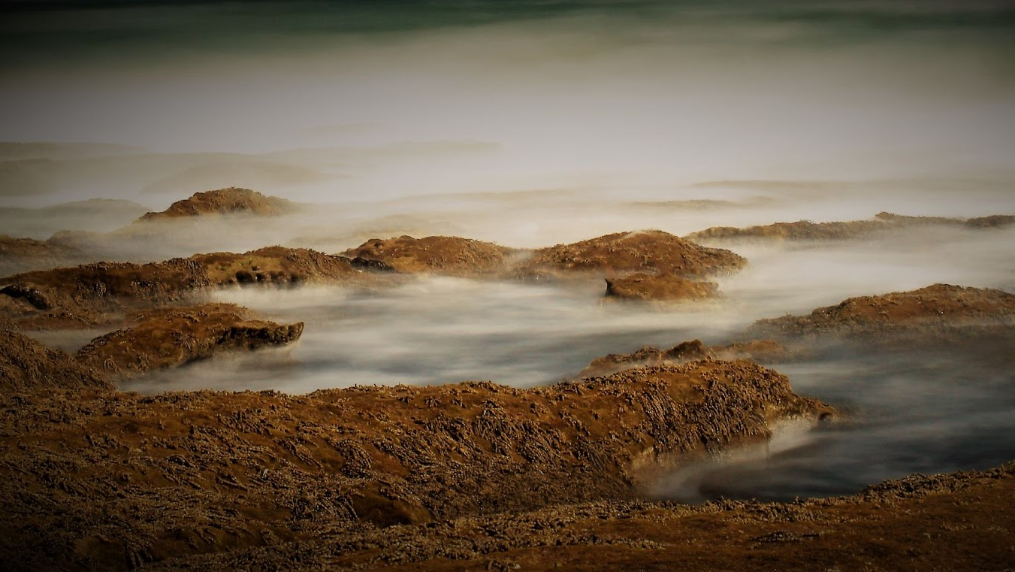
“God will not be outdone in generosity.”
St. Ignatius of Loyola

Slide 11
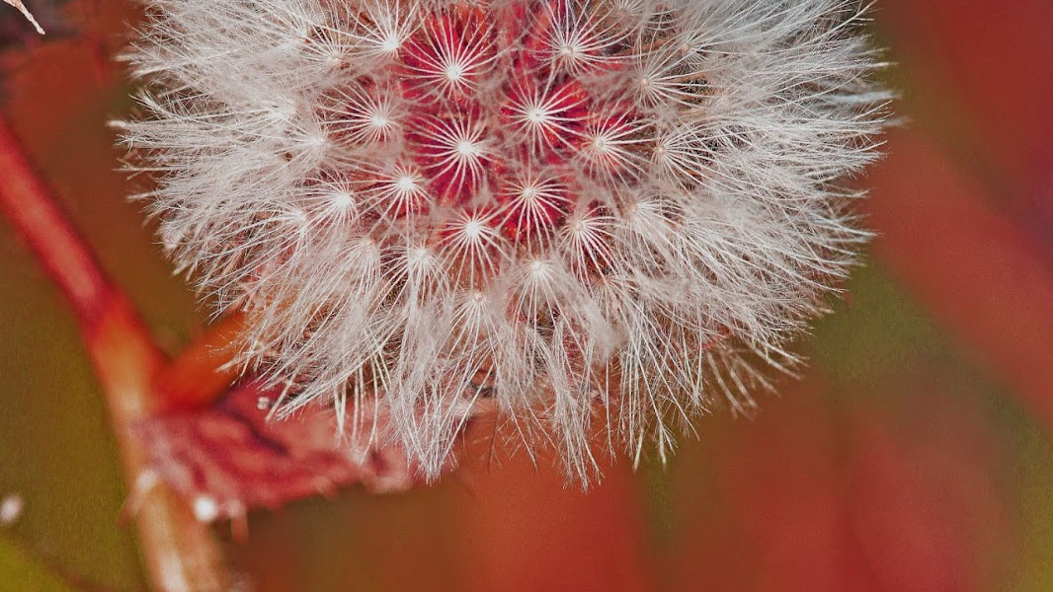
“All the things in this world are gifts of God”
St. Ignatius of Loyola

Slide 12
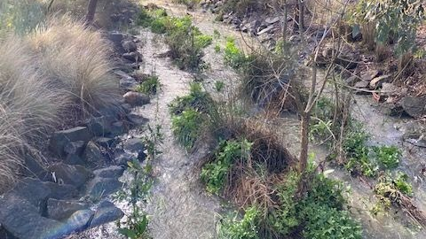
“Whatever you are doing, that which makes you feel the most alive...that is where God is.”
St. Ignatius of Loyola

Slide 13
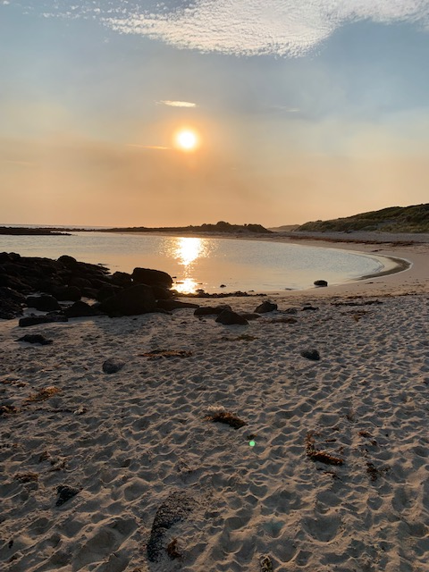
“Act as if everything depended on you; trust as if everything depended on God.”
St Ignatius of Loyola

Slide 14
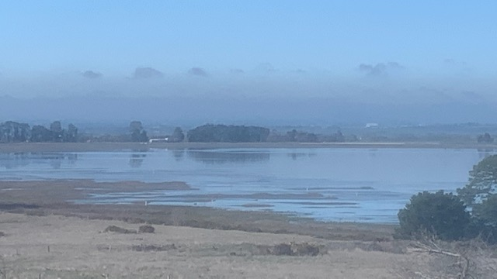
“Love is shown more in deeds than in words.”
St. Ignatius of Loyola

Slide 15
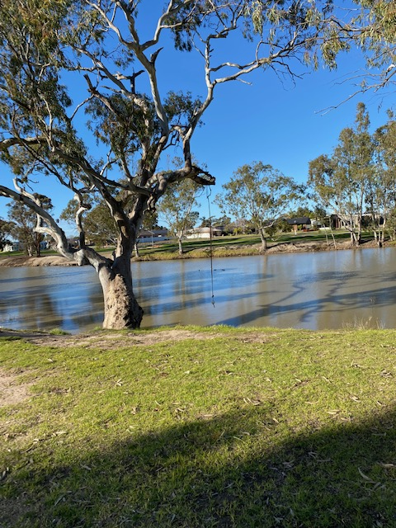
“The glory of God is humankind fully alive..”
St. Ignatius of Loyola

Slide 16
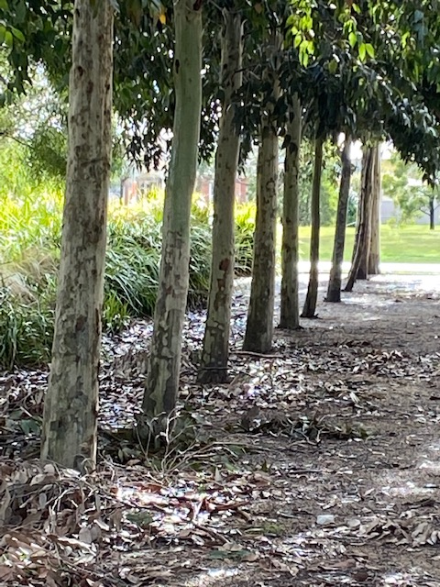
“Discouragement is not from God”
St. Ignatius of Loyola

Slide 17
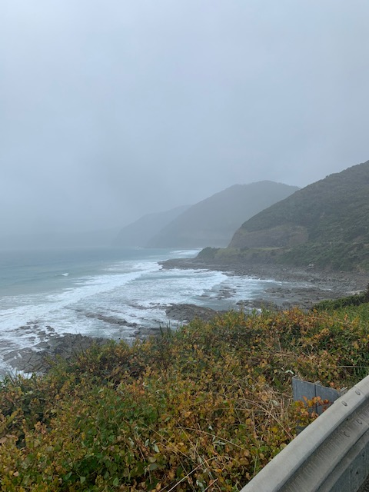
“Lord, teach me to be generous;.”
St. Ignatius of Loyola

Slide 18
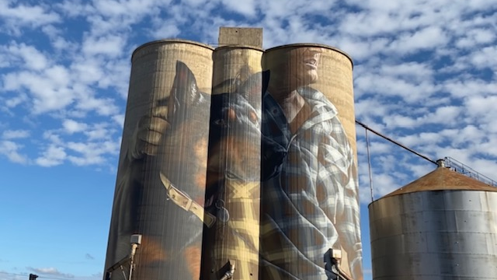
“For those who love, nothing is too difficult.”
St. Ignatius of Loyola

Slide 19
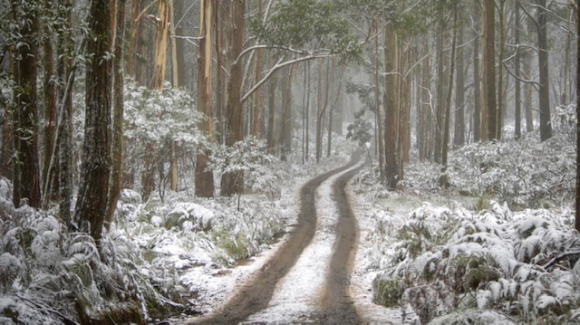
“Pray as if God will take care of all; act as if all is up to you.”
St. Ignatius of Loyola

Slide 20
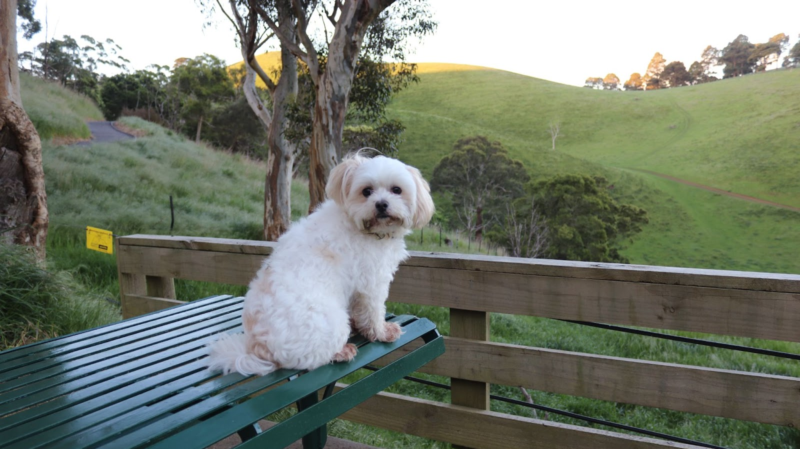
“Teach us to give and not to count the cost.”
St. Ignatius of Loyola

Slide 21
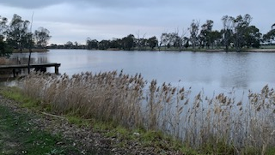
"If our church is not marked by caring for the poor, the oppressed, the hungry, we are guilty of heresy.”
St. Ignatius of Loyola

Slide 22
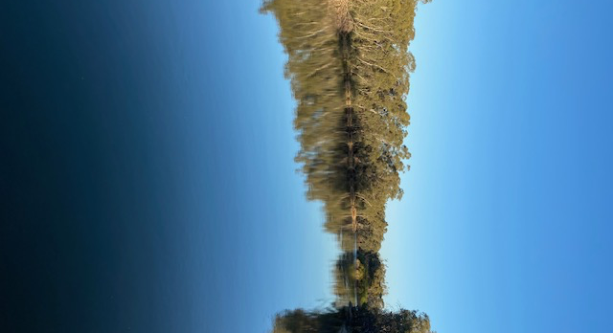
“Go forth and set the world on fire.”
St. Ignatius of Loyola

Slide 23
In this presentation….
Photos contributed by Gabrielle O’Brien & Jim Waight
Music from https://www.bensound.com/

