Slide 1
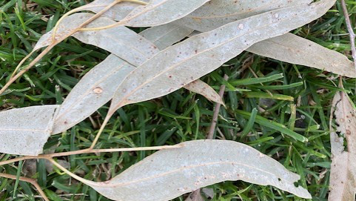
ADVENT 2024
Communities of
HOPE
PEACE
JOY
LOVE

Slide 2
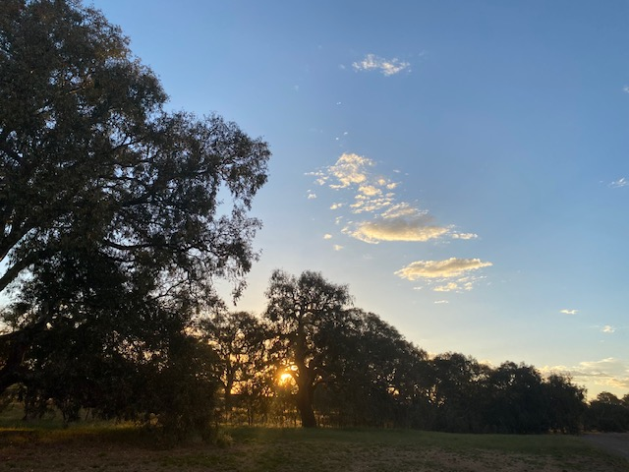
WEEK ONE
COMMUNITIES OF HOPE

Slide 3
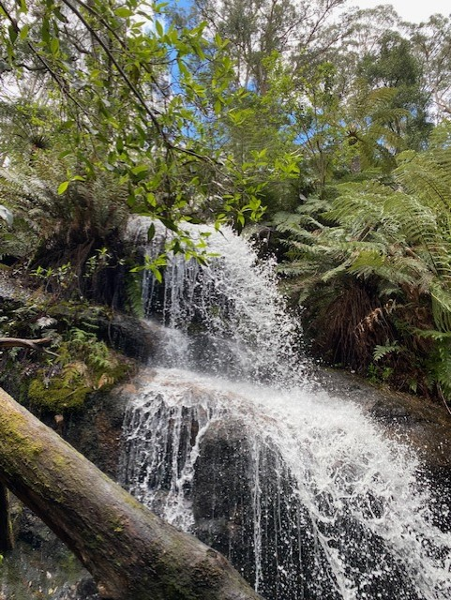
Holy Spirit, we call upon your divine guidance, wisdom, and blessings for those gathered here today.
We express our reverence for the traditional custodians of this land, both past and present, acknowledging their heritage and connection, weaved into the fabric of this community, and land we now call our home.
As we reflect on the footsteps of those before us, and the generations who will follow in our wake, may our path be one of thoughtfulness and respect, bound together by God’s love and united one in land, one in Spirit, and one in Faith.
Open our hearts to the needs of others, nurturing the bonds of this community with empathy and respect for all. Lead us along a path of reconciliation and mutual understanding, as we pray to hear voices in the community that are not heard.
Help us to be courageous as Jesus calls us to be, as we strive to promote the common good, uphold the dignity of every person and support the less fortunate and unfavourable.
We offer this prayer, trusting that you will inspire us to be instruments of peace and unity.
Through Christ our Lord,
Amen.
From CDF Melbourne with Sherry Balcombe

Slide 4
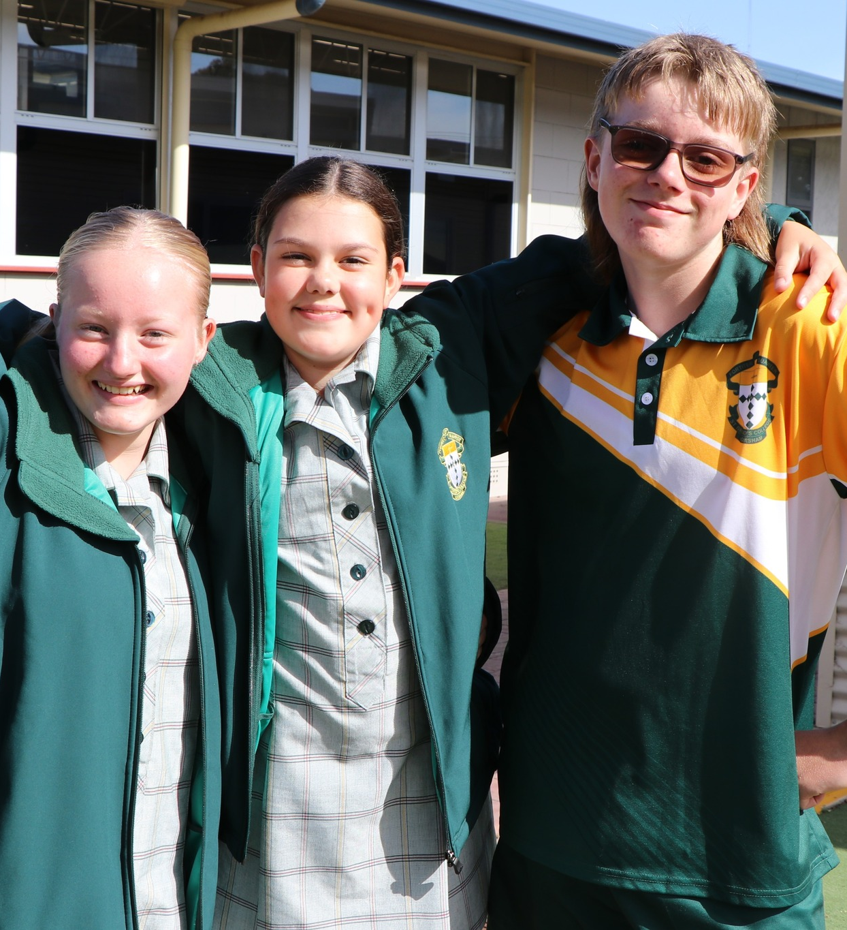
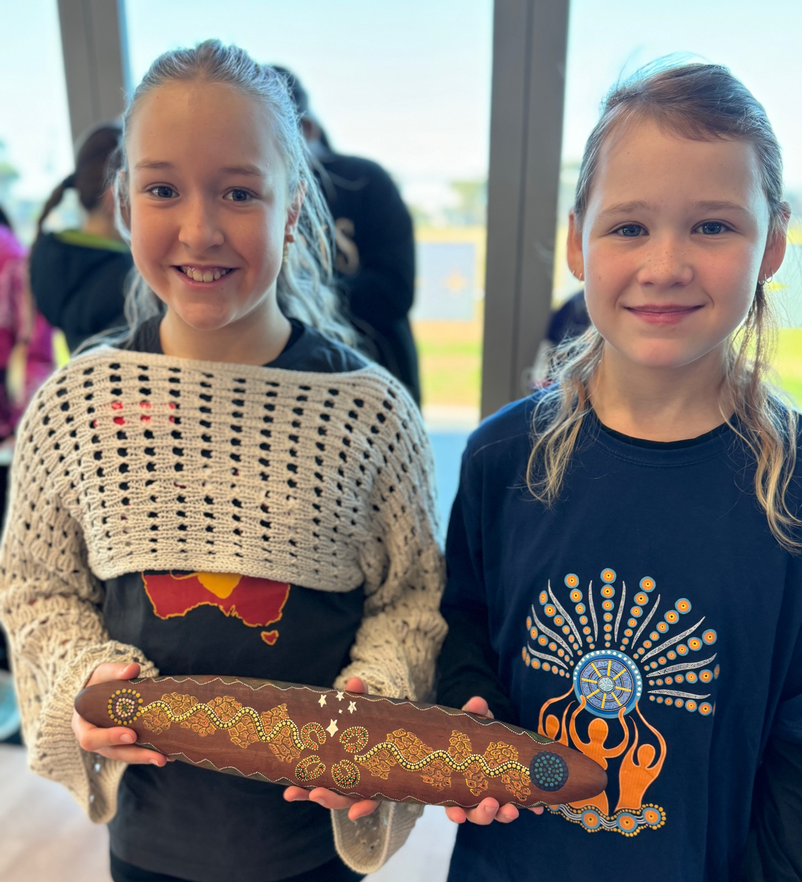
What do you see in these photos?
How could these images be connected to this week’s theme of hope?
Close your eyes and imagine your own hope filled scene.

Slide 5
Opening Prayer
God of Hope - Cameron Bellm
When our lofty words of love have been emptied of their meaning,
When our borders and computer screens have erected impenetrable walls,
When our minds are so quick to conflate "other" with "enemy,"
How will we find our common humanity?
It's never too late to make an earnest and tender start.
May we remove from our pockets the stones we intended to throw
And cement them together to build a home that welcomes all.
May we repent of our indifference and move into genuine encounter.
Instead of drawing battle lines,
May we draw our chairs up to a communal table,
Where we can feast in the knowledge of our shared dignity.
May God grant us the holy vision
To see every human being a sacred mystery,
And may we love each mystery not abstractly, but concretely.
Just as The Holy Family lived in fear, so do many today.
May we be unafraid to recommit to our suffering neighbours this Advent.
May we lay down our arms and offer our outstretched hands,
Until there is no "them," but only "us,"
Until we are at last one.
Then indeed Emmanuel, God with us, will be.
Amen
c

Slide 6
Luke 21:25-36
He told them this parable: “Look at the fig tree and all the trees. When they sprout leaves, you can see for yourselves and know that summer is near. Even so, when you see these things happening, you know that the kingdom of God is near."

Slide 7
Choose one of the following words from the text, or one of your own.
SEE NEAR
SPROUT
LOOK
TELL
Use the word as a mantra repeating it for yourself in silence for one minute

Slide 8
A Blessing of Hope
Hope that knows
how to holler
when it is called for,
Hope that knows
how to sing
when there seems
little cause,
Hope that raises us
from the dead—
Not someday
but this day,
every day,
again and
again and
again.
—Jan Richardson
from The Cure for Sorrow: A Book of Blessings for Times of Grief
So may we know
the hope
that is not just
for someday
but for this day—
here, now,
in this moment
that opens to us:
Hope not made
of wishes
but of substance,
Hope made of sinew
and muscle
and bone,
Hope that has breath
and a beating heart,
Hope that will not
keep quiet
and be polite,

Slide 9
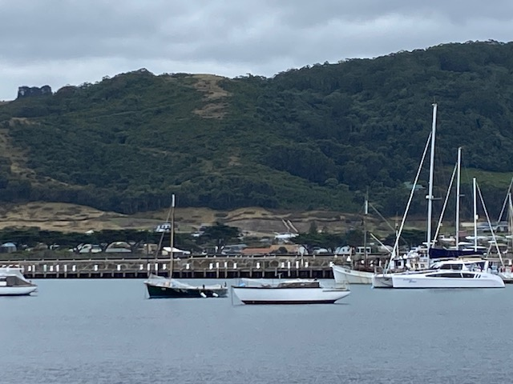
WEEK TWO
COMMUNITIES OF PEACE

Slide 10
Holy Spirit, we call upon your divine guidance, wisdom, and blessings for those gathered here today.
We express our reverence for the traditional custodians of this land, both past and present, acknowledging their heritage and connection, weaved into the fabric of this community, and land we now call our home.
As we reflect on the footsteps of those before us, and the generations who will follow in our wake, may our path be one of thoughtfulness and respect, bound together by God’s love and united one in land, one in Spirit, and one in Faith.
Open our hearts to the needs of others, nurturing the bonds of this community with empathy and respect for all. Lead us along a path of reconciliation and mutual understanding, as we pray to hear voices in the community that are not heard.
Help us to be courageous as Jesus calls us to be, as we strive to promote the common good, uphold the dignity of every person and support the less fortunate and unfavourable.
We offer this prayer, trusting that you will inspire us to be instruments of peace and unity.
Through Christ our Lord,
Amen.
From CDF Melbourne with Sherry Balcombe

Slide 11

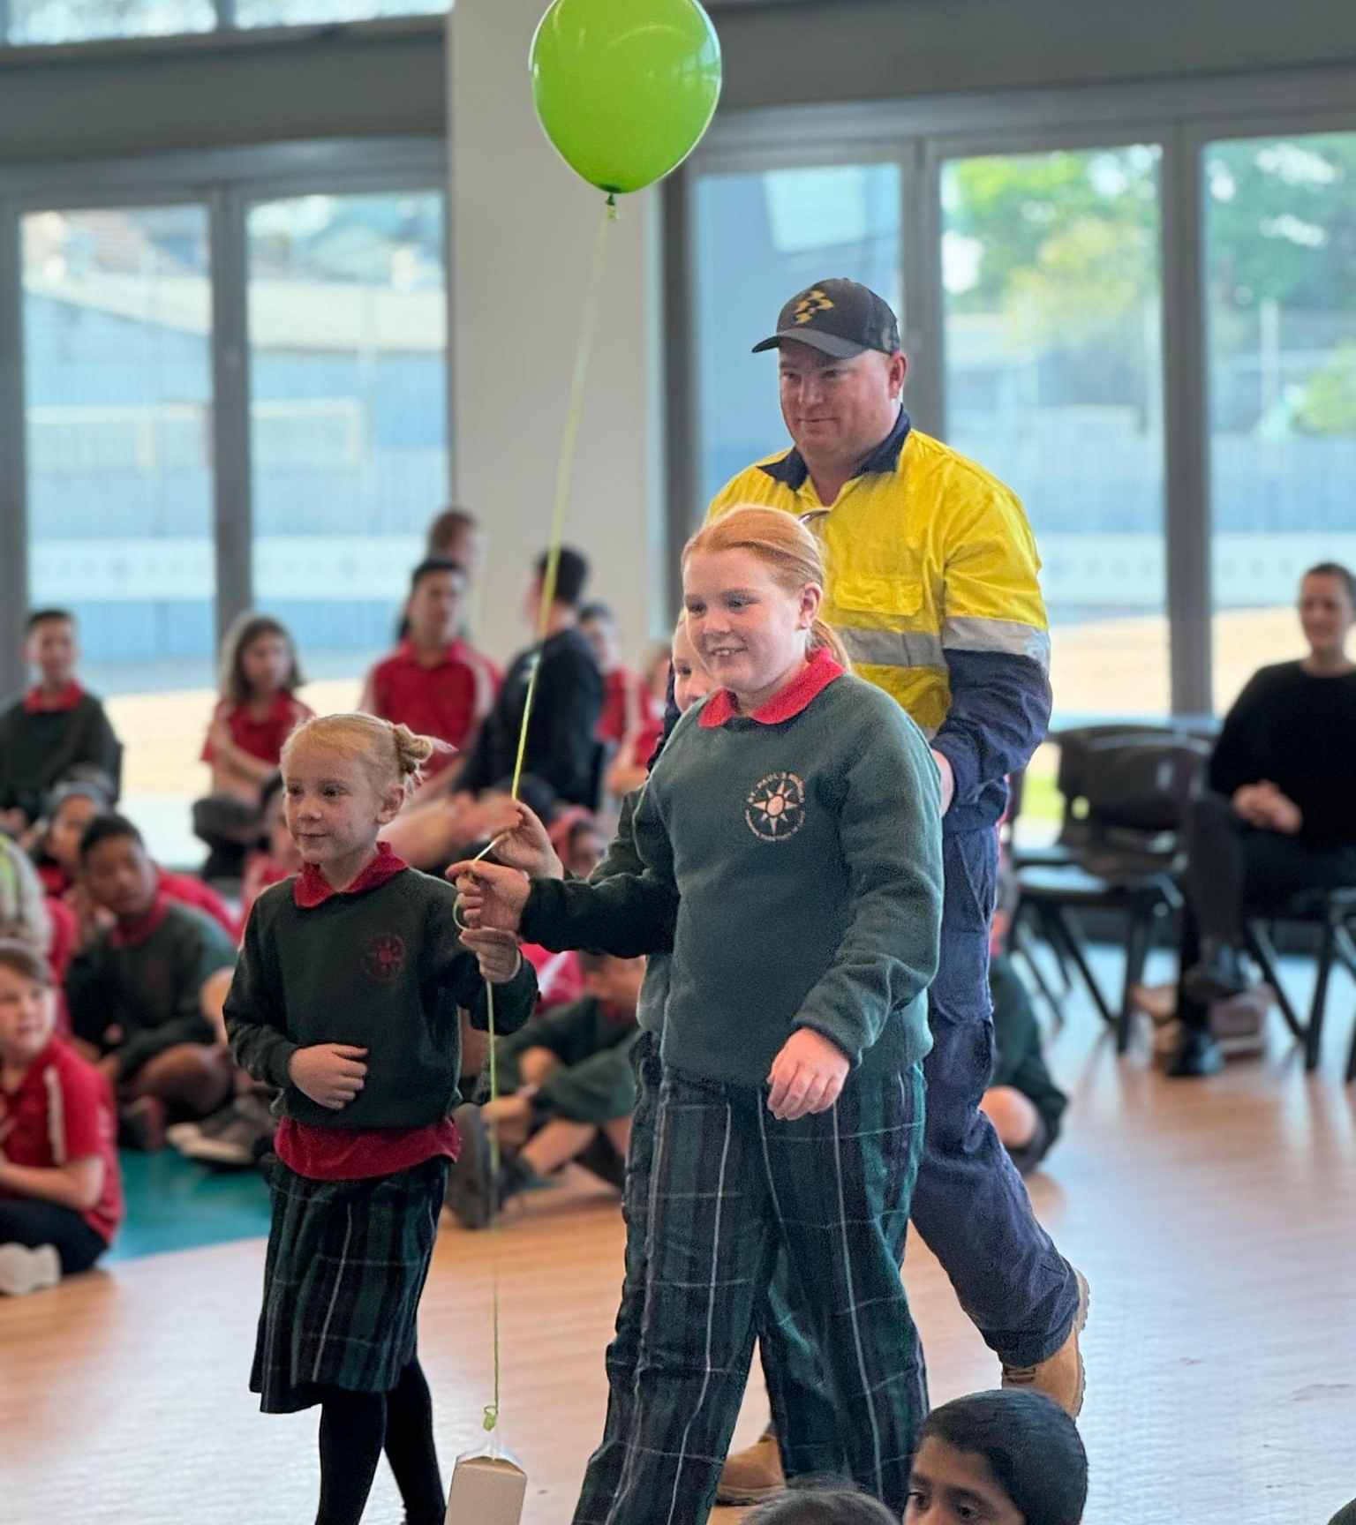
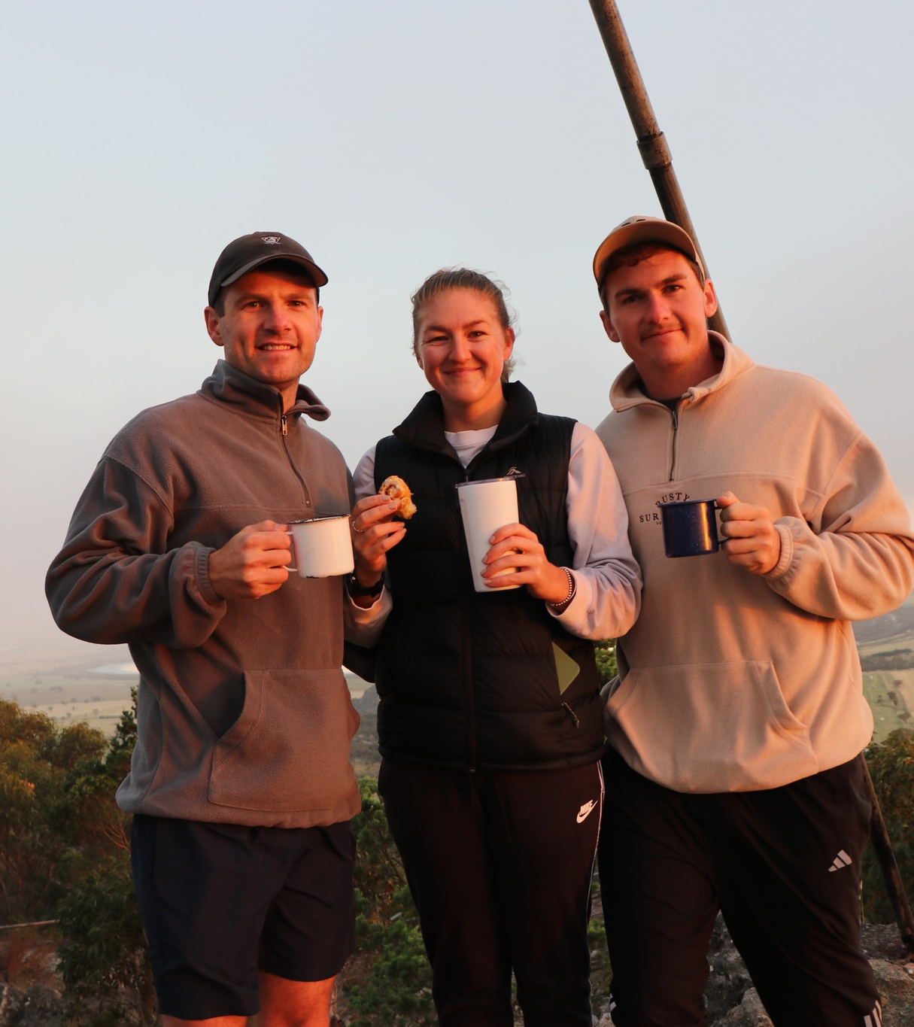
What do you see in these photos?
How could these images be connected to this week’s theme of peace?
Close your eyes and imagine your own peace filled scene.

Slide 12
Opening Prayer
God of All Creation
We bow to the sacred in all creation.
May our sprits fill the world with beauty and wonder.
May our minds seek truth with humility and openness.
May our hearts forgive without limit.
May our love for friend, enemy, and outcast be without measure.
May our needs be few and our living simple.
May our actions bear witness to the suffering of others.
May our hands never harm a living being.
May our steps stay on the journey of justice.
May our tongues speak for those who are poor without fear of the powerful.
May our prayers rise with patient discontent until no child is hungry.
May our life's work be a passion for peace and nonviolence.
May our soul rejoice in the present moment.
May our imagination overcome death and despair with new possibility.
And may we risk reputation, comfort, and security to bring this hope to all creation, as the babe of Bethlehem did.
Amen
Adapted from Mary Lou Kownacki, OSB

Slide 13
Luke 3:4-6
'A voice of one calling in the wilderness,
"Prepare the way for the Lord,
make straight paths for him.
Every valley shall be filled in,
every mountain and hill made low.
The crooked roads shall become straight,
the rough ways smooth.
And all people will see God’s salvation.”'

Slide 14
Choose one of the following words from the text, or choose one of your own.
VOICE
CALLING
Use the word as a mantra repeating it for yourself in silence for one minute
PEOPLE
ALL
PREPARE

Slide 15
A Blessing
To all that is chaotic in you, let there come silence.
Let there be a calming of the clamouring, a stilling of the voices that have laid their claim on you, that have made their home in you, that go with you even to the holy places but will not let you rest, will not let you hear your life with wholeness or feel the grace that fashioned you.
Let what distracts you cease. Let what divides you cease. Let there come an end to what diminishes and demeans, and let depart all that keeps you in its cage.
Let there be an opening into the quiet that lies beneath the chaos, where you find the peace you did not think possible and see what shimmers within the storm.
Amen
“Blessings in the Chaos” by Jan Richardson

Slide 16
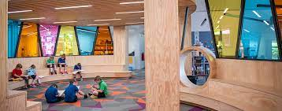
WEEK THREE
COMMUNITIES OF JOY

Slide 17
Holy Spirit, we call upon your divine guidance, wisdom, and blessings for those gathered here today.
We express our reverence for the traditional custodians of this land, both past and present, acknowledging their heritage and connection, weaved into the fabric of this community, and land we now call our home.
As we reflect on the footsteps of those before us, and the generations who will follow in our wake, may our path be one of thoughtfulness and respect, bound together by God’s love and united one in land, one in Spirit, and one in Faith.
Open our hearts to the needs of others, nurturing the bonds of this community with empathy and respect for all. Lead us along a path of reconciliation and mutual understanding, as we pray to hear voices in the community that are not heard.
Help us to be courageous as Jesus calls us to be, as we strive to promote the common good, uphold the dignity of every person and support the less fortunate and unfavourable.
We offer this prayer, trusting that you will inspire us to be instruments of peace and unity.
Through Christ our Lord,
Amen.
From CDF Melbourne wit Sherry Balcombe

Slide 18
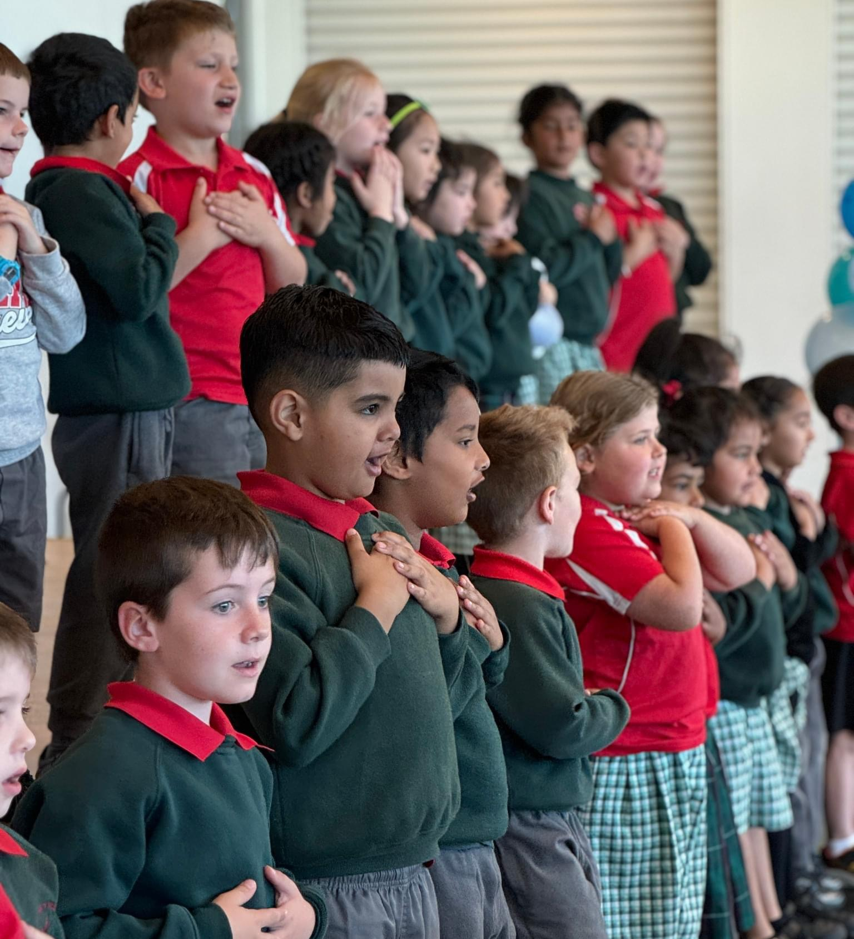
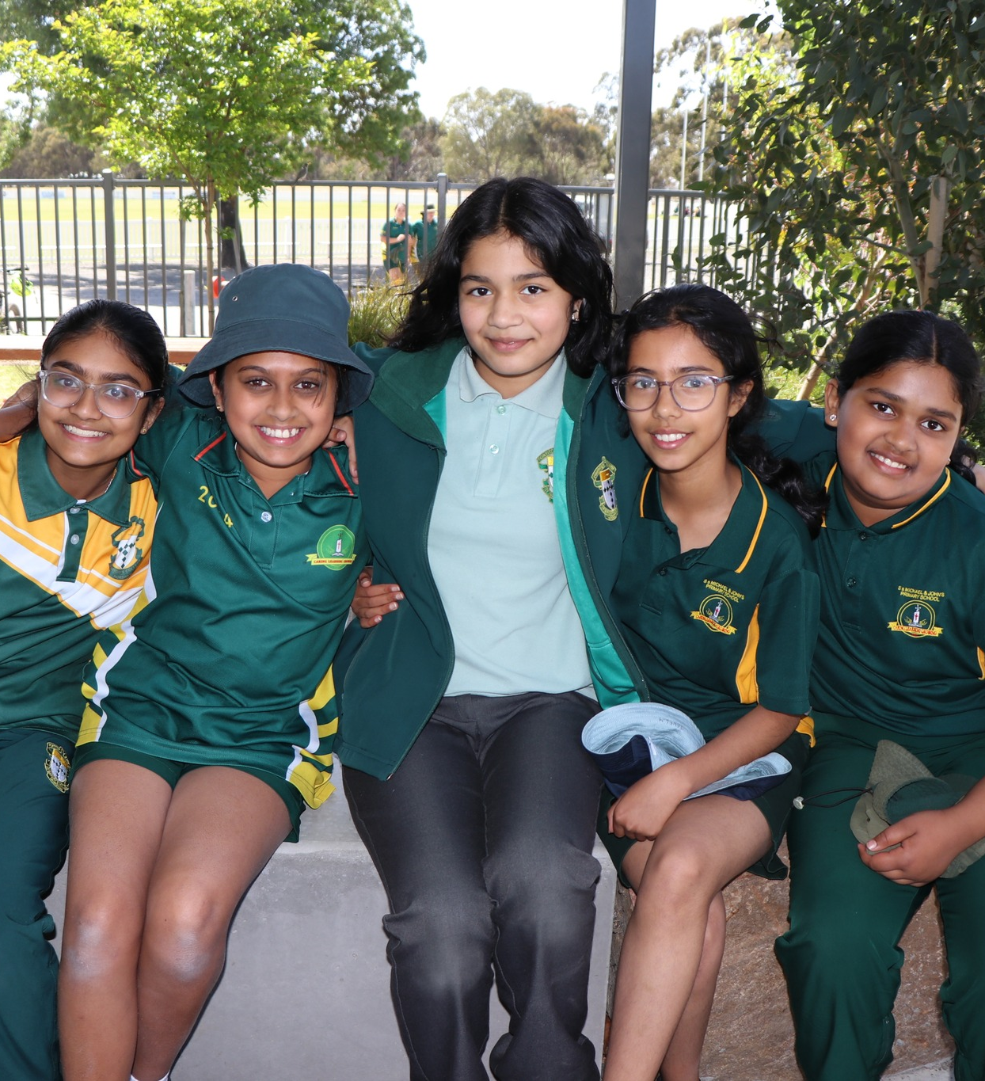
What do you see in these photos?
How could these images be connected to this week’s theme of joy?
Close your eyes and imagine your own joy filled scene.

Slide 19
This Third Week of Advent
May the God of joy be with us, thrilling us with God's nearness,
filling our hearts to fullness, and filling our throats with laughter and song.
May our joy bring life and joy to others.
May the blessing of joy be with us always.
May the God of love be with us.
May our lives be continual, giving and receiving of love with our God,
our friends, and with all whose lives we touch.
May God's love in us light fires of faith and hope,
and may the fire grow and burn deeply and enflame the earth.
May the blessing of love and friendship be with us always.
Amen
Author unknown

Slide 20
Luke 3:7-18
The people were waiting expectantly and were all wondering in their hearts if John might possibly be the Messiah. John answered them all, “I baptise you with water. But one who is more powerful than I will come, the straps of whose sandals I am not worthy to untie. He will baptize you with the Holy Spirit and fire. His winnowing fork is in his hand to clear his threshing floor and to gather the wheat into his barn, but he will burn up the chaff with unquenchable fire.” And with many other words John exhorted the people and proclaimed the good news to them.

Slide 21
Choose one of the following words from the text, or one of your own.
WAITING
EXPECTANCY
PROCLAIMED
GOOD
NEWS
Use the word as a mantra repeating it for yourself in silence for one minute

Slide 22
A Blessing of Joy
That not matter how long
it seems absent,
no matter how quiet
it becomes,
joy has never been far from us,
holding a space
of celebration,
watching us,
humming as it
keeps vigil.
May this Advent may we bring this joy to birth.
Amen
Adapted from Jan Richardson
The Cure for Sorrow: A Book of Blessings for Times of Grief
This blessing wanted
to open our eyes
to the joy that lives
in such strange company
with sorrow –
Wanted to make sure
to tell us,
In case we forget,

Slide 23
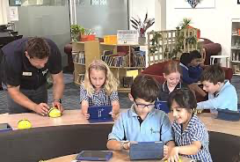
WEEK FOUR
COMMUNITIES OF LOVE

Slide 24
Holy Spirit, we call upon your divine guidance, wisdom, and blessings for those gathered here today.
We express our reverence for the traditional custodians of this land, both past and present, acknowledging their heritage and connection, weaved into the fabric of this community, and land we now call our home.
As we reflect on the footsteps of those before us, and the generations who will follow in our wake, may our path be one of thoughtfulness and respect, bound together by God’s love and united one in land, one in Spirit, and one in Faith.
Open our hearts to the needs of others, nurturing the bonds of this community with empathy and respect for all. Lead us along a path of reconciliation and mutual understanding, as we pray to hear voices in the community that are not heard.
Help us to be courageous as Jesus calls us to be, as we strive to promote the common good, uphold the dignity of every person and support the less fortunate and unfavourable.
We offer this prayer, trusting that you will inspire us to be instruments of peace and unity.
Through Christ our Lord,
Amen.
From CDF Melbourne with Sherry Balcombe

Slide 25
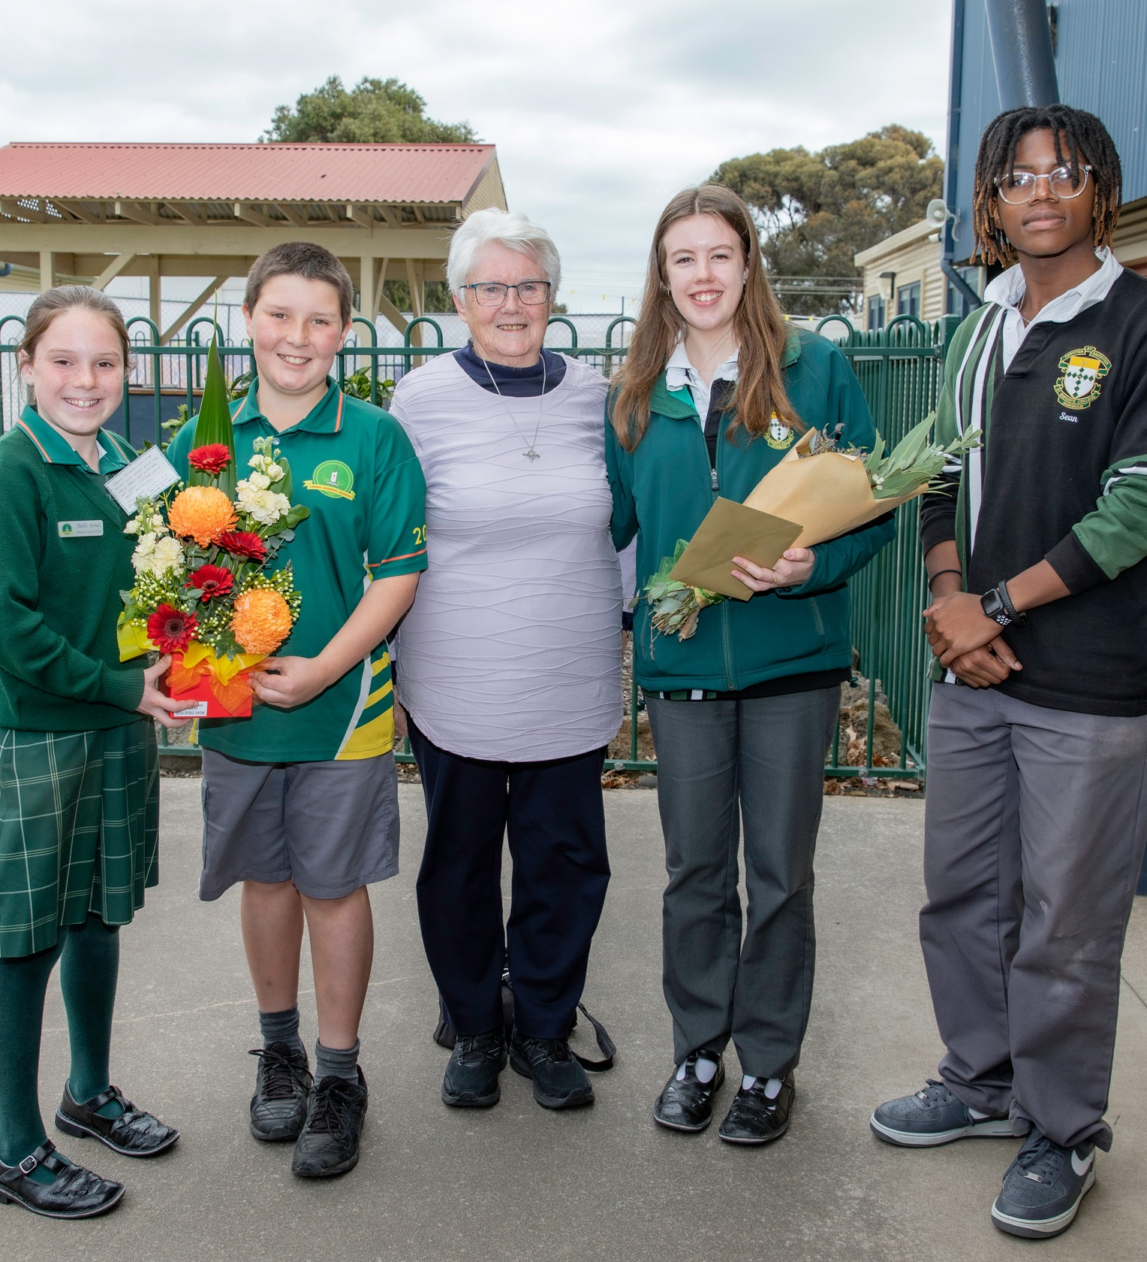
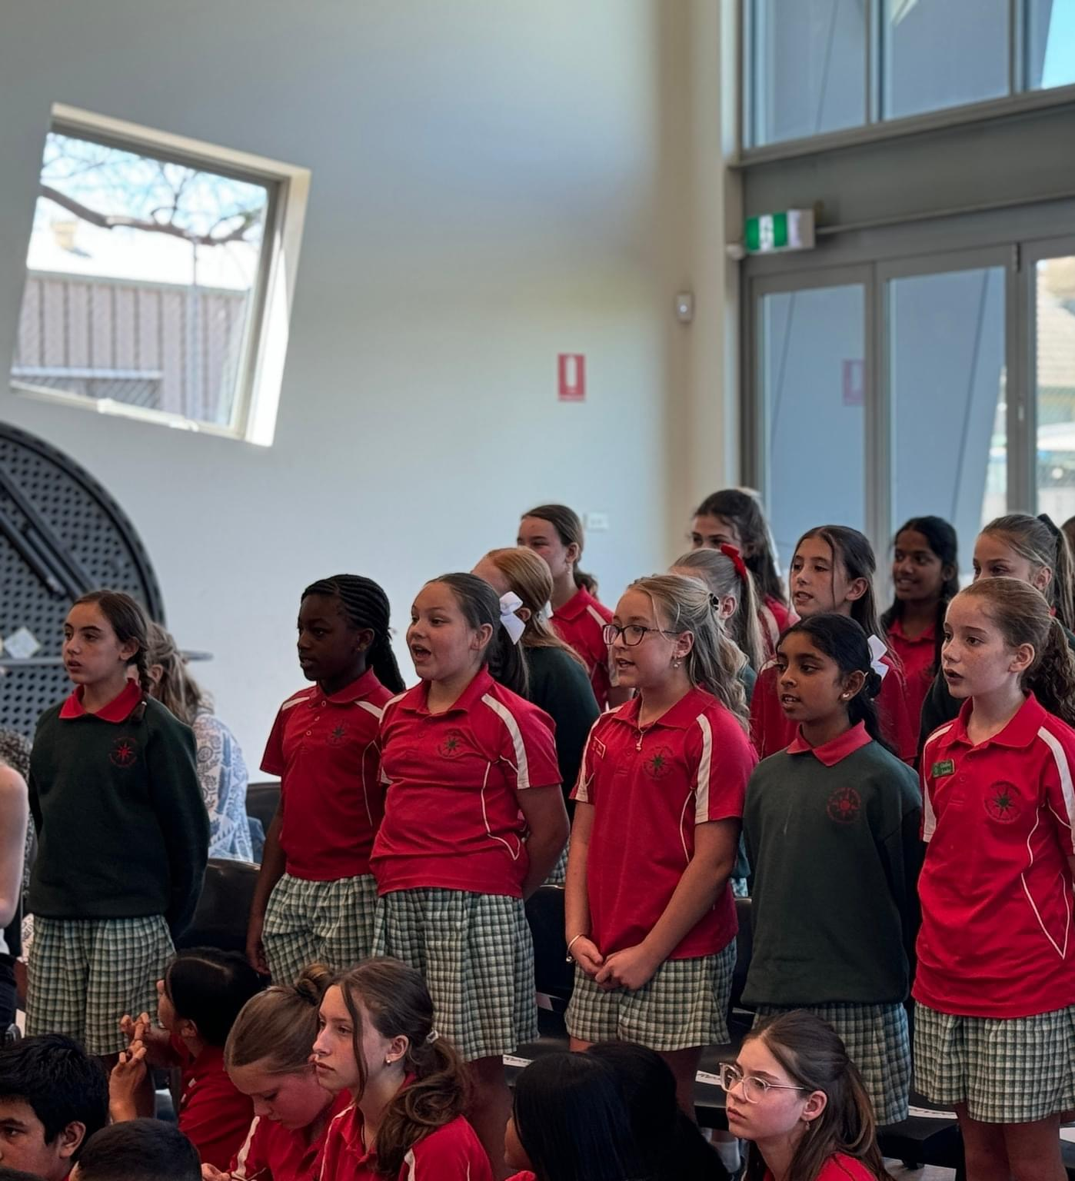
What do you see in these photos?
How could these images be connected to this week’s theme of love?
Close your eyes and imagine your own love filled scene

Slide 26
Opening Prayer
God of Love
In the Name of Love, we have come
To birth Jesus Christ into the world each day.
In the Name of Love, we are here.
And, in the Name of Love we will go.
We will go to all creation
Knowing in our Hearts and in our Souls
that what we have experienced is truly Divine.
We do not merely wait in this Season of Advent.
We continually make Jesus known.
Amen
Adapted from Dennis Yount

Slide 27
Luke 1:39-45
At that time Mary got ready and hurried to a town in the hill country of Judea, where she entered Zechariah’s home and greeted Elizabeth. When Elizabeth heard Mary’s greeting, the baby leaped in her womb, and Elizabeth was filled with the Holy Spirit. In a loud voice she exclaimed: “Blessed are you among women, and blessed is the child you will bear! But why am I so favoured, that the mother of my Lord should come to me? As soon as the sound of your greeting reached my ears, the baby in my womb leaped for joy. Blessed is she who has believed that the Lord would fulfill his promises to her!”

Slide 28
Choose one of the following words from the text, or one of your own.
HEARD
GREETING
BLESSED
FAVOURED
READY
Use the word as a mantra repeating it for yourself in silence for one minute

Slide 29
A Blessing
If you would enter
into the wilderness,
do not begin
without a blessing.
Do not leave
without hearing
who you are:
Beloved,
named by the One
who has travelled this path
before you.
Do not go
without letting it echo
in your ears,
and if you find
it is hard
to let it into your heart,
do not despair.
That is what
this journey is for.
I cannot promise
this blessing will free you
from danger,
from fear,
from hunger
or thirst,
from the scorching
of sun
or the fall
of the night.
But I can tell you
that on this path
there will be help.
I can tell you
that on this way
there will be rest.

Slide 30
I can tell you
that you will know
the strange graces
that come to our aid
only on a road
such as this,
that fly to meet us
bearing comfort
and strength,
that come alongside us
for no other cause
than to lean themselves
toward our ear
and with their
curious insistence
whisper our name:
Beloved.
Beloved.
Beloved.
By Jan Richardson

Slide 31
Acknowledgements:
The school communities of Lumen Christi Delacombe, St. Paul’s Mildura, Our Lady Help of Christians Wendouree, and St. Brigid’s College Horsham for images used throughout.
The Catholic Development Fund Melbourne with Sherry Balcombe for
Prayer of Acknowledgment
Prayers & Blessings:
Cameron Bellm
Jan Richardson
Mary Lou Kownacki, OSB
Dennis Yount

