Slide 1
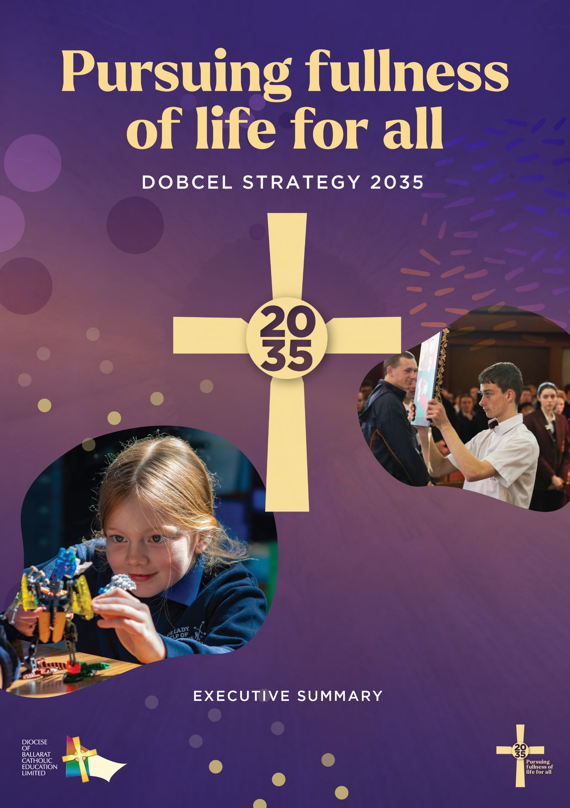
DOBCEL STRATEGY 2035
Pursuing fullness of life for all
As partners in Catholic education and open to God’s presence, we pursue fullness of life for all

Slide 2
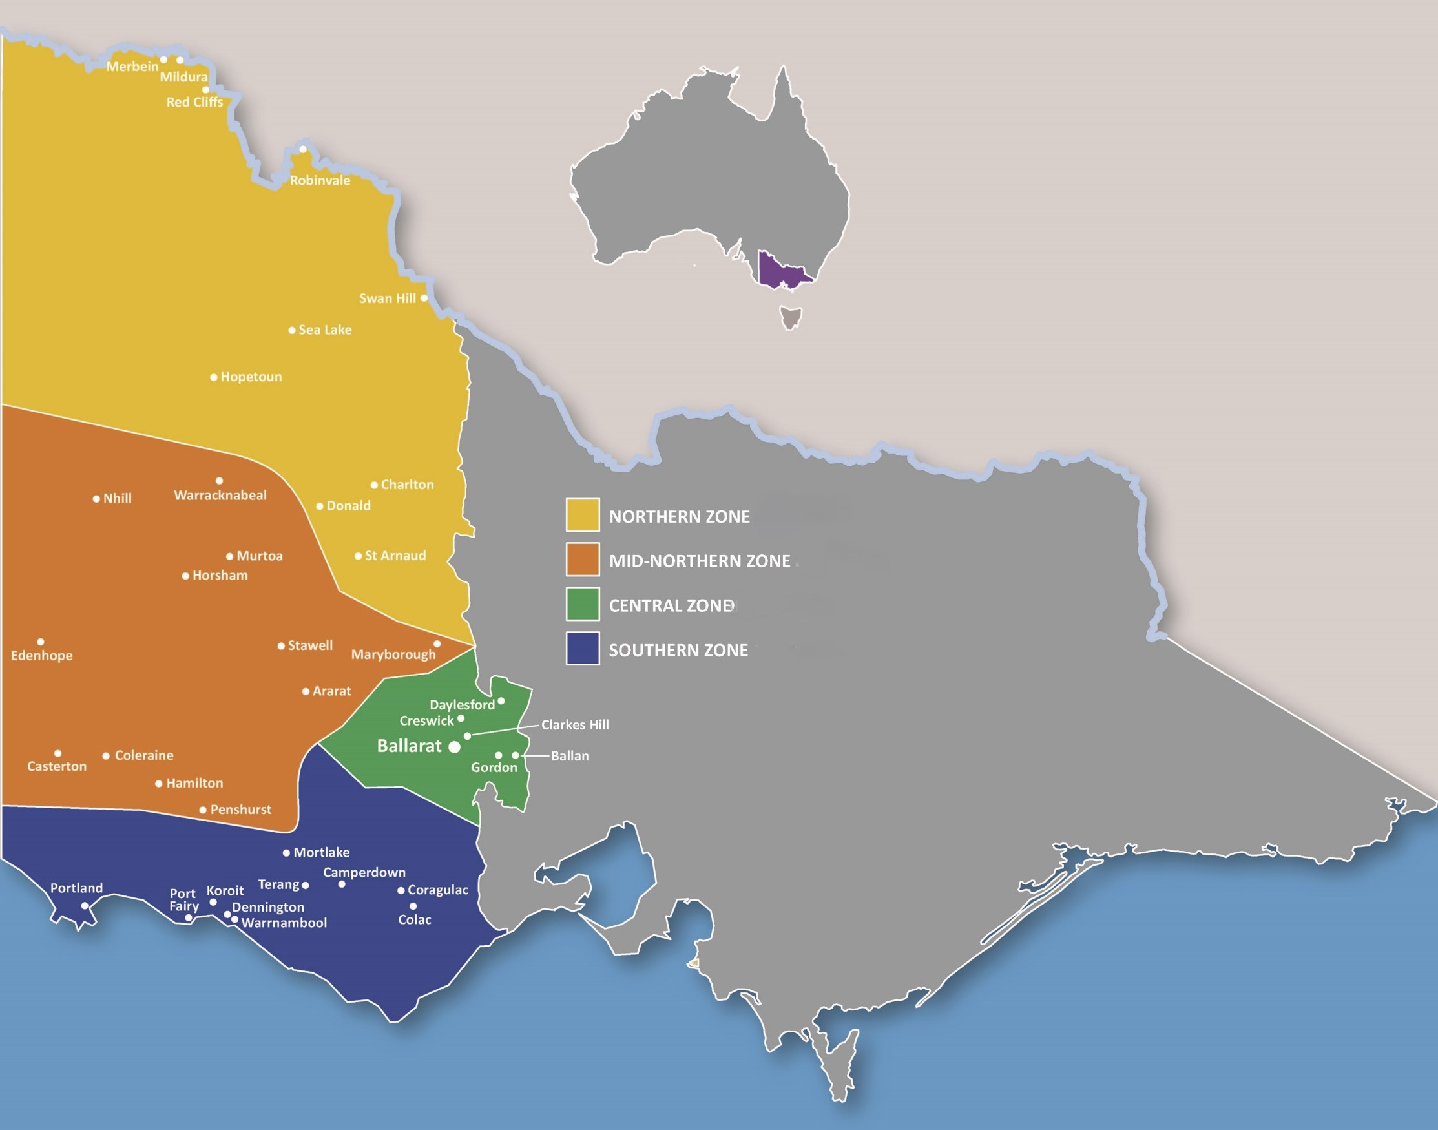
Diocese of Ballarat Catholic schools
From the Murray river to the sea, Catholic education in the Diocese of Ballarat aims to realise a vision of fullness of life for all of the 18,600 students and almost 3,000 teachers and staff across its community of 63 Catholic primary and secondary schools.

Slide 3

View a short video introducing DOBCEL Strategy 2035 here
https://youtu.be/bLzHSlEeFTQ

Slide 4

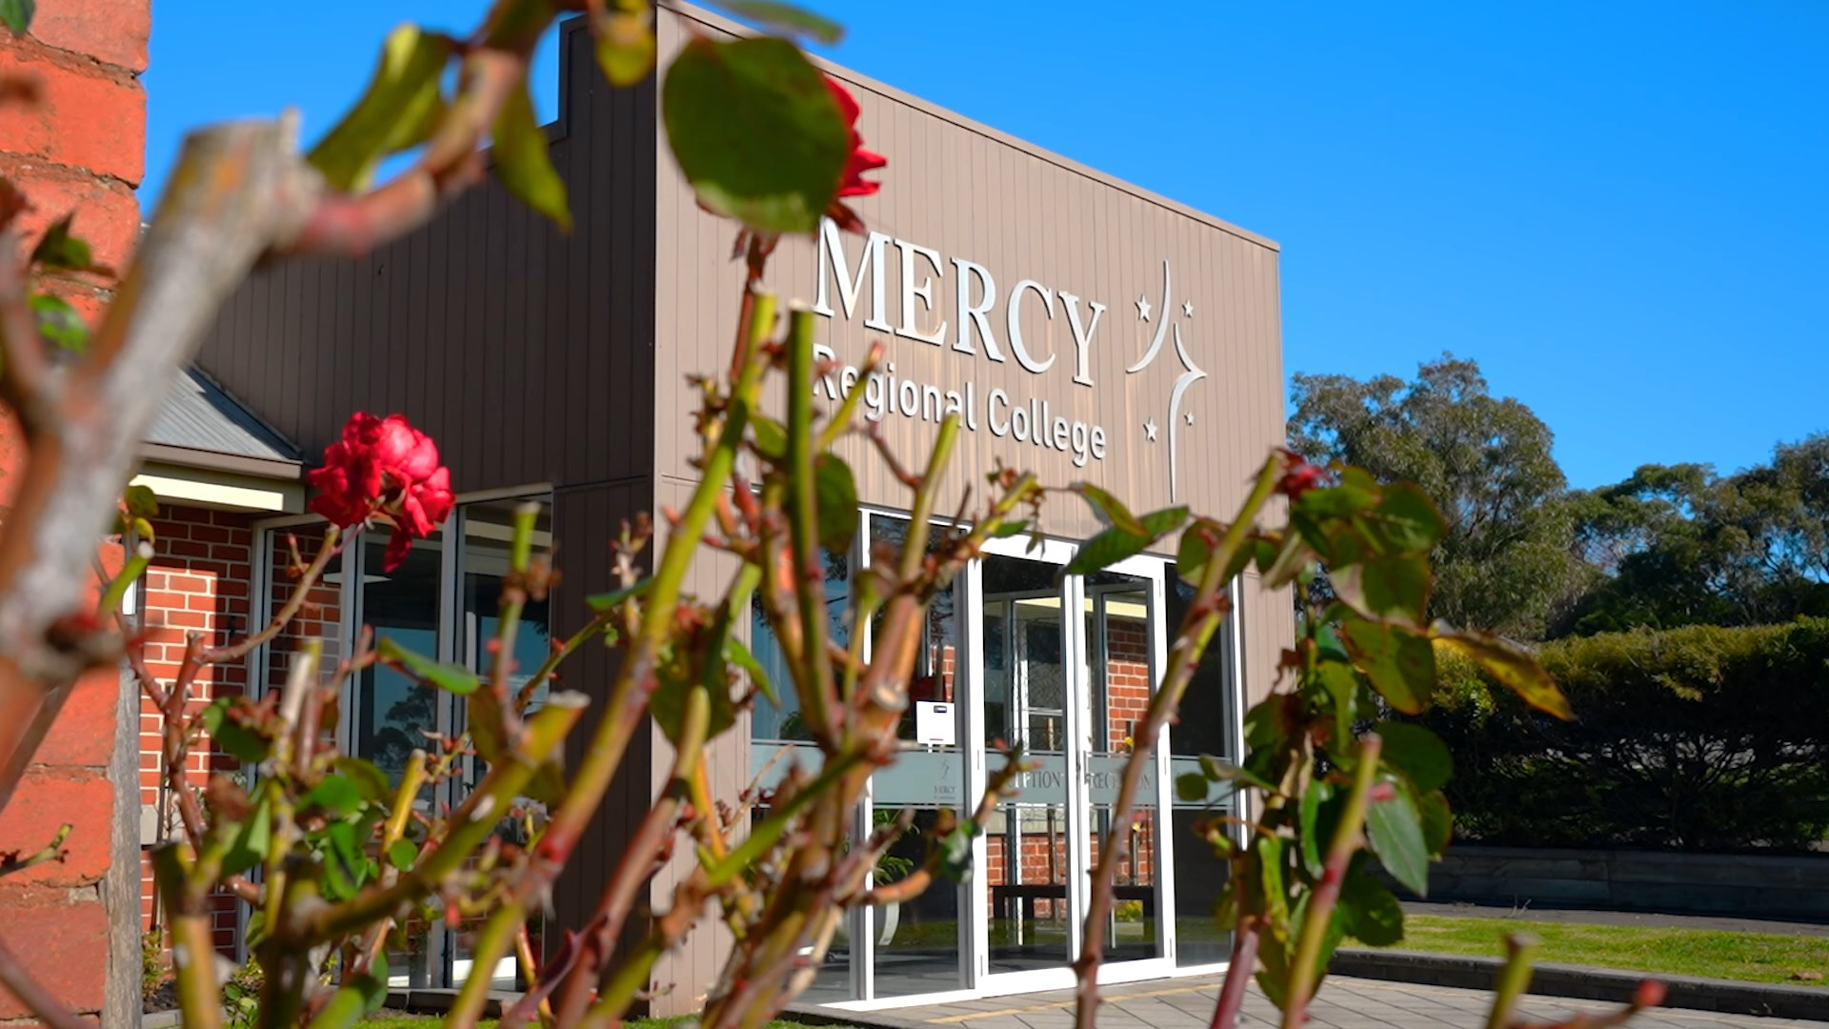
‘Standing still’ as a system is not an option
Data shows that our system of schools is currently performing quite well, underpinned by a strong Catholic identity and shared purpose.
However, research underpinning the new strategy has shown how the world is changing around us.

Slide 5
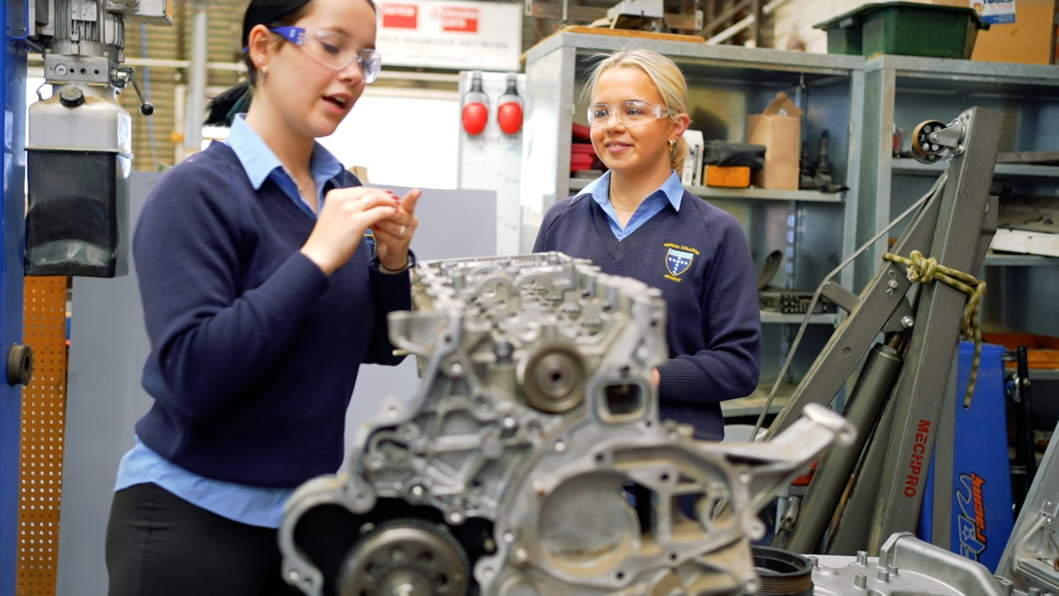
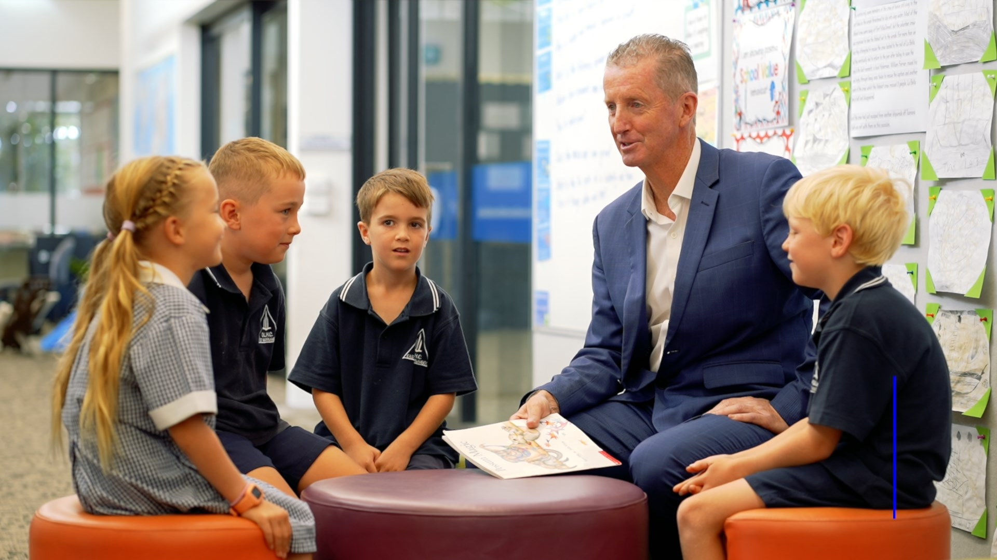
Mega trends including:
Growing inequalities
Increasing secularisation
Demographic shifts
Technological advancements
Climate change
Changing nature of work, learning and living
Persistent educational disadvantage for rural and regional students
Make it clear that ‘standing still as a system’ is not an option if we are to bring fullness of life to our students.

Slide 6
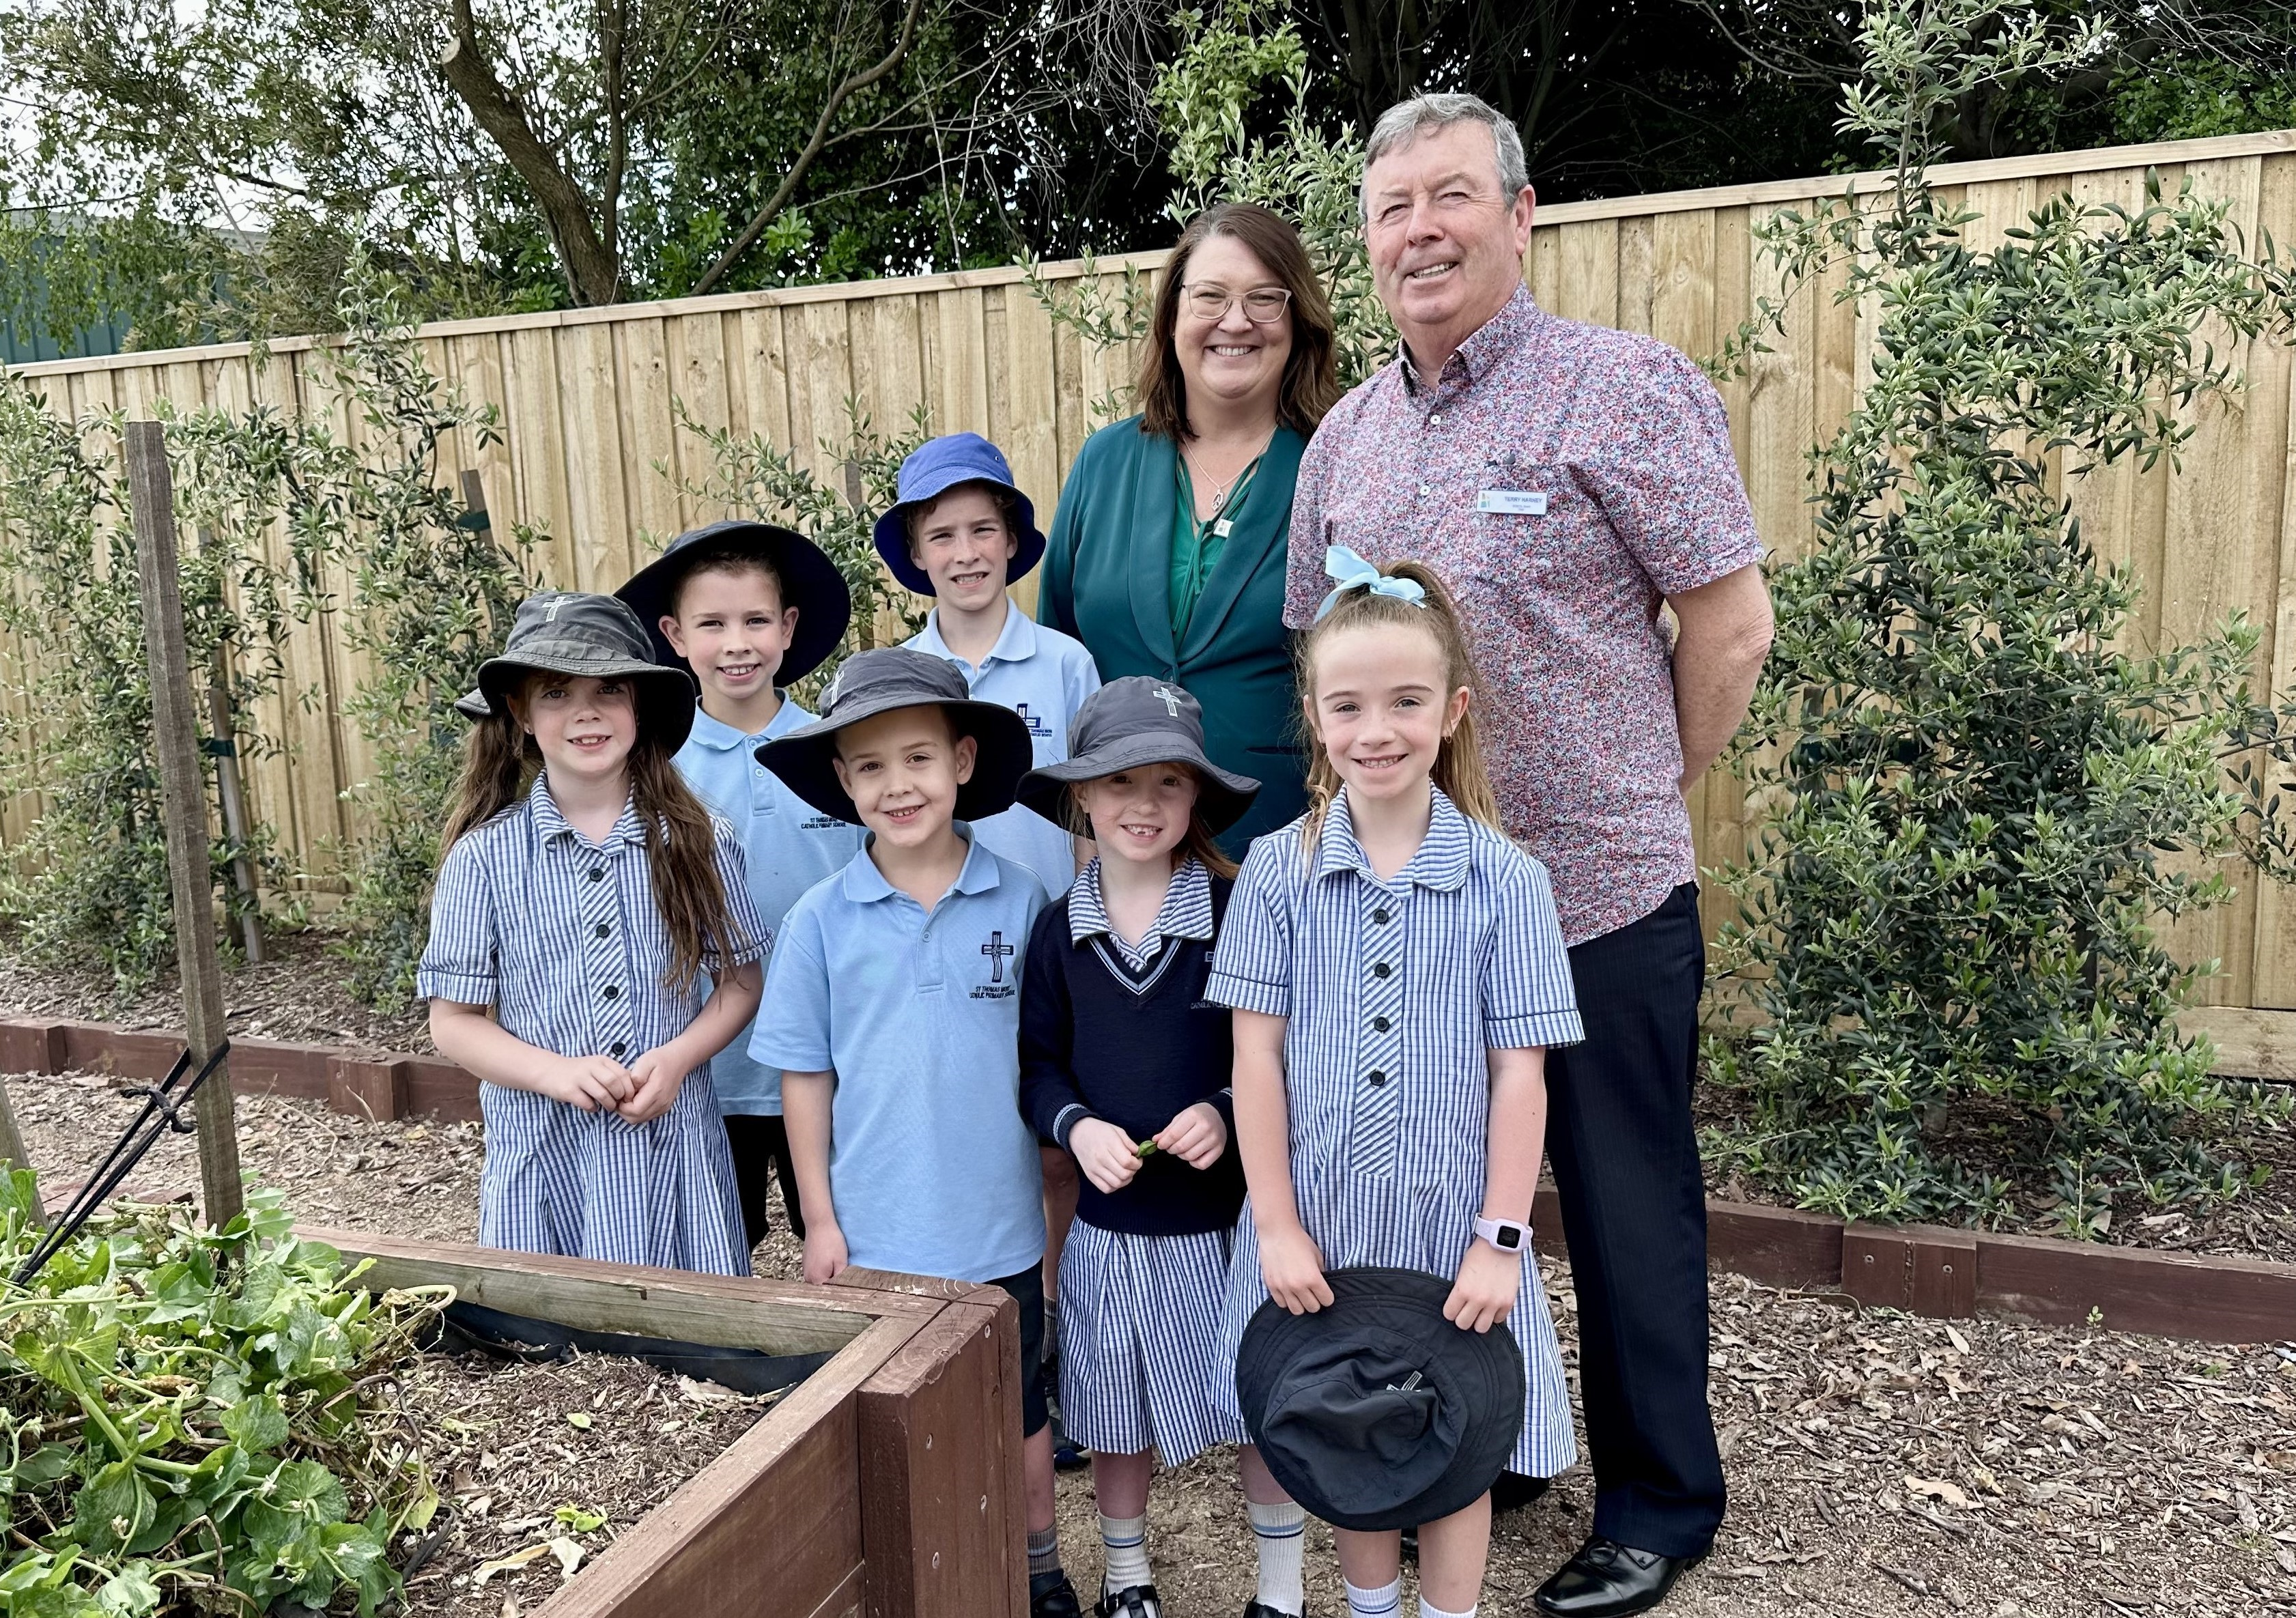
‘From good to great’
‘We are blessed to have a good system of Catholic schools led by highly skilled and dedicated Principals, teachers and staff, working in partnership with families, parishes and communities.
‘As the world changes, we are challenged to think differently about how to best meet the needs of our students and families.
‘Building on strong foundations and a rich heritage, this DOBCEL Strategy 2035 sets the sails towards a new tomorrow for our system - to move from good to great.’
Terry Harney (Chair, DOBCEL Board)

Slide 7
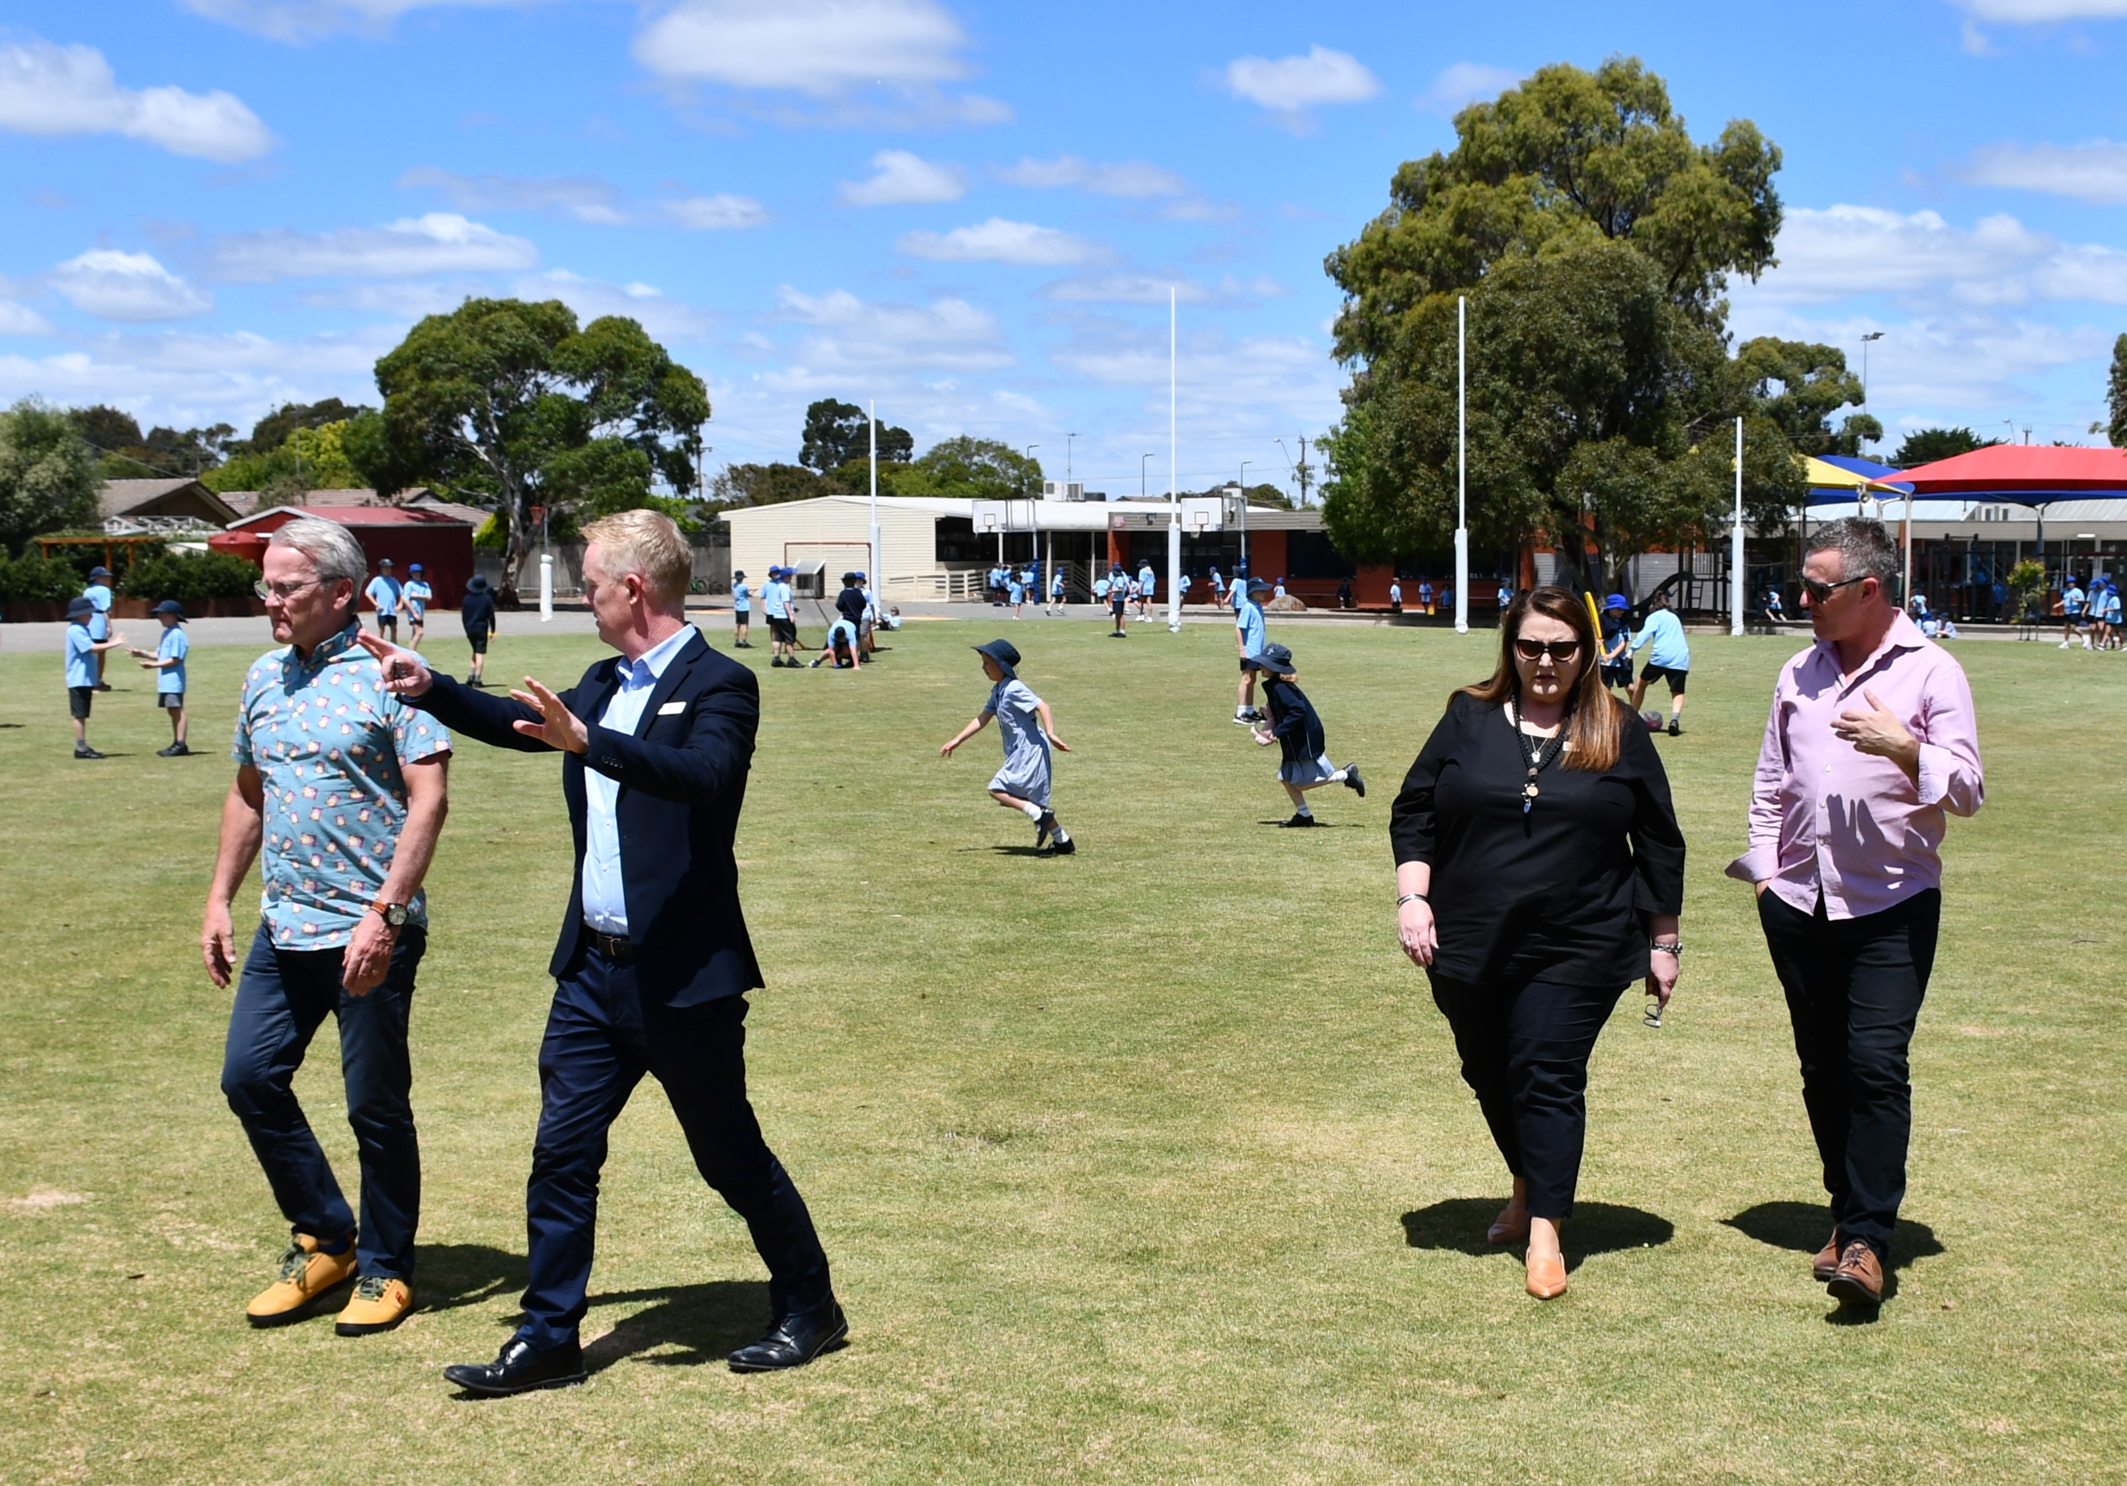
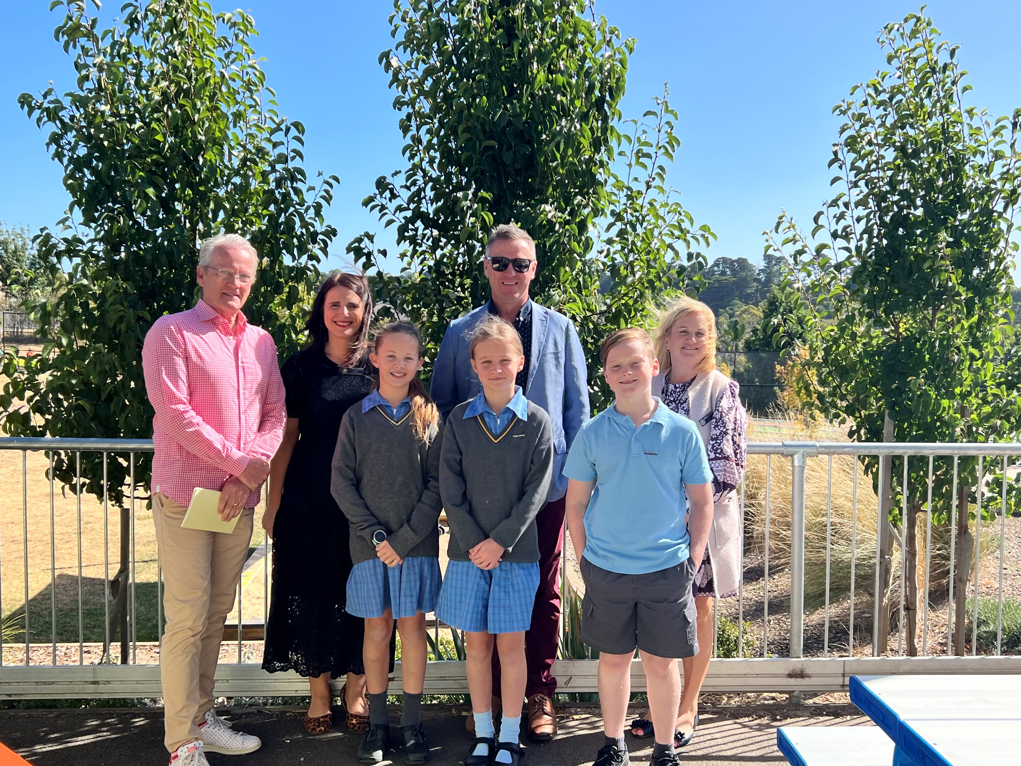
Strategy co-designed
Development of the strategy has followed a process of co-design with the DOBCEL Board and community over the past 12-18 months.
Facilitated by globally recognised Finnish educator Professor Pasi Sahlberg and Dave Runge, Director of Future Schools.
Included significant input from principals and school community representatives across the diocese.
Pasi and Dave intend to visit/engage all schools in the Diocese over coming months/years.

Slide 8

A pathway to high performance
DOBCEL Strategy 2035 aims to articulate the qualities of a high performing system of Catholic schools and provide the system settings and guidance for us all to achieve this over the next decade and beyond.

Slide 9
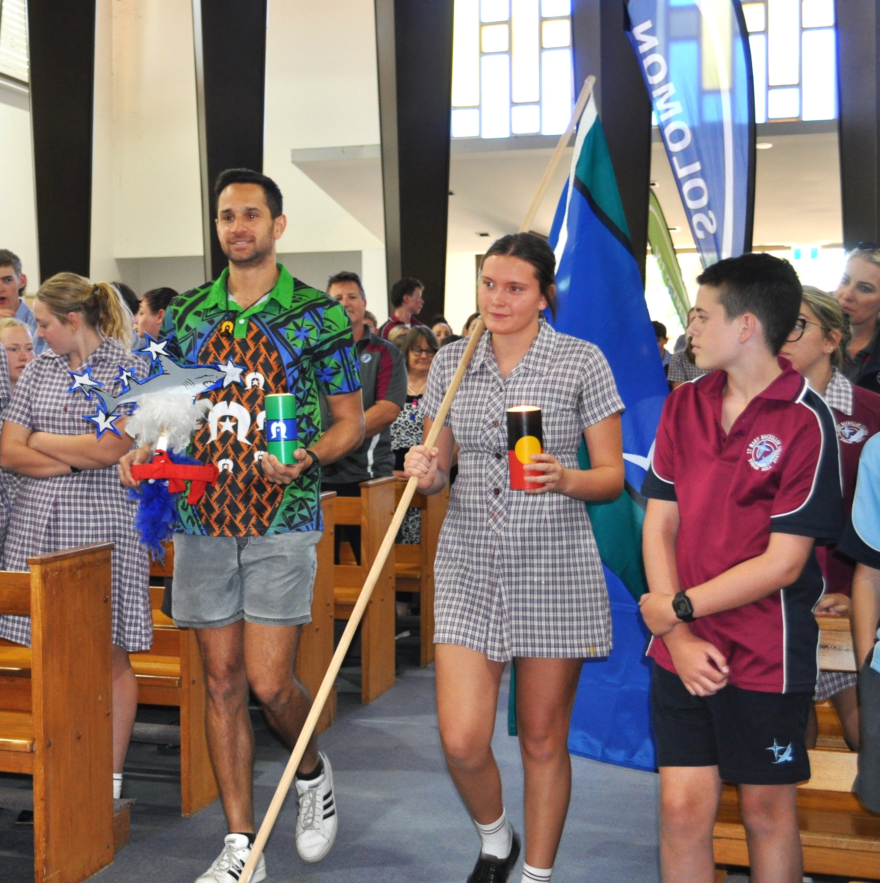
Our Catholic Identity underpins all we do
A high performing system of Catholic schools emphasises compassion, service, and respect for human dignity, embedded in the teachings of Jesus Christ.
In formulating the DOBCEL Strategy 2035, we have also examined school systems around the world which have improved academic standards, while also fostering student faith and holistic development, excellent well-being, and a strong sense of belonging.
This is the type of schooling system we aim to be.

Slide 10
Underpinned by strong Catholic Identity, DOBCEL 2035 defines a high performing system of Catholic schools as one where:
Everyone is engaged in learning and teaching and has a positive sense of belonging in their school and community.
Everyone feels safe, valued, respected, and their wellbeing and health enhanced as foundations of productive learning and teaching.
Educational research informs contemporary practice.
The quality of student learning outcomes across the curriculum exceeds expectations.
Student outcomes across different equity groups have similar distributions and averages and where all students have equal access to excellent learning and wellbeing opportunities.
All human resources, financial resources, time and natural resources invested in education benefit students, schools, community and society in optimal ways.

Slide 11
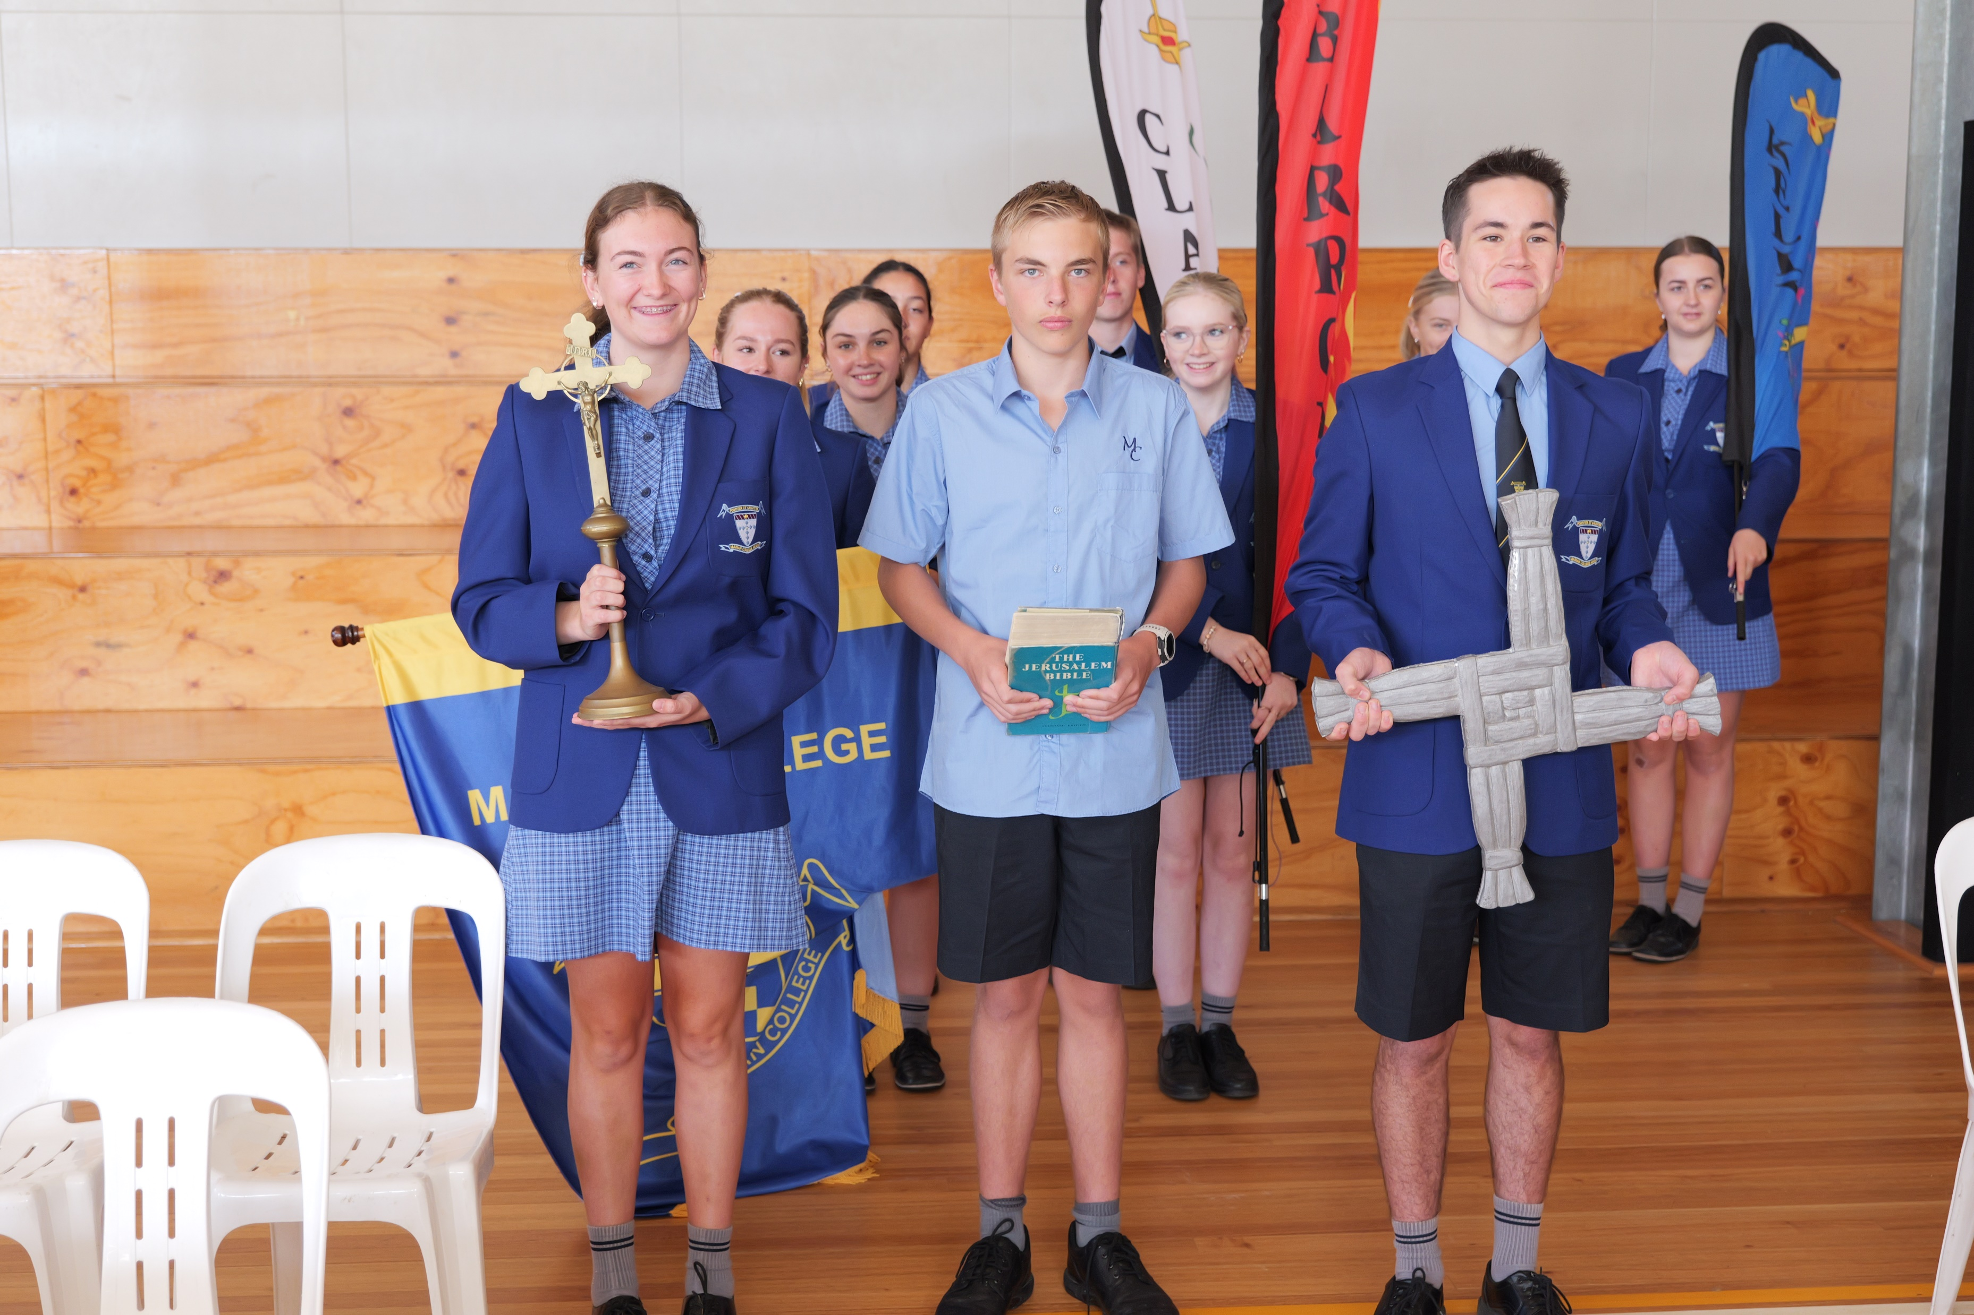
Underpinned by our Catholic Identity, the five core pillars of focus for the DOBCEL 2035 strategy are:
Collaborative Cultures
Engagement and Belonging
School as Community
Rich Pedagogical Practices for Deep Learning and Well-being
Sustainable Stewardship

Slide 12
What do we need to do?
This 10-year strategy provides general directions and strategic priorities for the DOBCEL school system. Guided by our vision, we will move towards the pillars and commonly agreed intentions through three practical principles:
1. Deeper collaboration:
Systematic efforts to enable deeper co-operation in and between schools combined with building social capital across the DOBCEL system.
2. Networked local innovation:
Purposeful investments initiating local innovation and renewal of learning and teaching through co-designed school improvement.
3. Collective autonomy and agency:
Schools and staff understand that they are trusted to make the best decisions for those in their care and understand their mutual obligation to the Governing Authority and the responsibilities that they carry. Schools are more connected to one another, and student voice, agency and active engagement are prioritised.

Slide 13
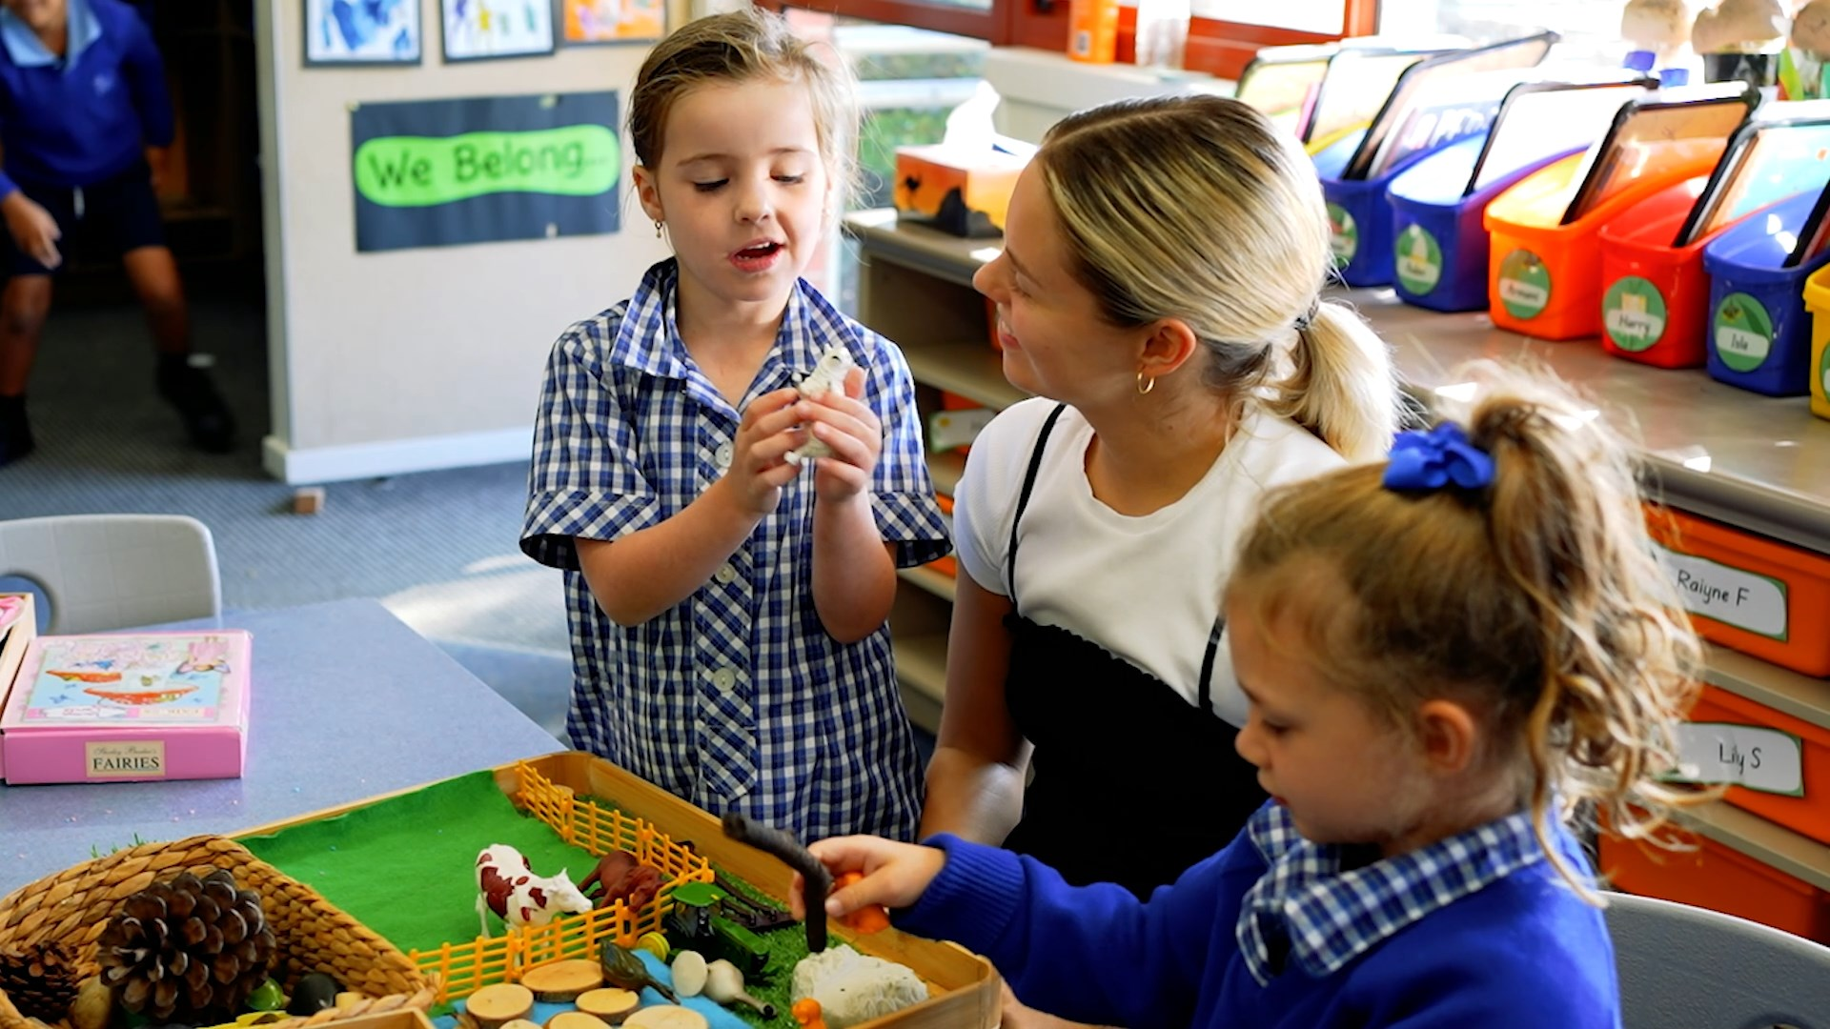
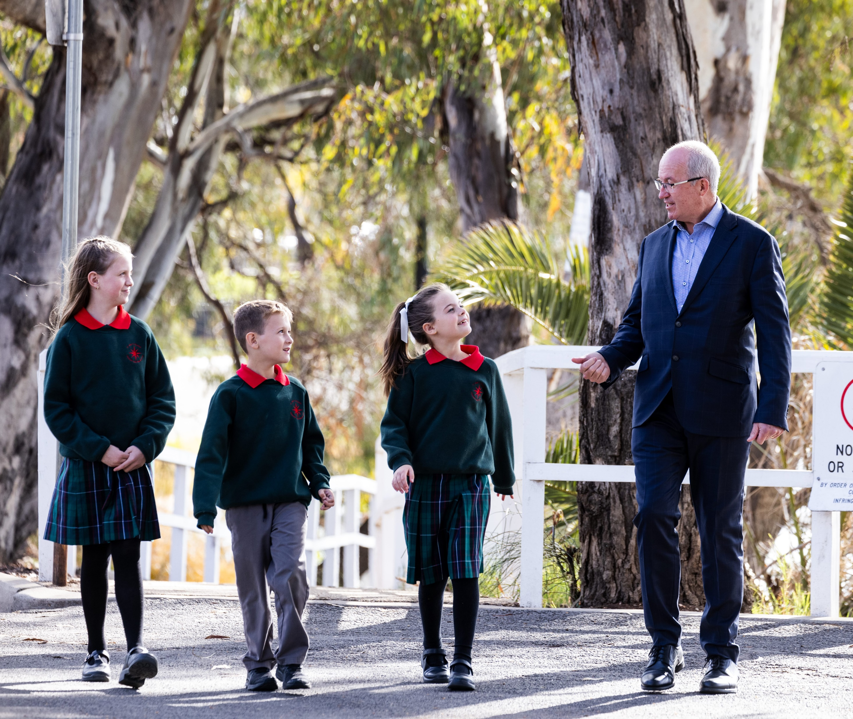
Unleashing the greatness in all of us
‘To realise our aspiration, it is imperative that the greatness existing in every person aligned with DOBCEL is unleashed.
‘It is by investing spiritually, emotionally, personally and financially in the social and human capital across our system that greatness will be enabled.
‘This strategy compels us to build a DOBCEL culture that is faithful to our Catholic identity and promotes both collaboration and innovation, actively seeking out and learning from existing examples of excellence within our diocese, nationally, and globally.’
Tom Sexton, Executive Director

Slide 14
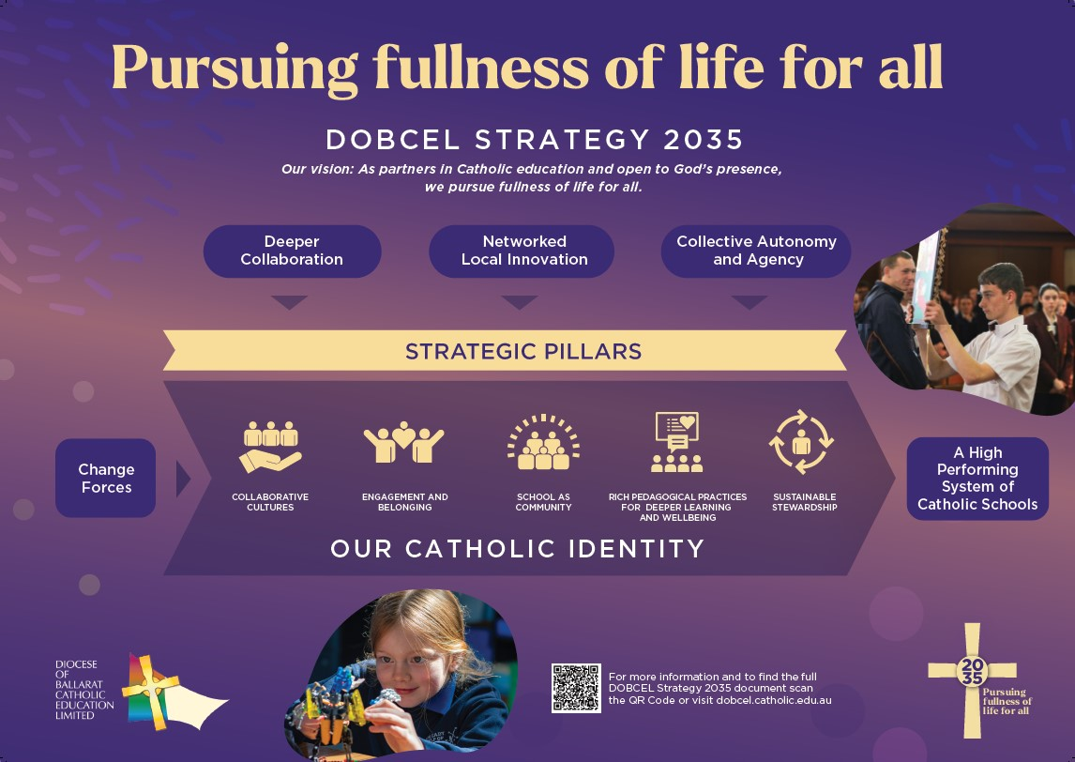
DOBCEL Strategy 2035 on a page

Slide 15
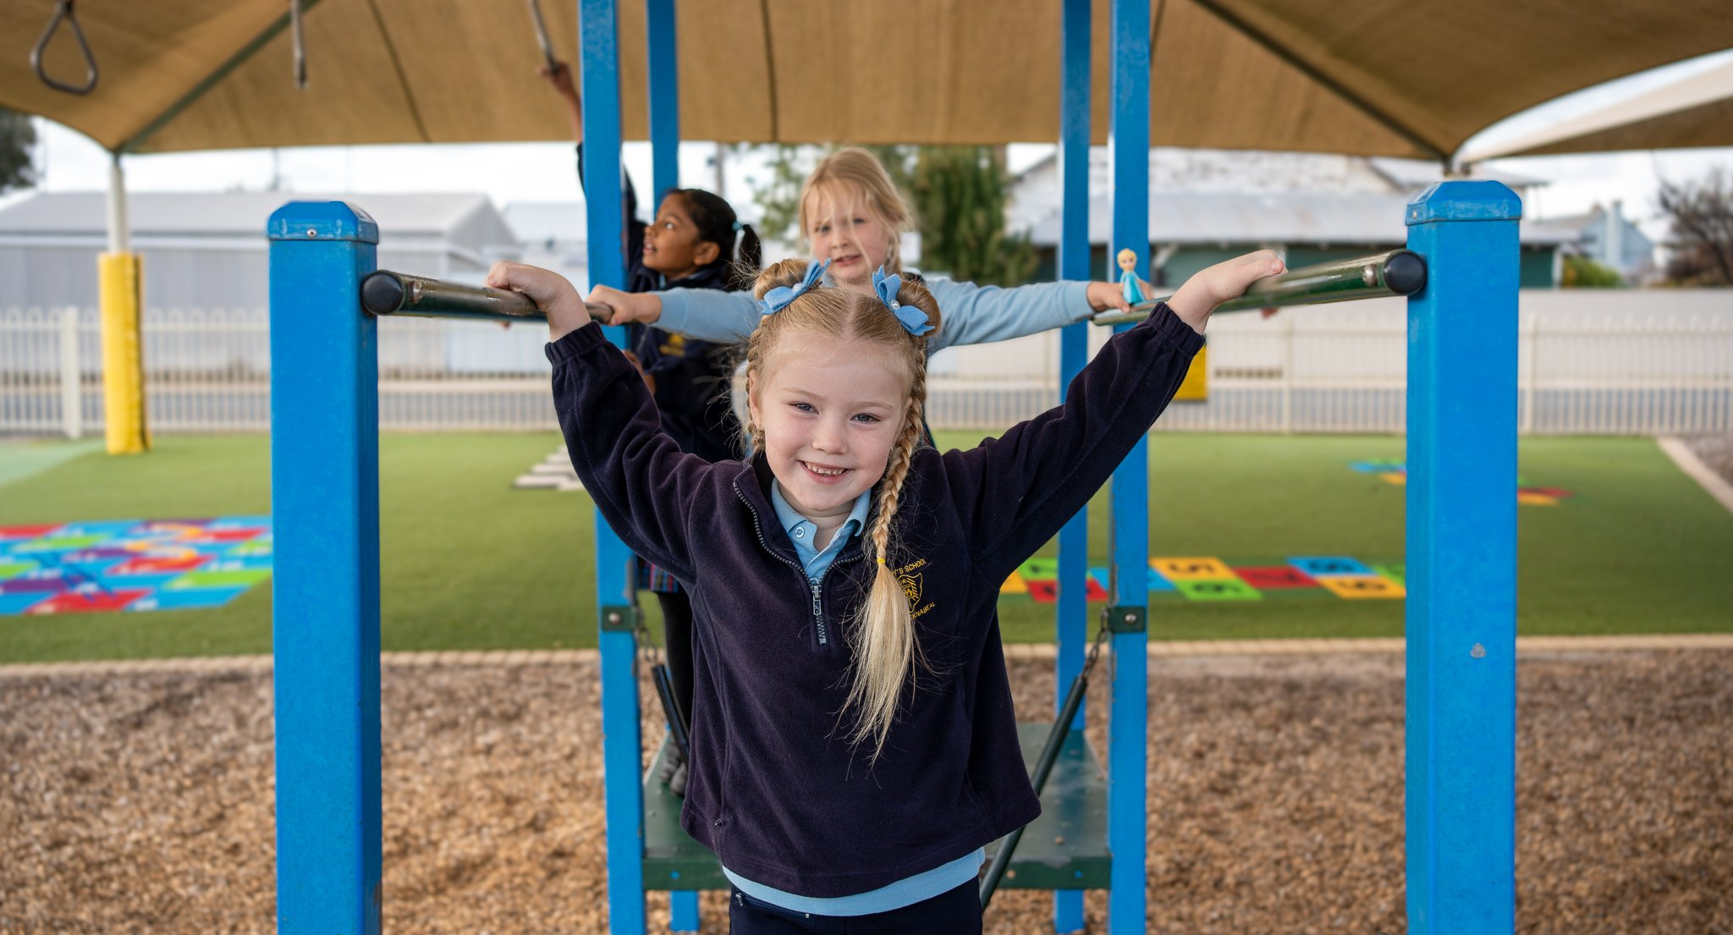
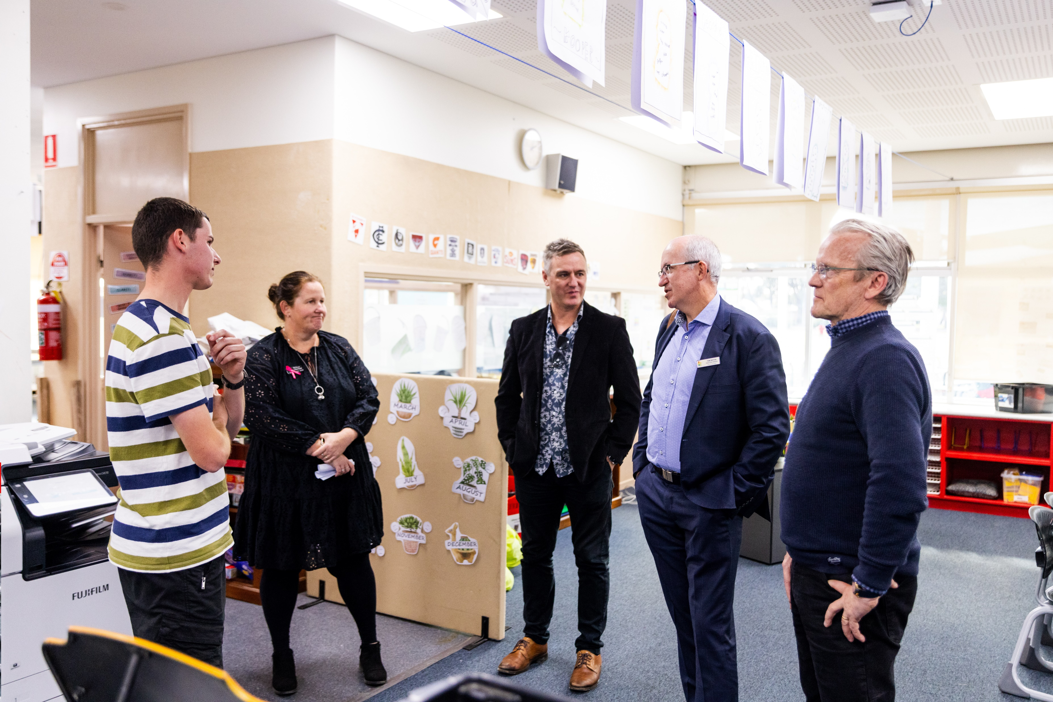
Initial steps on the journey in 2025
2025 is a year for staff and school communities to ‘make sense’ of the DOBCEL Strategy 2035 and what it means for them moving forward.
All staff across the diocese will have opportunities to gather in Zone groups in Term 2 for workshops focused on:
  Unpacking the pillars
  Collaboration and innovation prototypes
  Sharing existing good practice in our schools
  Responding to questions/queries/concerns
These workshops will be led by Tom Sexton, Pasi Sahlberg and Dave Runge.
Notes:
Go slow to go fast

Slide 16
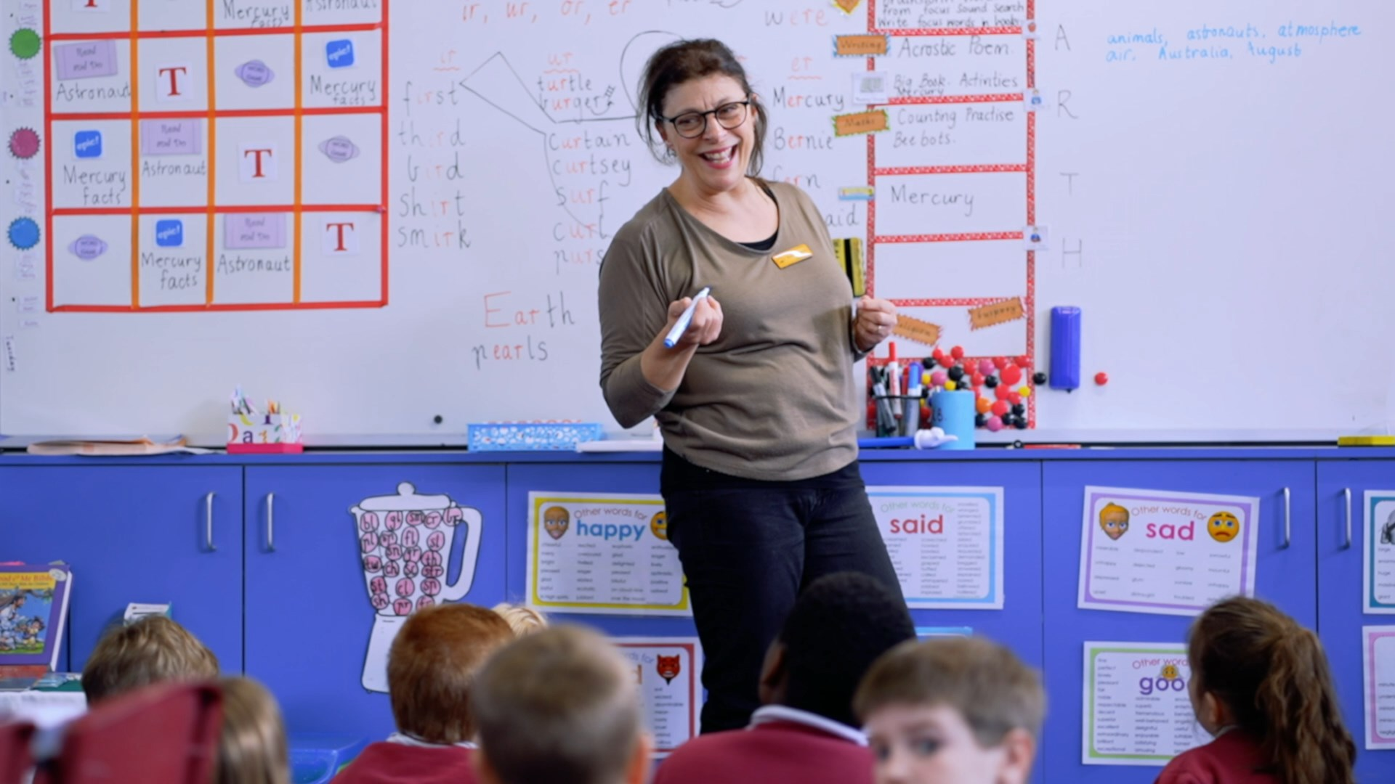
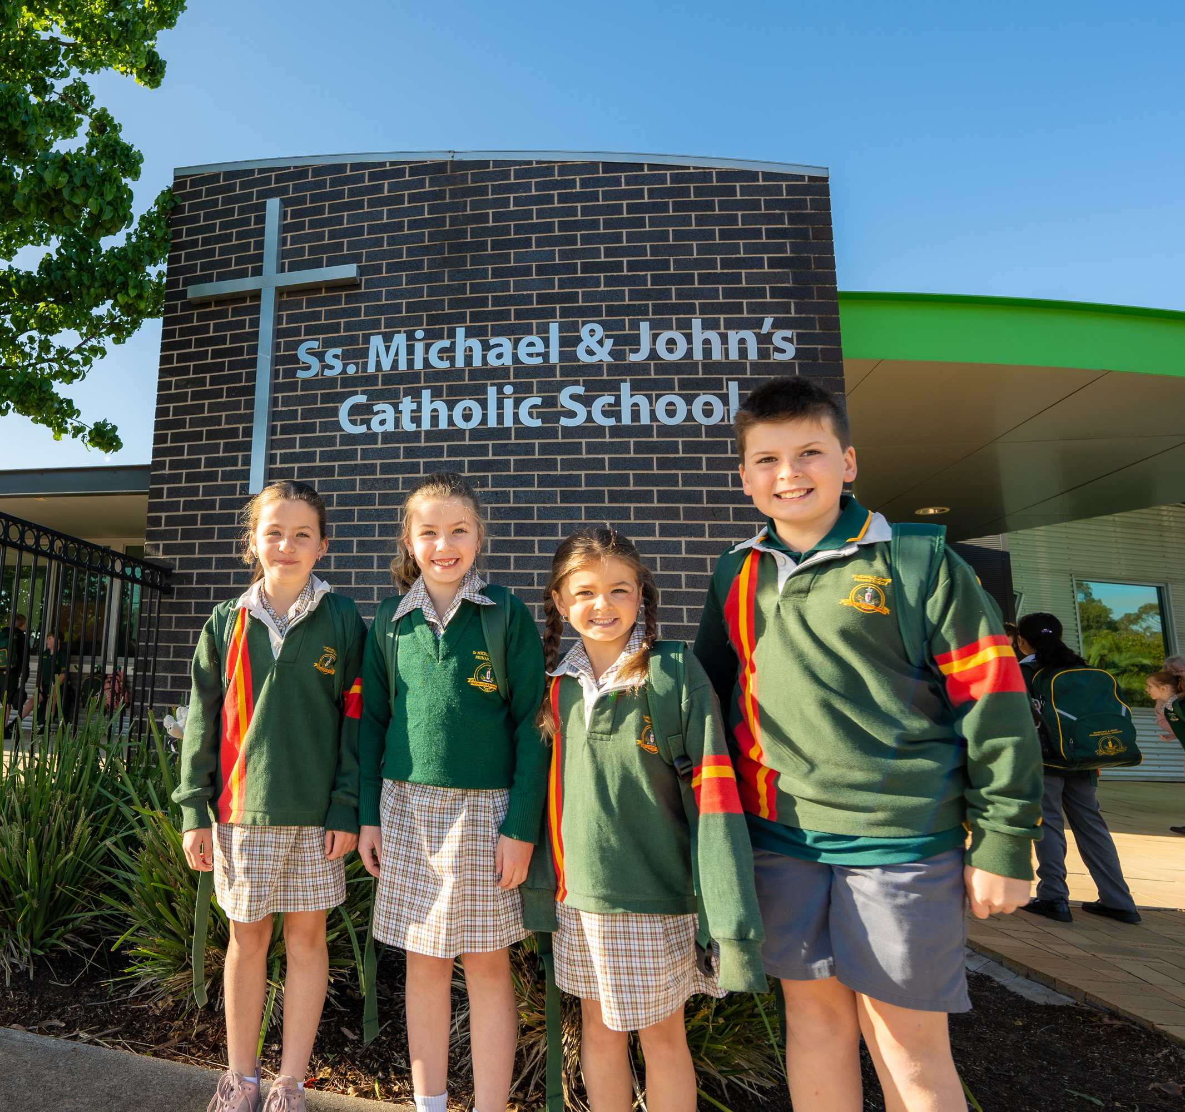
Initial steps on the journey in 2025 cont ….
Other potential activities for schools include:
  Participate in ‘sense making’ conversations internally
  Consider existing alignments with DOBCEL 2035 Strategic pillars
  Collect more baseline data on current performance
  Begin collaborating with another school(s)
  Identify and reflect on research literature for future directions
  Disseminate learnings across the system and beyond
  Participate in the range of professional learning activities planned at system level to begin activating the new plan from early 2025.

Slide 17
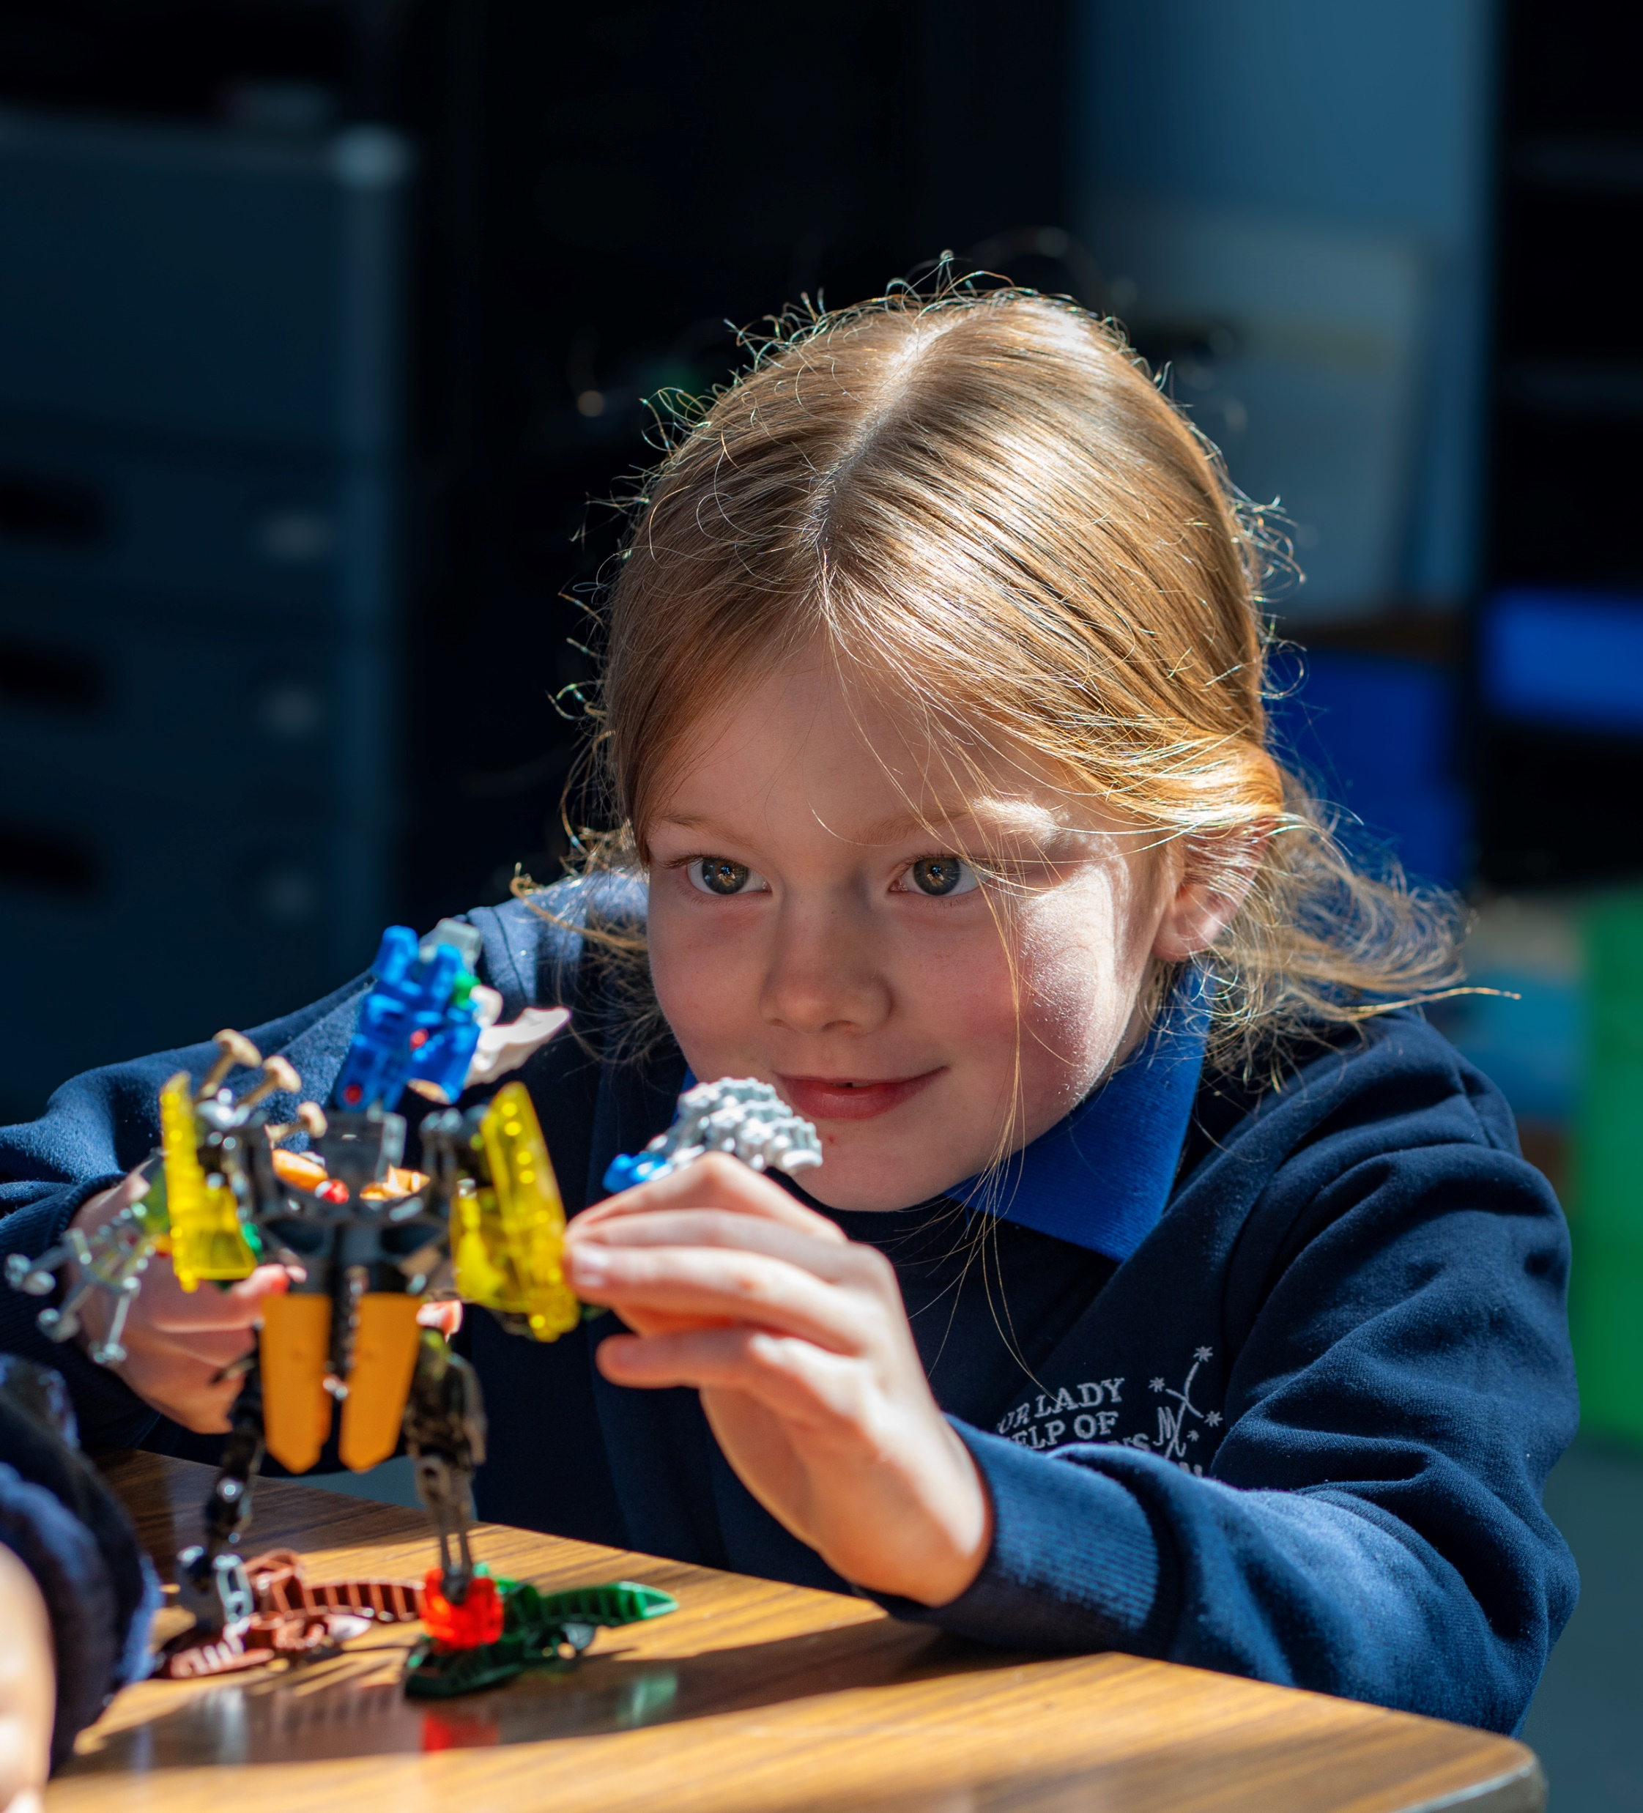
A shared opportunity to shape the future
DOBCEL 2035 Strategy provides an opportunity for us to collectively steward the system and shape the future.
This is both an immense privilege and responsibility.
We are grateful for your ongoing work and support as together we take this journey toward our system vision: As partners in Catholic education and open to God’s presence, we pursue fullness of life for all.

Slide 18
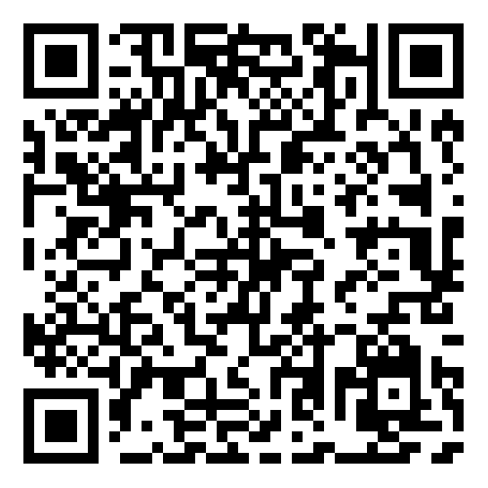
Please visit www.dobcel.catholic.edu.au for more resources and to read the full DOBCEL Strategy 2035 document.

Slide 19

Thank you

