Slide 1

Pilgrims of Hope
2025 – Jubilee Year
Catholic Education Ballarat
Background for Staff Formation 1st & 2nd October 2025

Slide 2
The purpose of this presentation:
Define the term formation.
Provide the background to what a Jubilee Year is in the Catholic Church.
Introduce the 2025 Jubilee Year theme “Pilgrims of Hope” and the concept of Pilgrimage.
Present to all staff, the planned formation experiences that are taking place on 1st and 2nd October, 2025.
Give staff an insight into some of the pilgrimage offerings being planned for this year enabling them to make informed decisions.

Slide 3
What is Formation?
It is an intentional, ongoing and reflective process that focuses on the growth of individuals and communities from their lived experiences, in spiritual awareness, theological understanding, vocational motivation and capabilities for mission and service in the Church and the world.
-A Framework for Formation for Mission in Catholic Education 2017
In the Catholic Tradition, formation is a continuous, intentional process of personal and communal growth, focused on developing individuals and communities in spiritual awareness, theological understanding, vocational motivation, and capabilities for mission and service. It's a lifelong journey of learning, questioning, growing, and the possibility of deepening one's relationship with God others and all of creation.
-Adapted from Melbourne Archdiocese Catholic Schools

Slide 4
What is Formation?
The following video was made to help explain what formation is in Catholic Education.
It is from The National Catholic Education Commission and was produced for schools and systems (that’s all of us!!) across Australia.
Formation opportunities such as our October staff formation have been created based on the contents of the video and more importantly, our lived experience and ongoing feedback from our staff, regarding how they would like to experience formation.
The content of the video is based upon the document
A Framework for Formation for Mission in Catholic Education. To explore the document: see:
https://ceoballarat.schoolzineplus.com/_file/media/150/aframework4formationmissionncec.pdf

Slide 5


Slide 6
CEB Formation
2025 A Jubilee Year
Pilgrims of Hope

Slide 7

What does Pilgrims of Hope mean?
Where does it come from?

Slide 8
What is a Jubilee Year?
In the Catholic Church, a Jubilee or Holy Year is a special year, in which people are invited to come back into right relationship with God, with one another, and with all of creation. 2025 is a Jubilee Year.
A Jubilee Year is celebrated by the Church every 25 years.
This has been the case since 1470, when Pope Paul II changed it from
every 50 years.
A Pope can also proclaim an Extraordinary Jubilee, like the Extraordinary Jubilee of Mercy which Pope Francis inaugurated in 2015.

Slide 9
Some background of "Jubilee”
The word Jubilee comes from the Hebrew word yobel, which is a ram's horn. This wind
instrument is blown to mark the start of a Jubilee Year in the Bible (Leviticus 25:9).
In the Bible the Jubilee Year occurred every 50 years and involved the cancelling of debts, a
period of rest for people and the earth, and land being restored to the landless.
In the Gospel of Luke, Jesus makes clear his own mission is to bring Jubilee. In the
synagogue at Nazareth he reads from the scroll of the prophet Isaiah, proclaiming the year of the
Lord's favour:
“The Spirit of the Lord has been given to me, because he has anointed me to bring good news to the
poor, to proclaim liberty to captives and recovery of sight to the blind, to let the oppressed go free,
and to proclaim the Lord's year of favour." (Luke 4:18-19)
After reading, Jesus announces: “Today this scripture has been fulfilled in your hearing." Jesus shows what God's Kingdom of justice, compassion and freedom looks like. He invites people to
join him in making it a reality. This is the call of each Jubilee Year.

Slide 10
What does “Pilgrims of Hope” mean?
The theme of this year’s Jubilee Year is Pilgrims of Hope.
In 2024, when introducing the theme of the 2025 Jubilee Year Pilgrims of Hope, Pope Francis invited Catholics to renew their hope and discover a vision that can "restore access to the fruits of the earth to everyone".
Catholics are also invited to rediscover a spirituality of God's creation in which they understand themselves as "pilgrims on the earth" rather than masters of the world.
This theme is an invitation to everyone working in Catholic organisations to reflect deeply upon what and how they complete their work. A jubilee year can inform the way we work in Catholic Education Ballarat, inviting dialogue between the context of the world in which we live and the Catholic Tradition.

Slide 11
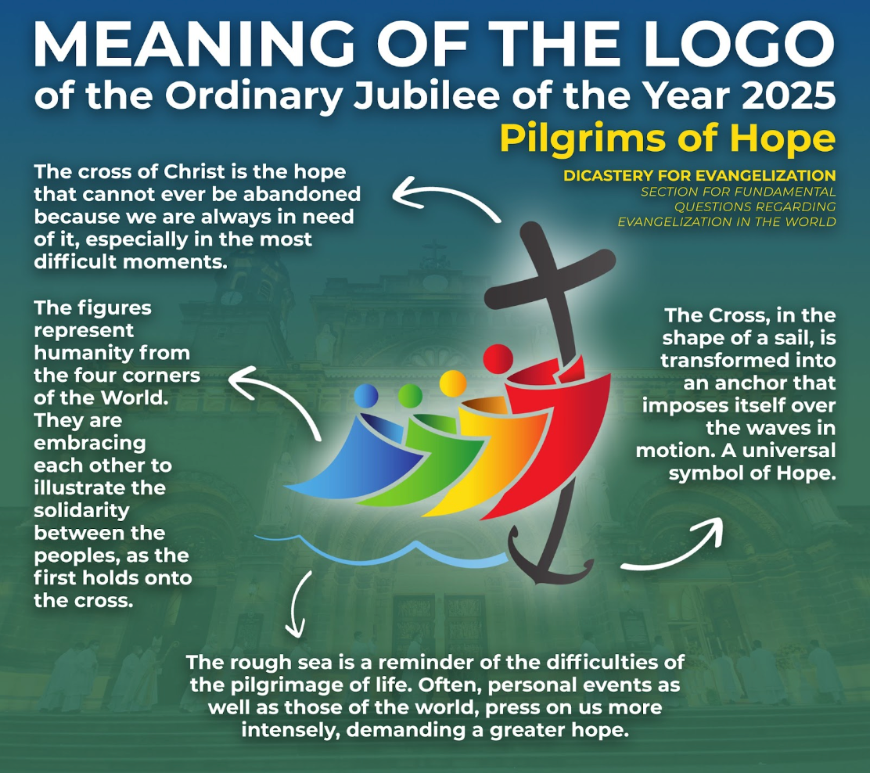



Slide 12
Our staff formation 2025, is constructed around the theme of pilgrimage. What is a pilgrimage?
A pilgrimage is a journey, often to a holy place, undertaken for spiritual or religious purposes. It can involve a physical journey or a metaphorical one. A time to reflect and make meaning. Pilgrimages are part of many cultures and religions, serving as a way to connect with the divine, seek renewal, or express gratitude.
-Adapted from CAFOD
Catholics in Australia can celebrate the Jubilee through local pilgrimages to designated Holy Door churches, special liturgies, and events hosted by dioceses and parishes. In addition, prayer and acts of charity are encouraged as ways to embody the Jubilee’s spirit of hope and unity.
-Australian Catholic Biship’s Conference

Slide 13
Staff Formation 2025
Staff Formation is taking place on 1st & 2nd October, 2025. Pilgrims of Hope will be the theme of our two days.
There will be seven different pilgrimages across a variety of locations
celebrating the theme Pilgrims of Hope.
Each of these pilgrimages will explicitly explore the connection
between the present context and the Catholic Tradition.
It is envisaged there will be approximately 20 people in each
pilgrimage.

Slide 14
Why this format?
The feed back from last year’s formation experience, indicated that people prefer a choice of experiences to engage in the Catholic story and vision.
Informed by this, the following rich and varied formation experiences have been constructed for Catholic Education Ballarat for our formation in 2025.

Slide 15

These pilgrimages include:
Yarrowee River Pilgrimage
Nimon’s Bridge to Ballarat Pilgrimage
There Where You Are Pilgrimage Retreat
The Lore of Hope Pilgrimage
A Pilgrimage to Laudato Si
Pilgrims of Hope on the Big Screen
Mary MacKillop Australia’s First Saint - A Fair Dinkum Pilgrim of Hope

Slide 16
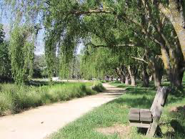
Yarrowee River Pilgrimage
Pilgrims walk along the Yarrowee Creek Trail. During this experience there will be time for reflection and dialoguing with The Catholic Tradition around concepts of hope, pilgrimage and the sacred. This pilgrimage will be 33km walk over two days. Accommodation will be in Ballarat either at the participant’s home or a booked venue. A shared evening meal will be a part of the experience.
To find out more about the trail itself:
Yarrowee River Trail, Attraction, Goldfields, Victoria, Australia

Slide 17
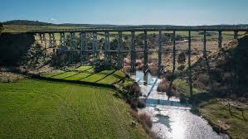
Nimon’s Bridge to Ballarat Pilgrimage
Pilgrims will begin their pilgrimage walk at Nimon’s Bridge on the Ballarat -Skipton Rail Trail. At the conclusion of the first day, pilgrims will camp at Smythesdale with tents, swags, etc. (BYO Equipment) Equipment will be delivered to the campsite from the Ballarat office, ensuring it will be there at the conclusion of day one. The evening meal will be at The Court House Hotel in Smythesdale. We plan to end the day with a camp-fire, dialogue and reflection. Throughout the experience connection will be made around pilgrimage, hope and the Catholic vision and story.
For venue accommodation see: Smythesdale Gardens | Goldfields Guide
This is about a 37km walk.
Nimon’s Bridge - Visit Ballarat
Ballarat Skipton Rail Trail Map
Ballarat-Skipton Rail Trail

Slide 18
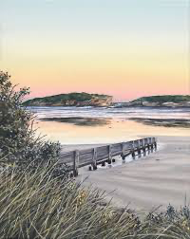
There Where You Are Pilgrimage Retreat
Pilgrims travel to Warrnambool and stay at The Lady Bay Resort, where they will experience a retreat around the theme of There Where You Are. This experience will be grounded in Ignatian Spirituality. Participants will be invited to recognise the sacred in their own lives and context including through the experience of the ocean and the natural environment. The retreat will extend an invitation to participants to reflect upon their lived experience, and spirituality, through the lenses of hope, pilgrimage and the sacred.
What Is Ignatian Spirituality?

Slide 19
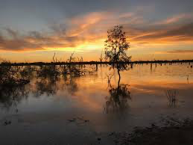
The Lore of Hope Pilgrimage
How has hope been named by our First Nations People?
On Country, Aunty Vicki Clark, Mutti Mutti woman, will explore how hope is expressed through
Indigenous Spirituality and the intersections with the Catholic Tradition
(Sacramental 2- Way Cross) and the pilgrim’s own spirituality or way life.
Connections will be explored through the theme of The Jubilee Year Pilgrims of Hope in 2025 . This event will take place in the northern Victorian town of Boort.
Accommodation will be in cabins located at The Boort Caravan Park

Slide 20
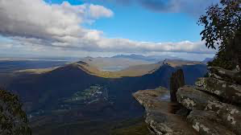
A Pilgrimage to Laudato Si
How is hope expressed through the lens of Laudato Si?
This pilgrimage aspires to express hope through active engagement with creation, emphasising a call to action and personal transformation. Participants will be invited to consider the inherent goodness and beauty of the natural world; a conviction that even in the face of environmental challenges, hope can be found in human responsibility and collaboration, particularly when it comes to caring for our "common home". The venue for this will be The Country Plaza at Halls Gap, with ample opportunity to explore the local environment.
What is Laudato Si?

Slide 21

Pilgrims of Hope on the Big Screen
How is hope expressed on the big screen?
Pilgrims will watch two films at one of the Ballarat Cinemas. These movies will be connected with being Pilgrims of Hope and making connections with The Catholic Christian story. There will be time for personal and shared reflection. At the end of each screening, a guided dialogue and personal reflection will take place (facilitated by Michael McGirr), focusing on how hope is expressed in each movie and ways we too can bring hope through our variety of roles at CEB.
Profile: Michael McGirr
A profile written about Michael McGirr capturing a part of his story.

Slide 22
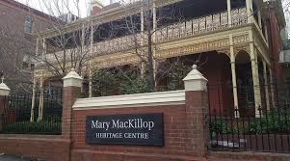
Mary MacKillop Australia’s First Saint –
A Fair Dinkum Pilgrim of Hope
Who are the pilgrims who have gone before us? & How have they brought hope?
Pilgrims make their way to the Mary MacKillop Heritage Centre, in East Melbourne, via train. On the first afternoon, they visit the heritage centre with a guided tour engaging in dialogue and journaling. In the evening, pilgrims will enjoy dinner together, followed by a night at either the Heritage Centre or the
Catholic Leadership Centre. (TBC) The following morning, they walk Mary’s Melbourne, visiting
significant sites in Fitzroy and East Melbourne connected to the life of Mary MacKillop. There will be
time to connect the life and story of Mary MacKillop with the work we are all called to do at CEB.
Around midday on the second day, pilgrims will return to Ballarat via train.
Mary's Legacy - Sisters of Saint Joseph of the Sacred Heart

Slide 23
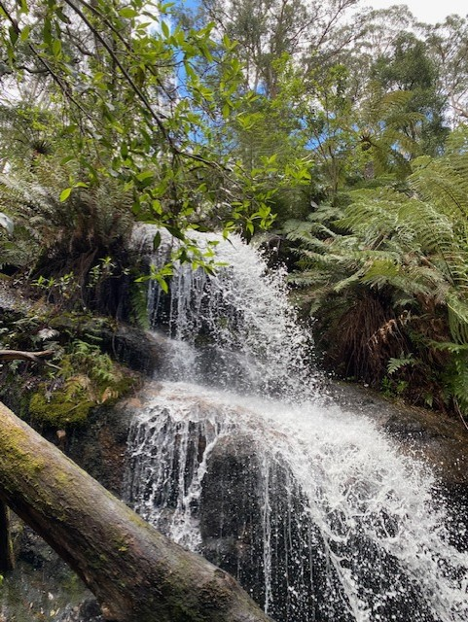
Where to from here?
Your job in the next week is to think about possible​
preferences that you would like to participate in for your​
pilgrimage. We will then start the process of organising.​
Please do not hesitate to ask Jim Waight or members of​
The Catholic Identity and Mission Team for further​
information.

