Slide 1
DOBCEL–ACU PhD Cohort Initiative
A New Research Partnership for DOBCEL’s Future
A/Prof Jessica Holloway & A/Prof Steven Lewis
Institute for Learning Sciences & Teacher Education
Australian Catholic University
14 August 2025

Slide 2
Purpose of this Presentation
Introduce the new DOBCEL–ACU PhD Cohort initiative
Show how it connects with DOBCEL Strategy 2035
Introduce the supervisory team
Explain what participants can expect
Outline who should consider joining

Slide 3

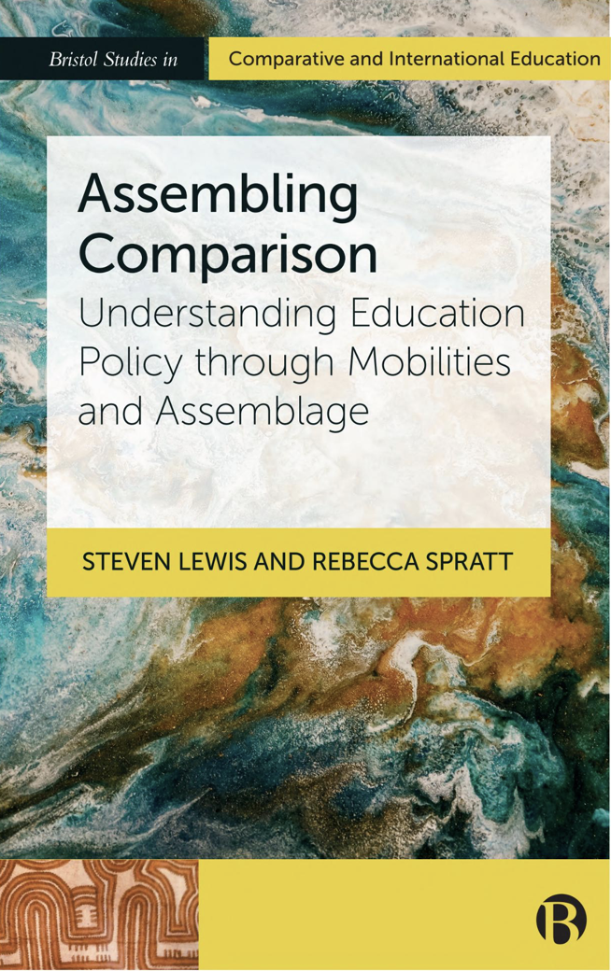
Introductions
Associate Professor Steven Lewis
Principal Research Fellow, Institute for Learning Sciences & Teacher Education (ILSTE)
Associate Director Research, Office of the DVC-Research and Enterprise
Expertise: Politics and policy of education, educational governance, teacher learning, comparative education, digital data and platforms, the OECD and PISA

Slide 4


Introductions
Associate Professor Jessica Holloway
Principal Research Fellow, Institute for Learning Sciences & Teacher Education (ILSTE)
Associate Head of School (Ballarat), National School of Education
Expertise: Teacher professionalism, accountability, educational leadership, educational policy and governance

Slide 5
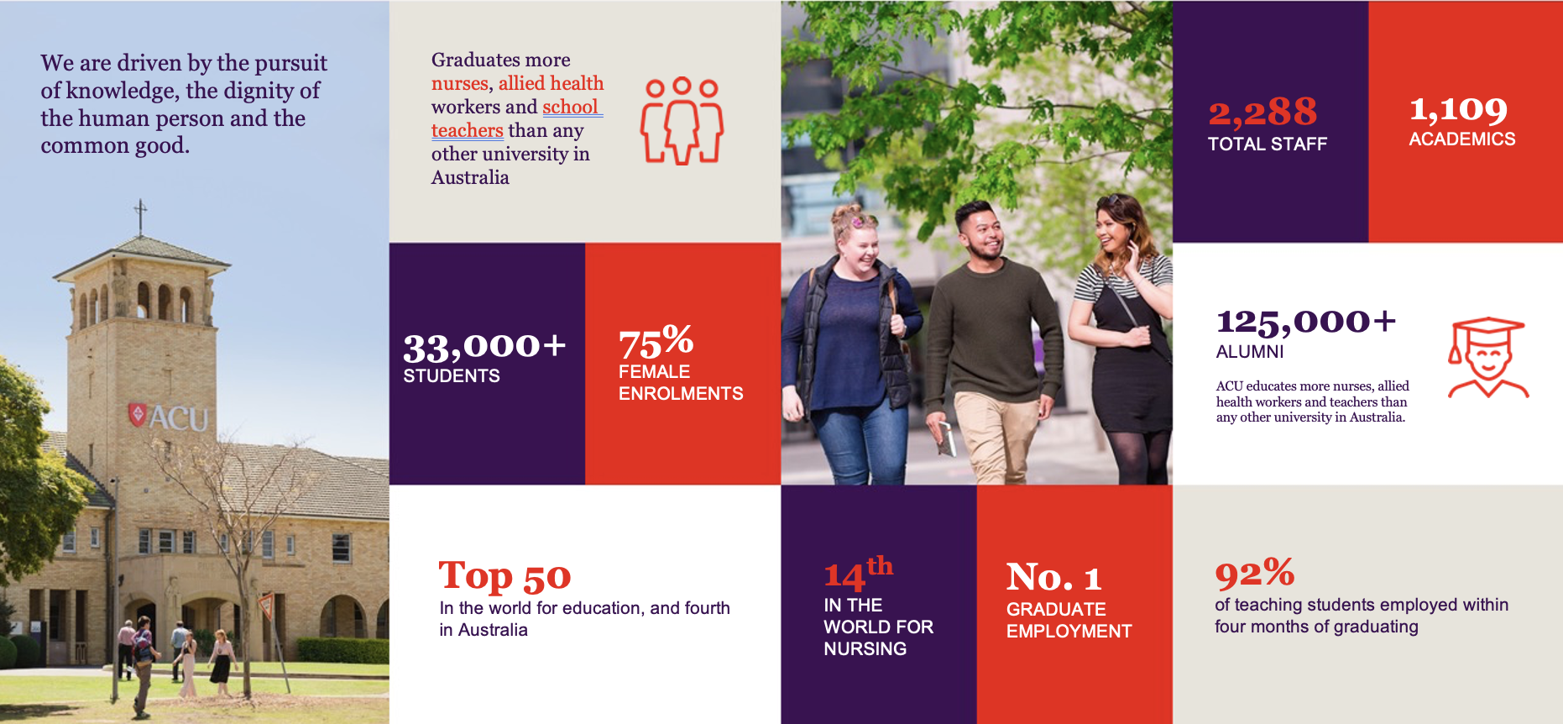

Slide 6


Slide 7

Why This Initiative?
Supports DOBCEL’s vision: Pursuing fullness of life for all
Directly advances Strategic Pillars:
  Collaborative Cultures – building a network of researchers across the system
  Engagement and Belonging – strengthening professional identity and agency
  Rich Pedagogical Practices – embedding research-informed teaching
  Sustainable Stewardship – investing in our people
Builds a Research Community of Practice grounded in DOBCEL’s context

Slide 8
What is the DOBCEL-ACU PhD Cohort?
A partnership between DOBCEL and Australian Catholic University
For DOBCEL employees (teachers, school leaders) who remain in their current roles
Each project is anchored in your school and your work
Research topics align with DOBCEL Strategy 2035
A part-time PhD with regular, system-wide cohort activities

Slide 9
The Cohort Model
Progress through your PhD together with peers
Intensive learning sessions each year, co-designed with DOBCEL leadership
Sessions hosted across DOBCEL regions to reflect our geographic diversity
Supervision from ACU’s leading education researchers, plus specialist co-supervisors
Focus on building research capability, leadership and impact

Slide 10
The Supervisory Team
Principal Supervisors (ILSTE & National School of Education, Ballarat):
A/Prof Steven Lewis – Policy, governance, teacher learning, global education systems
A/Prof Jessica Holloway – Teacher professionalism, accountability, educational leadership
Co-supervisors:
Drawn from ACU’s network of experts in areas including literacy, STEM, wellbeing, leadership, arts education, and more

Slide 11
What Participants Gain
High-quality doctoral supervision while working in your current role
The opportunity to research and improve your own practice
A contribution to DOBCEL’s strategic priorities and evidence base
Advanced research, writing, and analytical skills
Enhanced leadership capability through evidence-informed innovation

Slide 12
Benefits for DOBCEL
Research directly tied to system needs and priorities
Stronger evidence for innovation and decision-making
Professional expertise and leadership capacity embedded in schools
Networked sharing of knowledge and practice
Long-term capacity building aligned to Strategy 2035

Slide 13
What to Expect
Commitment: ~6-8 hours per week over 6 years (part-time), or as negotiated between DOBCEL and ACU
Intensives: Regularly per year, with regular supervisory meetings in between
Thesis: Focused on a DOBCEL-relevant issue or research problem
Support: Supervisors, cohort peers, DOBCEL leadership

Slide 14
Who Should Consider Applying?
You may be a good fit if you:
Are a DOBCEL employee (teacher, school leader, or professional staff in relevant roles)
Have a passion for research and inquiry
Want to address a real challenge or opportunity in your school or the system
Are ready for a significant long-term professional learning journey
Have the support of your leadership team

Slide 15
Next Steps
Expressions of Interest for the first DOBCEL–ACU PhD cohort will open soon
Start thinking about:
  Topics you are passionate about investigating
  How your ideas align with DOBCEL Strategy 2035
  Your readiness for the commitment involved
More details will be provided through DOBCEL communications

Slide 16
Closing
This initiative is an investment in DOBCEL’s people, schools and future.
Through collaborative, research-driven practice, we can shape a thriving Catholic school system for 2035 and beyond.
Direct questions to:
Steven.Lewis@acu.edu.au
Jessica.Holloway@acu.edu.au

