Slide 1


Slide 2

Overview
Victorian Catholic Education Authority (VCEA) and Catholic school employers have made an offer to improve the wages and conditions of Catholic school employees by the start of the 2026 school year.
It responds to employee feedback on wages being the top priority for the agreement and concerns about delays in the previous negotiations.
The offer provides a path to securing improved pay and conditions quickly.

Slide 3
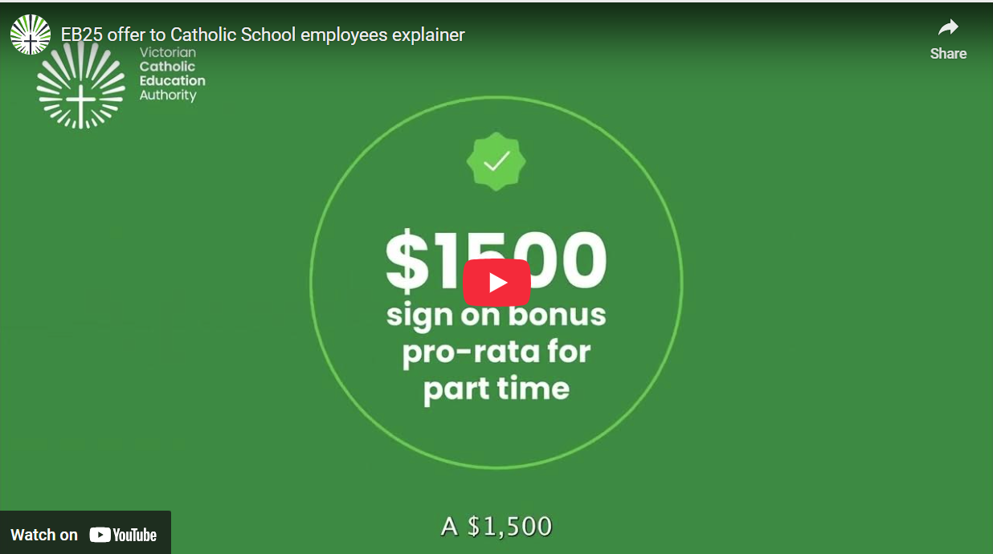
What’s being offered – video explainer
https://www.youtube.com/watch?v=s5yzSR_1PtM
Notes:
This video explains what is in the offer

Slide 4
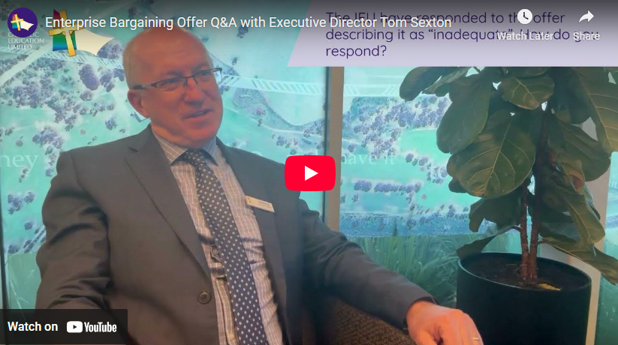
Hear from our Executive Director
https://youtu.be/VMEHHeE217g
www.eb.catholic.edu.au

Slide 5
Why this is important
The offer includes an initial minimum 7% increase in year one, plus a commitment to further increases (including in 2026 if needed) to match the government sector wage outcomes over the life of the agreement.
We have had pay parity for teachers with the government sector since 1997. The offer continues that commitment. This means for all employees whatever the total % increase applied to government school employees over the life of the agreement you will get the same.
You will receive a $1500 sign on bonus for full-time employees, pro-rata for part-time employees
Employers would have budget clarity to plan for the new school year, and a chance to work on any required administrative changes ahead of time.
Having an agreement in place for the start of the school year means we can all focus on our core work in 2026.

Slide 6

Where to get more information
Check the website www.eb.catholic.edu.au/eb25-offer
Read the full detail
You can provide feedback through the website

Slide 7
What happens next
You will be asked to indicate your support in a staff survey
You will receive an email on Monday 20 October with a unique link to a staff survey
You will be asked if you support the offer
If there is sufficient support from employees, we will request that the IEU and ANMF agree to proceed to a vote on the Enterprise Agreement.
If the IEU and ANMF withhold their agreement, we will ask the Fair Work Commission for a voting order so you and your colleagues can participate in a formal vote on the Agreement this year.
An Agreement being approved this year will deliver a minimum of 7% wage increases and benefits from January 2026.

Slide 8
www.eb.catholic.edu.au

