Slide 1

May our Hearts be Open.
A Lenten Journey to Easter
Catholic Education Ballarat

Slide 2
An approach to entering scripture
Each week, when we gather, we will engage with the text of the gospel of the Sunday of that week.
The approach that you are invited to use to help reflection on the text is that outlined by Fr. James Martin SJ in the following clip. It is his approach to Lectio Divina.

Slide 3
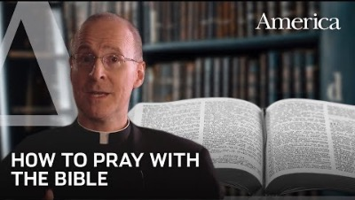
https://www.youtube.com/watch?v=i27FqIyk2qY

Slide 4
The Four Key Questions
What does the text say?
What does the text say to me?
What do I want to say to God about this text?
What difference will this text make in my life?

Slide 5
Each week….
After the gospel is read each week, you might like to explore these question individually or as a group.

Slide 6
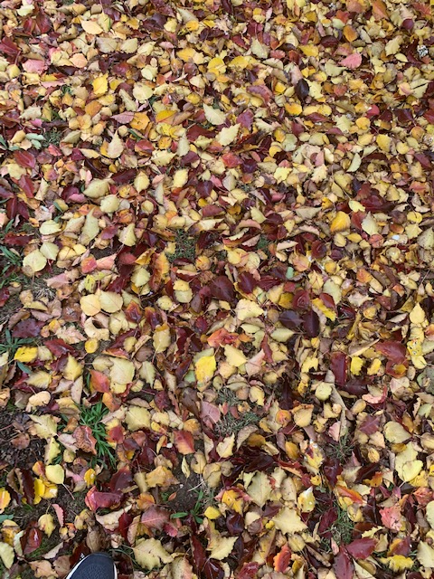
Week One
Jesus is Tempted in the Desert
Luke 4: 1–13

Slide 7
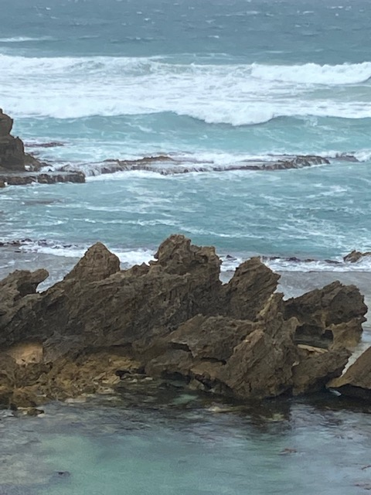
Acknowledgement of Country
We are on holy ground. For millennia, age-old ritual and ceremony have taken place on this country and a proud living culture has and continues to exist. We acknowledge this country, the waterways, peoples, and all creation as sacred. This land was and always will be, that of our First Australian brothers and sisters. We recommit ourselves to hope, peace, justice, and reconciliation for all.

Slide 8
Let us be still
Be still and become aware.
Notice how your body is feeling, become aware of your breathing, listen to your breathing.
Spend some time focusing on the sacred in your life.
Recognise that the creator is in and through all creation. In and through us.

Slide 9
Luke 4: 1-13
Jesus, full of the Holy Spirit, returned from the Jordan and was led by the Spirit in the wilderness, where for forty days he was tempted by the devil. He ate nothing at all during those days, and when they were over, he was famished. The devil said to him, “If you are the Son of God, command this stone to become a loaf of bread.” Jesus answered him, “It is written, One does not live by bread alone.”
Then the devil led him up and showed him in an instant all the kingdoms of the world. And the devil said to him, “To you I will give their glory and all this authority; for it has been given over to me, and I give it to anyone I please. If you, then, will worship me, it will all be yours.” Jesus answered him,
“It is written, worship the Lord your God and serve only him.” Then the devil took him to Jerusalem, and placed him on the pinnacle of the temple, saying to him, “If you are the Son of God, throw yourself down from here, for it is written, He will command his angels concerning you, to protect you, On their hands they will bear you up, so that you will not dash your foot against a stone.”
Jesus answered him, “It is said, Do not put the Lord your God to the test.” When the devil had finished every test, he departed from him until an opportune time.

Slide 10
The Four Key Questions
What does the text say?
What does the text say to me?
What do I want to say to God about this text?
What difference will this text make in my life?

Slide 11
Let us pray together…..
Let us pray the Our Father…..

Slide 12
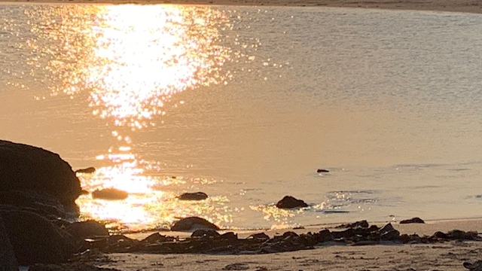
Week 2 Luke 9: 28–36 Jesus is Transfigured Before Peter, James and John.

Slide 13
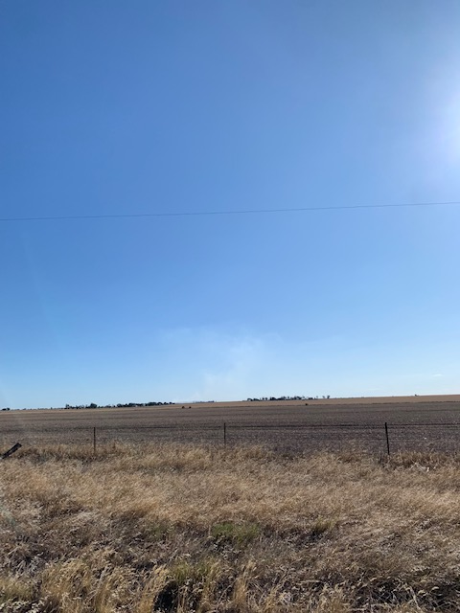
Acknowledgement of Country
We are on holy ground. For millennia, age-old ritual and ceremony have taken place on this country and a proud living culture has and continues to exist. We acknowledge this country, the waterways, peoples, and all creation as sacred. This land was and always will be, that of our First Australian brothers and sisters. We recommit ourselves to hope, peace, justice, and reconciliation for all.

Slide 14
Let us be still
Be still and become aware
Notice how your body is feeling, become aware of your breathing, listen to your breathing.
Spend some time focusing on the sacred in your life.
Recognise that the creator is in and through all creation. In and through us.

Slide 15
Luke 9: 28–36
Now about eight days after these sayings Jesus took with him Peter, John and James, and went up on the mountain to pray. And while he was praying, the appearance of his face changed, and his clothes became dazzling white. Suddenly they saw two men, Moses and Elijah, talking to him. They appeared in glory and were speaking of his departure, which he was about to accomplish at Jerusalem.
Now Peter and his companions were weighed down with sleep; but since they had stayed awake, they saw his glory and the two men who stood with him. Just as they were leaving him, Peter said to Jesus, “Master, it is good for us to be here; let us make three dwellings,[one for you, one for Moses, and one for Elijah.” While he was saying this, a cloud came and overshadowed them; and they were terrified as they entered the cloud. Then from the cloud came a voice that said, “This is my Son, my Chosen; listen to him!” When the voice had spoken, Jesus was found alone. And they kept silent and in those days told no one any of the things they had seen.

Slide 16
The Four Key Questions
What does the text say?
What does the text say to me?
What do I want to say to God about this text?
What difference will this text make in my life?

Slide 17
Let us pray together…..
Let us pray the Our Father…..

Slide 18
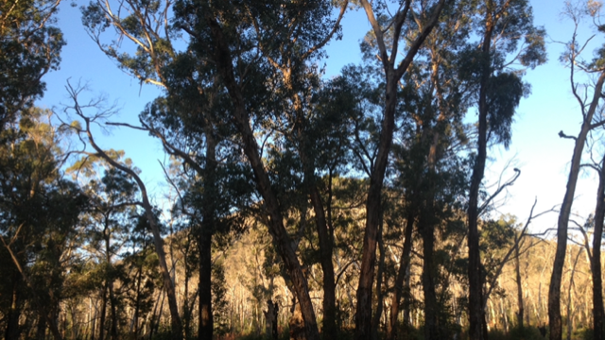
Week 3 Luke 13: 6–9
The Parable of the Fig Tree.

Slide 19
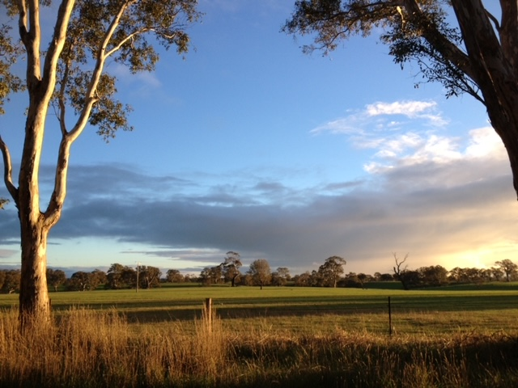
Acknowledgement of Country
We are on holy ground. For millennia, age-old ritual and ceremony have taken place on this country and a proud living culture has and continues to exist. We acknowledge this country, the waterways, peoples, and all creation as sacred. This land was and always will be, that of our First Australian brothers and sisters. We recommit ourselves to hope, peace, justice, and reconciliation for all.

Slide 20
Let us be still
Be still and become aware
Notice how your body is feeling, become aware of your breathing, listen to your breathing.
Spend some time focusing on the sacred in your life.
Recognise that the creator is in and through all creation. In and through us.

Slide 21
Luke 13: 6–9
Then he told this parable: “A man had a fig tree planted in his vineyard; and he came looking for fruit on it and found none. So he said to the gardener, ‘See here! For three years I have come looking for fruit on this fig tree, and still I find none. Cut it down! Why should it be wasting the soil?’ He replied, ‘Sir, let it alone for one more year, until I dig around it and put manure on it. If it bears fruit next year, well and good; but if not, you can cut it down.’”

Slide 22
The Four Key Questions
What does the text say?
What does the text say to me?
What do I want to say to God about this text?
What difference will this text make in my life?

Slide 23
Let us pray together…..
Let us pray the Our Father…..

Slide 24
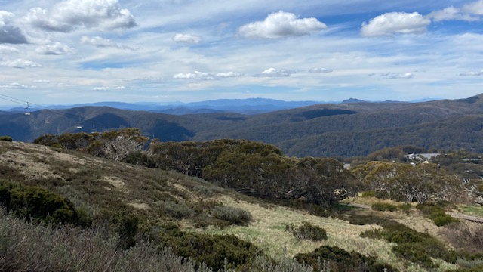
Week Four Luke 15: 11–32 The Parable of the Prodigal Son.

Slide 25
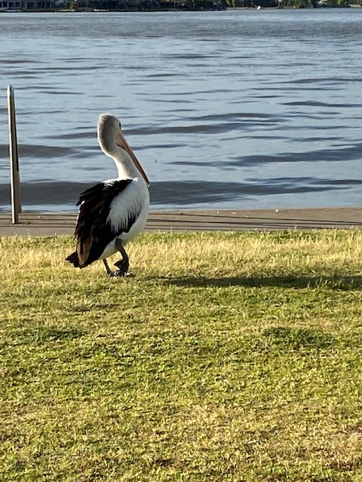
Acknowledgement of Country
We are on holy ground. For millennia, age-old ritual and ceremony have taken place on this country and a proud living culture has and continues to exist. We acknowledge this country, the waterways, peoples, and all creation as sacred. This land was and always will be, that of our First Australian brothers and sisters. We recommit ourselves to hope, peace, justice, and reconciliation for all.

Slide 26
Let us be still
Be still and become aware
Notice how your body is feeling, become aware of your breathing, listen to your breathing.
Spend some time focusing on the sacred in your life.
Recognise that the creator is in and through all creation. In and through us.

Slide 27
Luke 15: 11–32
Then Jesus said, “There was a man who had two sons. The younger of them said to his father, ‘Father, give me the share of the property that will belong to me.’ So he divided his property between them. A few days later the younger son gathered all he had and travelled to a distant country, and there he squandered his property in dissolute living. When he had spent everything, a severe famine took place throughout that country, and he began to be in need. So he went and hired himself out to one of the citizens of that country, who sent him to his fields to feed the pigs. He would gladly have filled himself with the pods that the pigs were eating; and no one gave him anything. But when he came to himself he said, ‘How many of my father’s hired hands have bread enough and to spare, but here I am dying of hunger! I will get up and go to my father, and I will say to him, Father, I have sinned against heaven and before you; I am no longer worthy to be called your son; treat me like one of your hired hands.’ So he set off and went to his father. But while he was still far off, his father saw him and was filled with compassion; he ran and put his arms around him and kissed him. Then the son said to him, ‘Father, I have sinned against heaven and before you; I am no longer worthy to be called your son.’ But the father said to his slaves, ‘Quickly, bring out a robe—the best one—and put it on him; put a ring on his finger and sandals on his feet. And get the fatted calf and kill it, and let us eat and celebrate; for this son of mine was dead and is alive again; he was lost and is found!’ And they began to celebrate.”

Slide 28
Luke 15: 11–32
“Now his elder son was in the field; and when he came and approached the house, he heard music and dancing. He called one of the slaves and asked what was going on. He replied, ‘Your brother has come, and your father has killed the fatted calf, because he has got him back safe and sound.’ Then he became angry and refused to go in. His father came out and began to plead with him. But he answered his father, ‘Listen! For all these years I have been working like a slave for you, and I have never disobeyed your command; yet you have never given me even a young goat so that I might celebrate with my friends. But when this son of yours came back, who has devoured your property with prostitutes, you killed the fatted calf for him!’ Then the father said to him, ‘Son, you are always with me, and all that is mine is yours. But we had to celebrate and rejoice, because this brother of yours was dead and has come to life; he was lost and has been found.’”

Slide 29
The Four Key Questions
What does the text say?
What does the text say to me?
What do I want to say to God about this text?
What difference will this text make in my life?

Slide 30
Let us pray together…..
Let us pray the Our Father…..

Slide 31
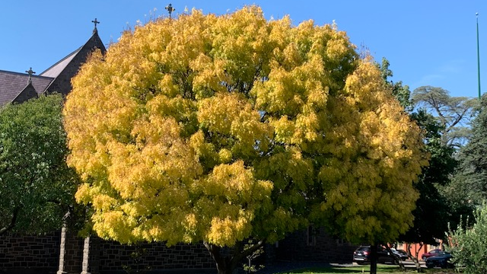
Week Five John 8: 1–11 The Pharisees Confront Jesus with an Adulteress.

Slide 32
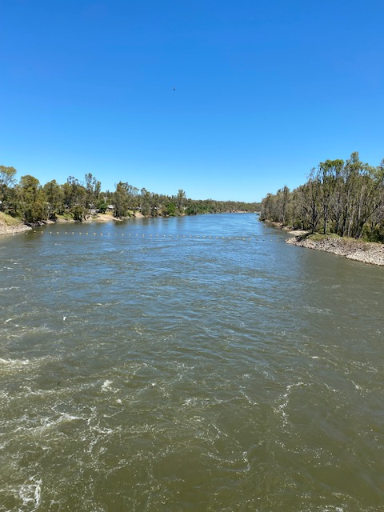
Acknowledgement of Country
We are on holy ground. For millennia, age-old ritual and ceremony have taken place on this country and a proud living culture has and continues to exist. We acknowledge this country, the waterways, peoples, and all creation as sacred. This land was and always will be, that of our First Australian brothers and sisters. We recommit ourselves to hope, peace, justice, and reconciliation for all.

Slide 33
Let us be still
Be still and become aware
Notice how your body is feeling, become aware of your breathing, listen to your breathing.
Spend some time focusing on the sacred in your life.
Recognise that the creator is in and through all creation. In and through us.

Slide 34
John 8: 2-11
Early in the morning he came again to the temple. All the people came to him and he sat down and began to teach them. The scribes and the Pharisees brought a woman who had been caught in adultery; and making her stand before all of them, they said to him, “Teacher, this woman was caught in the very act of committing adultery. Now in the law, Moses commanded us to stone such women. Now what do you say?” They said this to test him, so that they might have some charge to bring against him.
Jesus bent down and wrote with his finger on the ground. When they kept on questioning him, he straightened up and said to them, “Let anyone among you who is without sin be the first to throw a stone at her.” And once again he bent down and wrote on the ground. When they heard it, they went away, one by one, beginning with the elders; and Jesus was left alone with the woman standing before him. Jesus straightened up and said to her, “Woman, where are they? Has no one condemned you?” She said, “No one, sir.” And Jesus said, “Neither do I condemn you. Go your way, and from now on do not sin again.”

Slide 35
The Four Key Questions
What does the text say?
What does the text say to me?
What do I want to say to God about this text?
What difference will this text make in my life?

Slide 36
Let us pray together…..
Let us pray the Our Father…..

Slide 37
Acknowledgements:
Music: https://www.bensound.com
Biblical References: https://www.biblegateway.com
Photos: Private collection of Jim Waight

